Slide 1
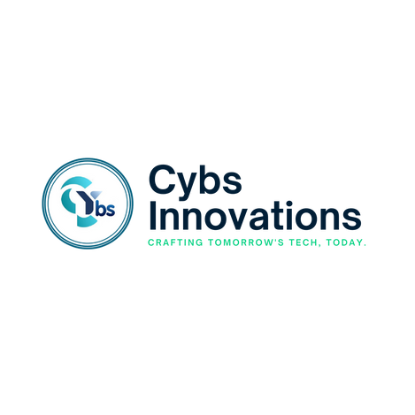
2025
AI
APPLICATION
SERVICES
Boost your business with AI! Our AI application services help automate tasks, improve decision-making, and drive growth. Let’s make AI work for you!
Created By
CYBS INNOVATIONS

Slide 2
Table of Contents
Introduction
01
Why Choose Cybs Innovations?
02
Our AI Development Services
03
Our AI Development Services
04
Industries We Serve
05
Contact Us
06

Slide 3


2025
Revolutionize Your Business with AI-Powered Applications
Introduction
At Cybs Innovations, we develop advanced AI applications that help businesses automate processes, enhance customer experiences, and drive growth. Our expert team leverages artificial intelligence, machine learning, and data analytics to create smart, tailored solutions.
With AI rapidly transforming industries, staying competitive requires intelligent solutions. We provide AI-driven applications that optimize workflows, reduce costs, and boost productivity. Whether you're a startup integrating AI into your products or an enterprise improving efficiency, we have the expertise to bring your vision to life.

Slide 4


2025
Why Choose Cybs Innovations?
01
Expert AI Development Team
02
Custom AI Solutions
Our AI specialists and data scientists build cutting-edge solutions using neural networks, reinforcement learning, and cognitive computing to drive innovation.
We design AI applications tailored to your specific goals, ensuring they provide long-term value and align with your business vision.
03
Advanced Technologies
04
Seamless Integration
Leveraging deep learning, NLP, and computer vision, we develop intelligent systems for autonomous decision-making and pattern recognition.
Our AI solutions integrate smoothly with your existing systems, ensuring minimal disruption and maximum efficiency.
05
Scalable and Secure
06
End-to-End AI Development
We build AI applications that are scalable, secure, and future-ready, safeguarding data while ensuring business growth.
We offer end-to-end AI development, from concept to deployment, with seamless execution, ongoing support, and continuous optimization.

Slide 5

2025
Our AI Development Services
01
AI-Powered Chatbots and Virtual Assistants
Enhance customer interactions with AI-driven chatbots and virtual assistants that provide instant support and personalized responses.
02
Machine Learning Solutions
Unlock insights with custom machine learning models for decision-making, fraud detection, and predictive analytics.
03
Natural Language Processing (NLP)
Empower your applications with NLP for sentiment analysis, text summarization, language translation, and automated content generation.

Slide 6
2025
Our AI Development Services
04
Computer Vision Applications
Leverage AI-driven image and video analysis for facial recognition, object detection, and medical diagnostics.
05
AI for Business Automation
Automate workflows, reduce manual work, and improve accuracy with AI-powered business automation solutions.
06
AI-Enabled Predictive Analytics
Use AI-driven predictive analytics to forecast trends, customer behaviors, and business outcomes for smarter decision-making.

Slide 7


2025
Industries We Serve
Healthcare – AI-driven diagnostics, patient management, and personalized healthcare solutions.
Retail & eCommerce – Smart recommendations, demand forecasting, and AI-powered customer support.
Finance – Fraud detection, risk assessment, and AI-driven financial planning.
Manufacturing – Predictive maintenance, quality control, and supply chain optimization.
Education – AI-powered learning systems, virtual tutors, and personalized education tools.
Logistics & Transportation – AI-driven route optimization, fleet management, and demand forecasting.
Real Estate – AI-powered property valuation, virtual property tours, and predictive market analysis.

Slide 8




2025
Let’s Build the Future Together!
Cybs Innovations helps businesses harness AI for remarkable success.
+91 7646809755
info@cybsinnovations.com
www.cybsinnovations.com

