Slide 1


CUSTOM
SOFTWARES
Created By
CYBS INNOVATIONS
2025

Slide 2
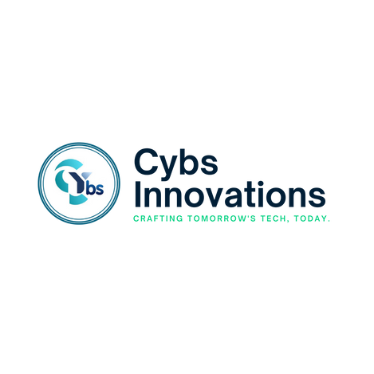

PAGE 2
Table of Contents
Introduction
03
Why Choose Custom Software
04
Our Services
05
Our Services
06
Our Process
07
Industries We Serve
08
Why Cybs Innovations
09
Contact Us
10

Slide 3


PAGE 3
Introduction
At Cybs Innovations, we create custom software solutions that help businesses work better and faster. We design software that fits your needs, making daily tasks easier and more efficient. Our experienced team builds software that automates processes, improves productivity, and keeps your business ahead of the competition. Whether you need enterprise software, AI-powered tools, cloud solutions, system integration, or workflow automation, we provide complete development services to help your business grow in the digital world.

Slide 4


PAGE 4
Why Choose Custom Software?
Tailored to Your Needs – Built specifically for your business processes and goals.
Scalable – Designed to grow with your business and adapt to future demands.
Secure & Reliable – Ensures strong data protection, compliance, and stability
User-Friendly – Intuitive and easy-to-use, enhancing overall efficiency and productivity.
Cost-Effective – Reduces inefficiencies and long-term expenses by automating tasks and improving workflow.

Slide 5

PAGE 5
Our Services
Enterprise Software Development
We build powerful enterprise applications that help organizations manage data, streamline workflows, and automate business operations for maximum efficiency.
AI-Powered Software Solutions
Our AI-driven software integrates machine learning, natural language processing, and predictive analytics to help businesses make data-driven decisions, improve customer interactions, and automate repetitive tasks.
Cloud Solutions
We develop cloud-based applications that offer high performance, flexibility, and security. Whether you need SaaS (Software as a Service) or cloud migration services, we provide scalable solutions tailored to your business needs.

Slide 6
PAGE 6
Our Services
E-commerce
Development
We design and develop custom e-commerce platforms that provide smooth and secure shopping experiences. Our solutions include inventory management, payment gateway integration, and personalized shopping recommendations.
Automation & Workflow Optimization
We help businesses save time and reduce manual work by automating repetitive processes. Our custom automation solutions increase efficiency, reduce human errors, and improve overall productivity.
Software Maintenance & Support
We provide ongoing support and maintenance to ensure that your software remains up-to-date, secure, and fully functional. From bug fixes to performance enhancements, our team is always ready to assist.

Slide 7

PAGE 7
Our Process
Consultation & Requirement Analysis
We take the time to understand your business needs and challenges.
Planning & Design
Our team creates a detailed plan and user-friendly designs tailored to your workflow.
Development & Testing
We build high-quality software with rigorous testing to ensure performance and security.
Deployment & Training
We deploy the software and provide training to your team for a smooth transition.
Ongoing Support & Maintenance
We offer continuous support to keep your software up-to-date and running efficiently.

Slide 8

PAGE 8
Industries We Serve
We provide custom software solutions for a wide range of industries, helping businesses of all sizes enhance their operations with tailored digital solutions. Our expertise spans multiple sectors, ensuring that each industry receives software designed specifically for its unique challenges and needs. Our industry-specific software solutions improve efficiency, streamline workflows, and boost overall productivity. We cater to industries such as:
Healthcare & Medical Services
Finance & Banking
Retail & E-commerce
Logistics & Transportation
Real Estate & Property Management
Education & E-learning
Manufacturing & Supply Chain
Startups & Small Businesses

Slide 9

PAGE 9
Why Cybs Innovations?
Experienced Team – A highly skilled team of developers, designers, and project managers with years of experience.
Cutting-Edge Technology – We use the latest programming languages, frameworks, and tools to create future-ready solutions.
Client-Centric Approach – Every solution is tailored to meet your specific business requirements.
Proven Track Record – We have successfully delivered custom software solutions for businesses across different industries.
Innovative AI Integration – We leverage artificial intelligence to improve efficiency, decision-making, and automation for your business.

Slide 10




PAGE 10
Let’s Work Together
www.cybsinnovations.com
info@cybsinnovations.com
+91 7646809755

