Slide 1

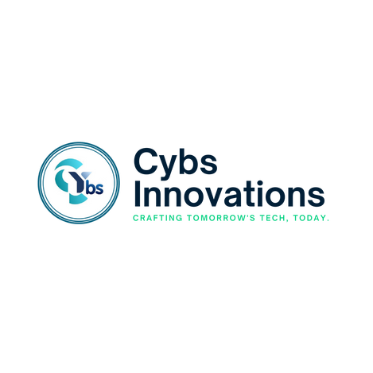



Managed IT Services
Managed IT Services
LET CYBS INNOVATIONS TAKE CARE OF YOUR IT, SO YOU CAN FOCUS ON GROWING YOUR BUSINESS.
Contact
Phone
Website
Email
+91 7646809755
www.cybsinnovations.com
info@cybsinnovations.com

Slide 2


Table of Contents
01
02
03
04
05
06
INTRODUCTION
WHY YOUR BUSINESS NEEDS MANAGED IT SERVICES
WHY YOUR BUSINESS NEEDS MANAGED IT SERVICES
OUR COMPREHENSIVE MANAGED IT SERVICES
THE BENEFITS OF CHOOSING CYBS INNOVATIONS
CONTACT
US

Slide 3

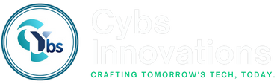


INTRODUCTION
In the modern business world, technology is the backbone of every successful company. Whether you're a small startup or an established enterprise, the role of technology in your day-to-day operations cannot be overstated. However, managing and maintaining IT infrastructure, troubleshooting issues, ensuring cybersecurity, and upgrading systems is an ongoing challenge that many businesses struggle with.
At Cybs Innovations, we offer comprehensive Managed IT Services designed to relieve your company from the complexities of IT management. With our expert support, proactive monitoring, and cutting-edge technology, we ensure that your IT infrastructure works smoothly, securely, and efficiently—empowering you to focus on what matters most: growing your business.
www.cybsinnovations.com
Managed IT Services

Slide 4



WHY YOUR BUSINESS NEEDS MANAGED IT SERVICES
Cost-Effective & Predictable Expenses
Managing an in-house IT team is costly with recruitment, salaries, and maintenance. With Managed IT Services, you get a fixed monthly fee that allows for better budgeting, eliminating unexpected costs and providing scalable solutions as your business grows.
Expert IT Support – Always Available
Finding skilled IT professionals can be expensive and difficult. With our services, you get access to a full team of experts available 24/7 to quickly resolve issues and keep your systems running smoothly.
Proactive Monitoring & Cybersecurity
Cybersecurity is critical in today's world. Our proactive monitoring helps identify and resolve potential threats before they harm your business. We implement top-notch security measures, such as regular patches, firewalls, and antivirus protection, to keep your data safe.
Managed IT Services

Slide 5
WHY YOUR BUSINESS NEEDS MANAGED IT SERVICES
Scalability for Business Growth
As your business expands, so do your IT needs. Our Managed IT Services grow with you, providing additional resources, security, and cloud services to match your evolving requirements.
Faster Problem
Resolution
Downtime costs productivity. Our team ensures fast problem resolution, using advanced tools to detect and fix issues before they cause disruptions, keeping your systems running efficiently.
Access to the Latest Technology
Staying up-to-date with technology is essential. We provide access to the latest software, hardware, and IT solutions, ensuring your business benefits from the most efficient tools without the hassle of managing them yourself.
Managed IT Services

Slide 6

Our Comprehensive Managed IT Services
24/7 Help Desk Support - Our help desk is available around the clock to assist with IT issues, from system errors to connectivity problems. No need to wait for office hours—we’re just a call or email away, anytime.
Network Monitoring & Management - We monitor your network continuously to ensure optimal performance and security. Our proactive approach resolves issues before they disrupt your business, keeping your systems fast, secure, and reliable.
Comprehensive Cybersecurity Solutions - We protect your business from cyber threats with multi-layered security measures, including firewalls, antivirus, and intrusion detection. We also provide employee training to prevent attacks.
Data Backup & Disaster Recovery - Our automated backups and disaster recovery plans ensure your data is safe and quickly recoverable in case of hardware failure, human error, or disaster, minimizing downtime.
Cloud Services & Solutions - We help you leverage the cloud’s flexibility, scalability, and cost savings, offering cloud storage, applications, and remote work tools to improve efficiency.
IT Consulting & Strategic Planning - Our IT consultants work with you to develop strategies that align technology with your business goals, guiding you through digital transformations, IT optimizations, and security planning.
Software Management - We manage all aspects of your software, from procurement and installation to updates and maintenance, ensuring your systems are always up-to-date and running smoothly without the hassle.
www.cybsinnovations.com
Managed IT Services

Slide 7





The Benefits of Choosing Cybs Innovations
Reliability
We provide you with a dependable IT infrastructure, ensuring that your systems are always available and functioning at their best.
Efficiency
Our services streamline your IT operations, reducing complexity and increasing productivity across your organization.
Focus on Core Activities
With us handling your IT needs, you can focus your energy on driving business growth, developing new products, and serving your customers.
Peace of Mind
Knowing that your IT is in the hands of trusted experts means you can focus on what you do best—while we take care of the rest.

Slide 8

Thank You
Let’s Get Started Today!
Contact
Phone
Website
+91 7646809755
www.cybsinnovations.com
Address
Email
123 Anywhere St., Any City, ST 1234
info@cybsinnovations.com

