Slide 1
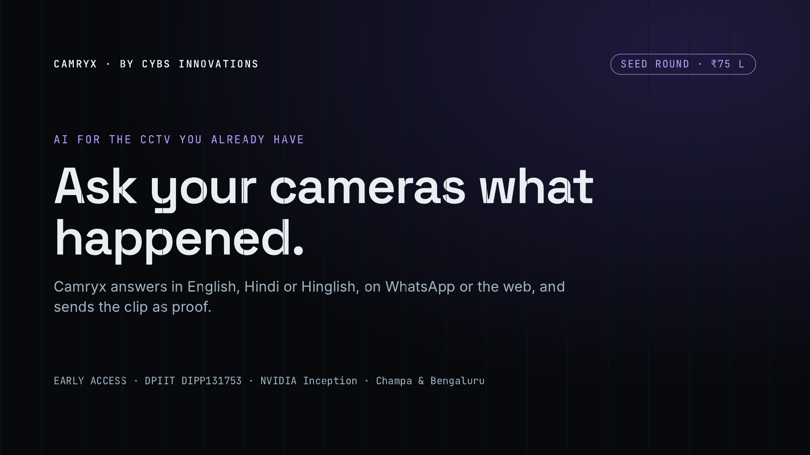
Notes:
Camryx puts AI on the CCTV a shop, warehouse or factory already has. You ask a question in plain language, in English, Hindi or Hinglish, and get an answer with the camera, the time and the clip. It is built by Cybs Innovations and is in early access. We are raising an indicative ₹75 lakh to take it to general availability.

Slide 2
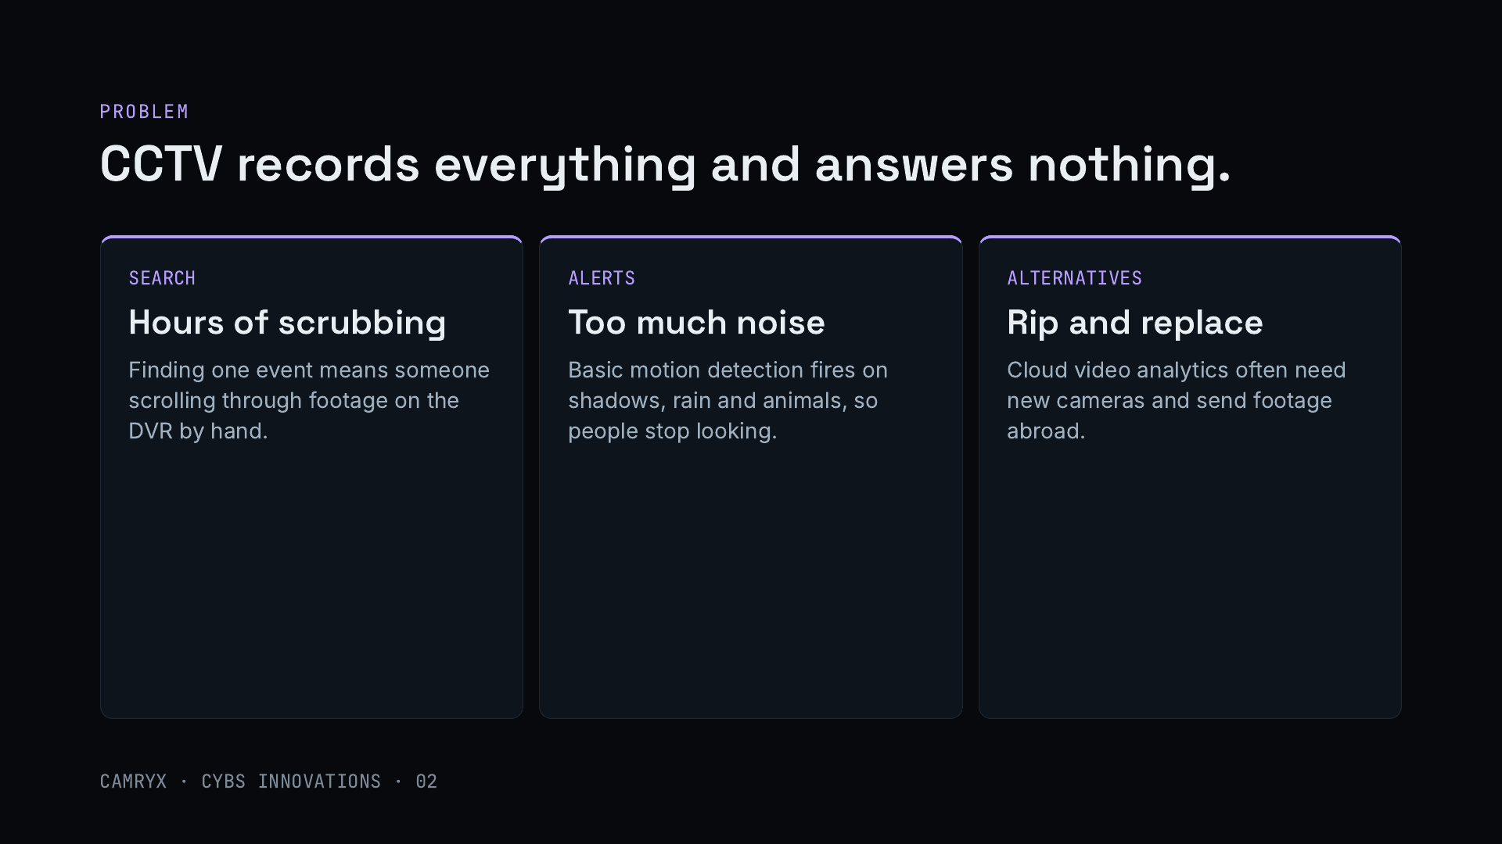
Notes:
Indian shops, warehouses, schools and factories have invested in CCTV, but the cameras only record. When something happens, someone has to scroll through hours of footage on the recorder. The built-in motion alerts are noisy, so they get ignored. And the alternatives, cloud video analytics platforms, usually mean new cameras and sending footage to a foreign cloud, which raises cost and privacy concerns.

Slide 3
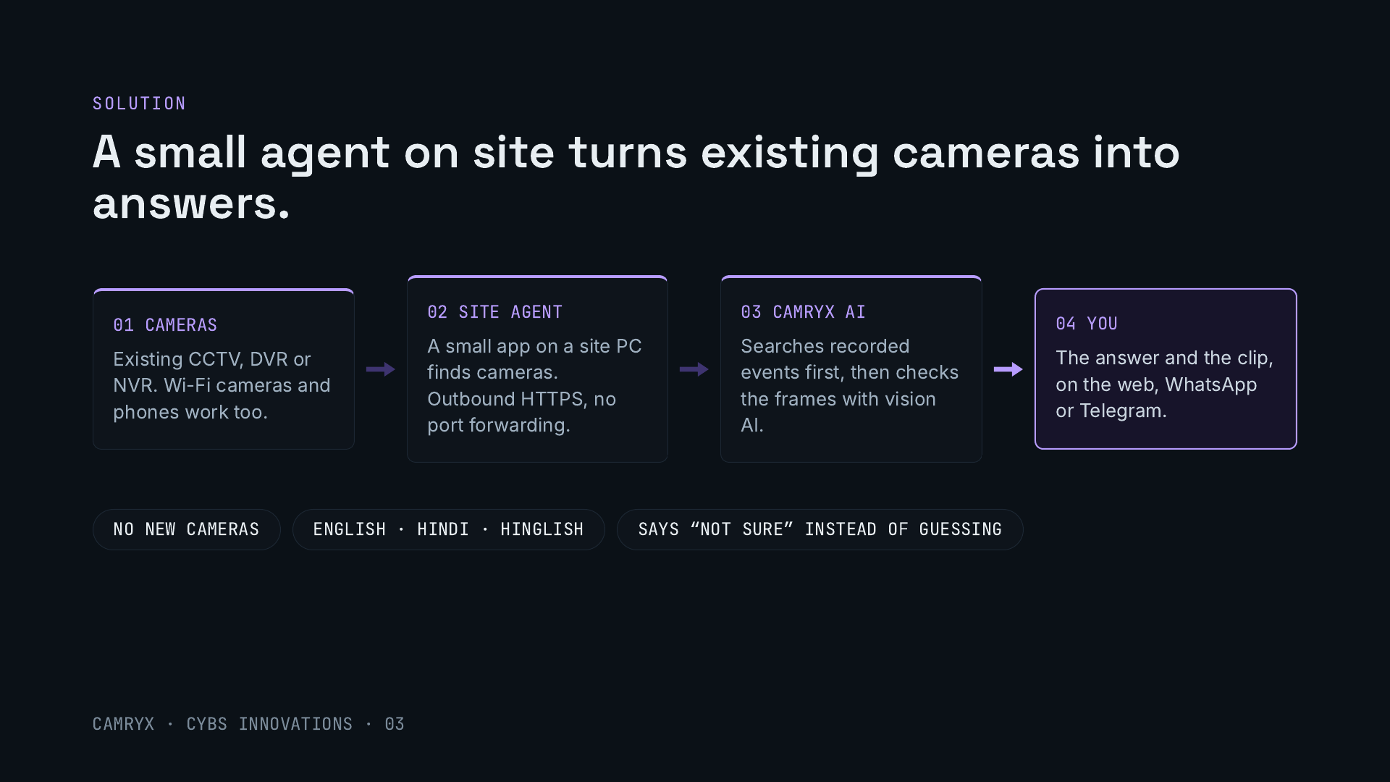
Notes:
Camryx works on the cameras a site already has. A small agent on a PC at the site discovers the cameras and connects out over HTTPS, so there is no port forwarding or network change. When someone asks a question, Camryx searches the recorded events first and then checks the actual frames with vision AI before answering. The answer comes back on the web, WhatsApp or Telegram with the clip. When it is unsure, for example in poor night footage, it says so rather than guessing.

Slide 4
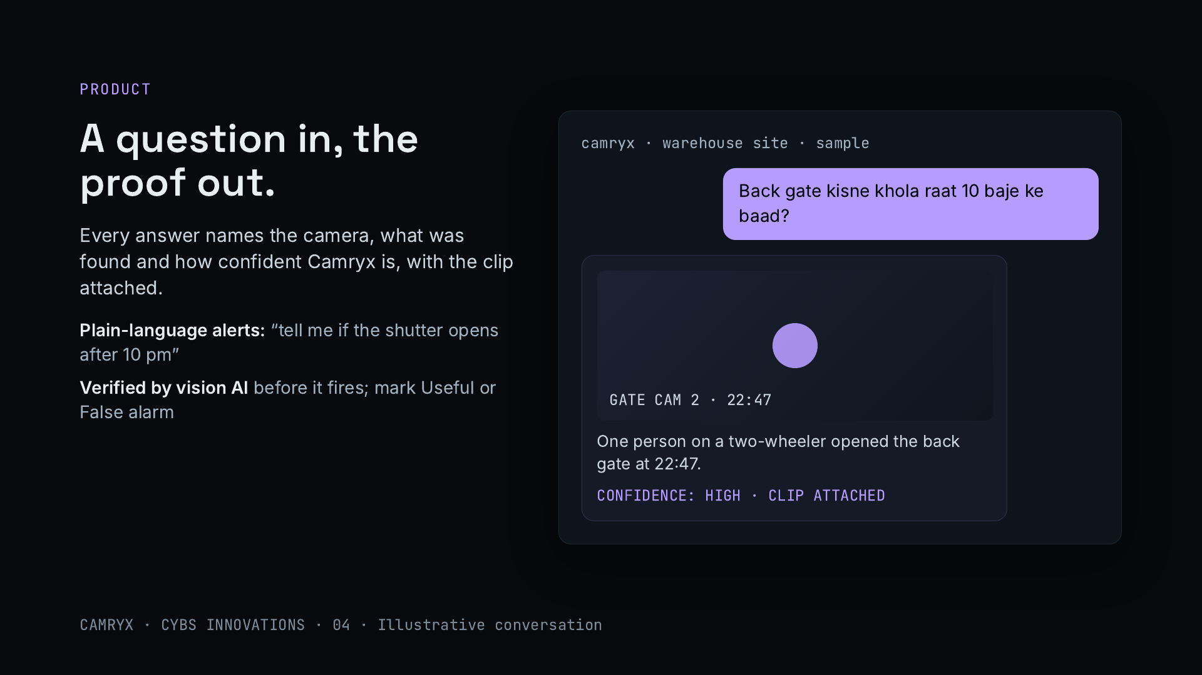
Notes:
This is what using Camryx looks like. The owner asks in Hinglish who opened the back gate after 10 pm. Camryx answers with the camera, the time, what it found and its confidence, and attaches the clip. Alerts work the same way: the owner writes a rule in plain words, vision AI checks each event before an alert goes out, and marking alerts as useful or false alarm improves the rules. The conversation is illustrative.

Slide 5
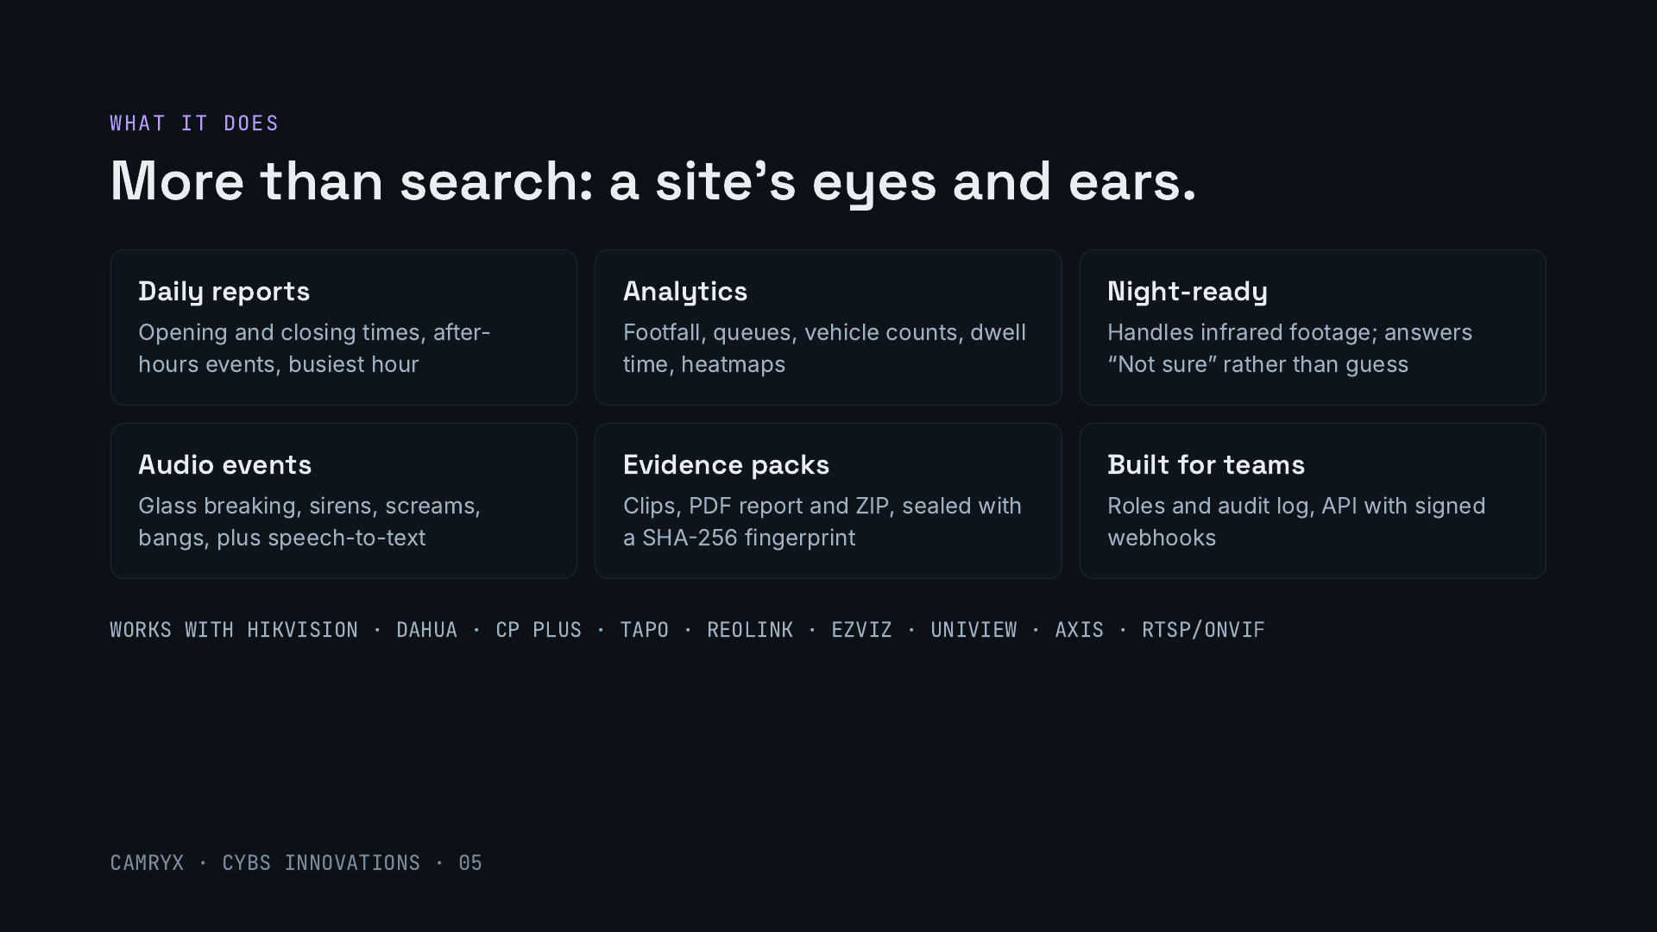
Notes:
Beyond answering questions, Camryx sends daily reports on opening and closing times and after-hours activity, measures footfall, queues, vehicles and dwell time, handles infrared night footage, and listens for sounds like breaking glass or sirens. It packages evidence as clips and reports sealed with a SHA-256 fingerprint, and supports team roles, an audit log and an API. It works with the camera brands Indian sites already use through RTSP and ONVIF.

Slide 6
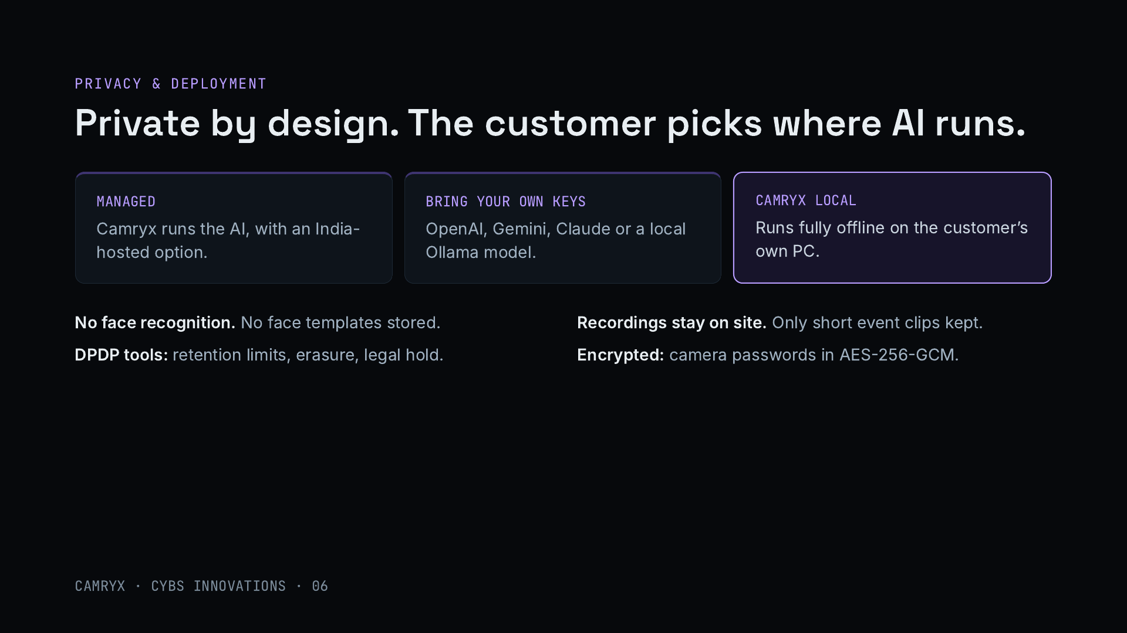
Notes:
Privacy is a selling point, not an afterthought. Customers choose how the AI runs: managed by us with an India-hosted option, with their own AI provider keys, or fully offline with Camryx Local. Full recordings never leave the customer’s recorder; Camryx keeps only short event clips. There is no face recognition, camera passwords are encrypted, and there are tools for retention limits, erasure on request and legal hold, which support compliance with India’s Digital Personal Data Protection Act. Licence-plate recognition exists but is off by default.

Slide 7
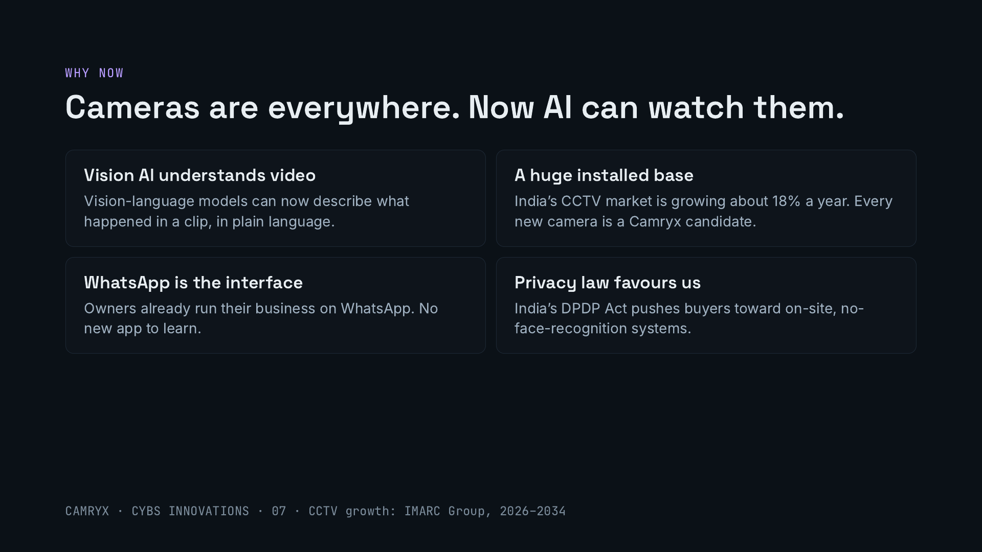
Notes:
Four shifts. Vision-language models can now describe what happens in a video clip, which was not practical a few years ago. India’s CCTV market is large and growing about 18% a year according to IMARC, so the installed base keeps expanding. Indian business owners already live on WhatsApp, so an assistant there needs no training. And India’s data protection law makes privacy-first systems, with footage kept on site and no face recognition, easier to buy.

Slide 8
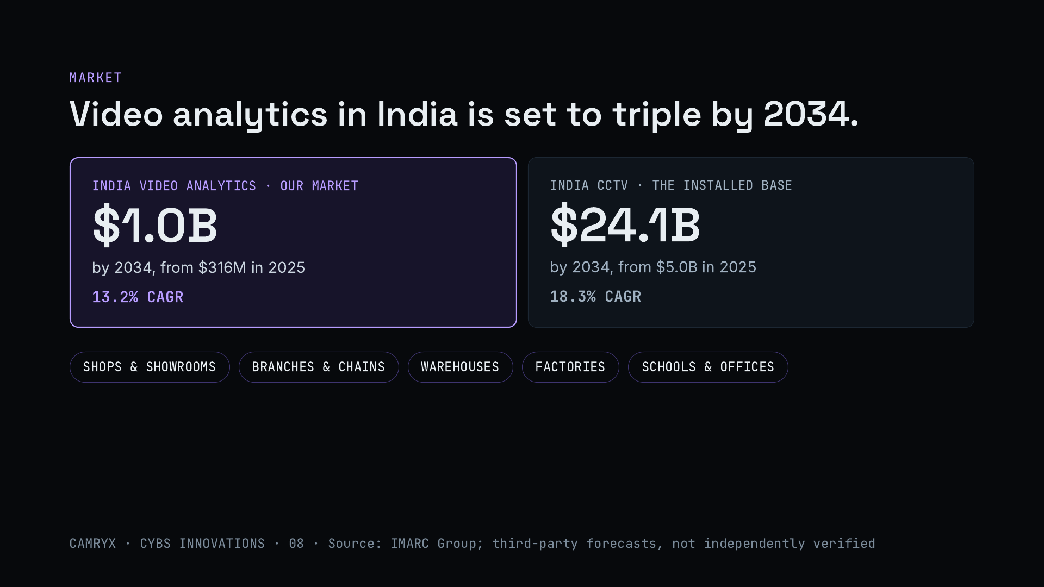
Notes:
IMARC sizes India’s video analytics market at about $316 million in 2025, reaching about $1 billion by 2034, a 13.2% annual growth rate. That sits on top of a much larger CCTV market, about $5 billion in 2025 growing to about $24 billion by 2034. Every one of those cameras is a site Camryx can add intelligence to without new hardware. Our customers are shops and showrooms, chains, warehouses, factories, schools and offices. These are third-party forecasts.

Slide 9
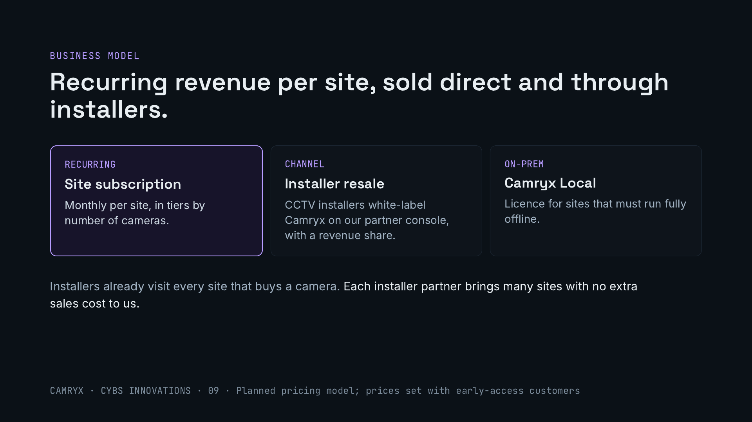
Notes:
The planned model has three parts. A monthly subscription per site, priced in tiers by the number of cameras. Resale by CCTV installers, who can white-label Camryx through our partner console and earn a revenue share. And a licence for Camryx Local, for sites that must run fully offline. The installer channel is the lever: installers already visit every site that buys cameras, so each partner can bring many sites without us paying to acquire them. Prices will be set with our early-access customers.

Slide 10
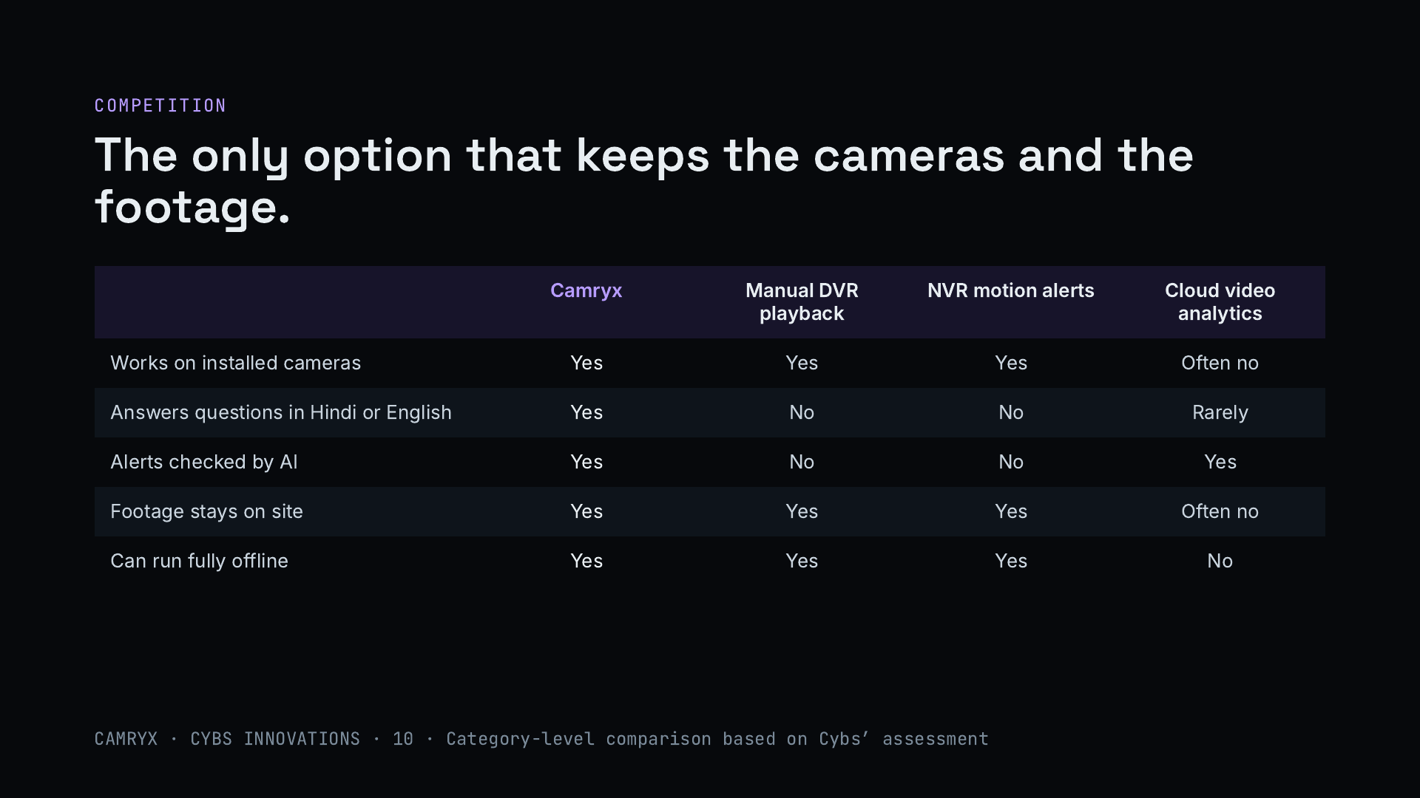
Notes:
Today a site has three options. Scrubbing DVR footage by hand works with any camera but takes hours. The motion alerts built into recorders are noisy and cannot answer questions. Cloud video analytics platforms are capable but often need new cameras and send footage off site. Camryx combines the strengths: it works on what is installed, answers in Hindi or English, checks alerts with AI, keeps footage on site and can run fully offline. This is a category-level comparison from our own assessment.

Slide 11
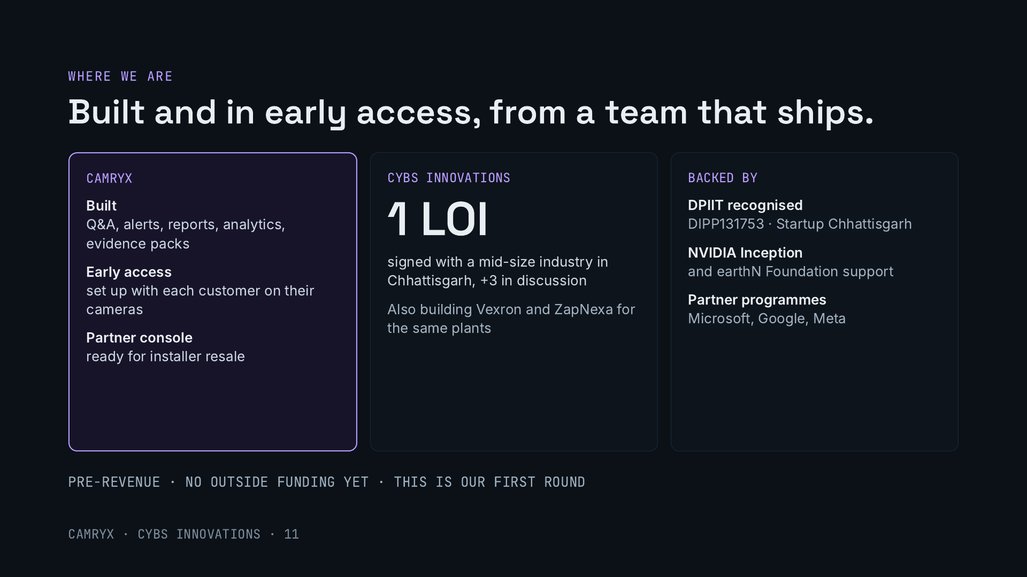
Notes:
Be direct about the stage. Camryx is built, with question answering, alerts, reports, analytics and evidence packs, and is in early access, where we set it up on each customer’s cameras with them. The partner console for installers is ready. At company level, Cybs has one signed letter of intent from a mid-size industry in Chhattisgarh and three more in discussion, and also builds Vexron and ZapNexa for the same plants. We are pre-revenue and have not raised outside money.

Slide 12
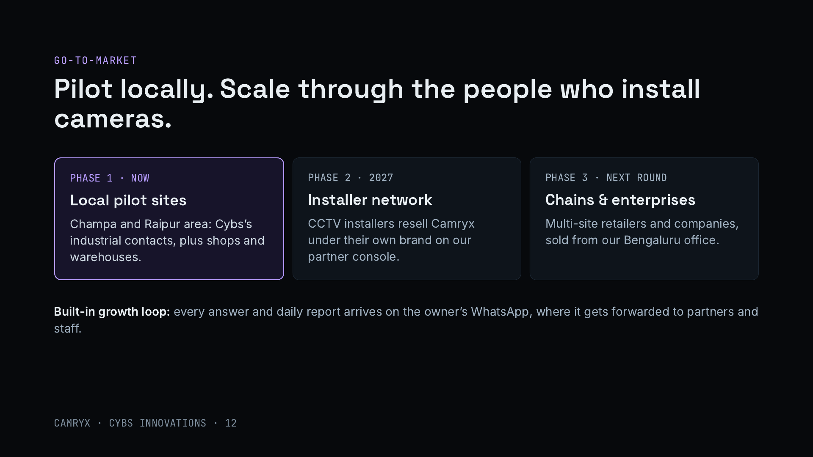
Notes:
Phase one is pilot sites near us in Champa and Raipur, using Cybs’s existing industrial contacts plus local shops and warehouses. Phase two is the installer network: CCTV installers already visit every site that buys cameras, and our partner console lets them resell Camryx under their own brand. Phase three, after the next round, is multi-site retail chains and enterprises sold from Bengaluru. Because answers and reports arrive on WhatsApp, they get shared, which helps word of mouth.

Slide 13
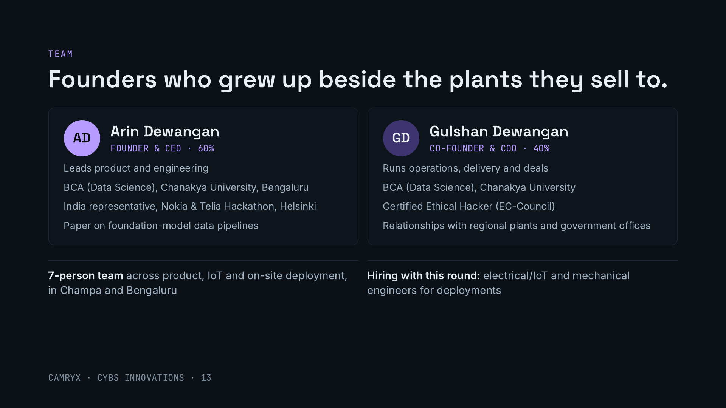
Notes:
Both founders grew up in Champa, Chhattisgarh. Arin leads product and engineering: data science degree from Chanakya University, represented India at the Nokia and Telia hackathon in Helsinki, and has presented research on data pipelines for foundation models. Gulshan runs operations, delivery and deals and is a Certified Ethical Hacker, which matters for a product that connects to cameras and handles footage. A 7-person team covers product, IoT and deployment.

Slide 14
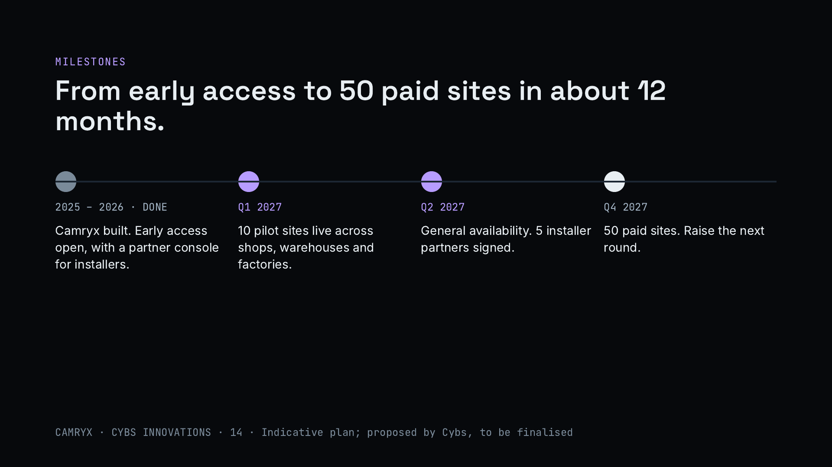
Notes:
The plan for this round. Camryx is built and in early access. By the first quarter of 2027, ten pilot sites live across shops, warehouses and factories. By the second quarter, general availability and five installer partners signed. By the end of 2027, fifty paying sites, which sets up the next round. These are indicative targets proposed by Cybs and will be finalised.

Slide 15
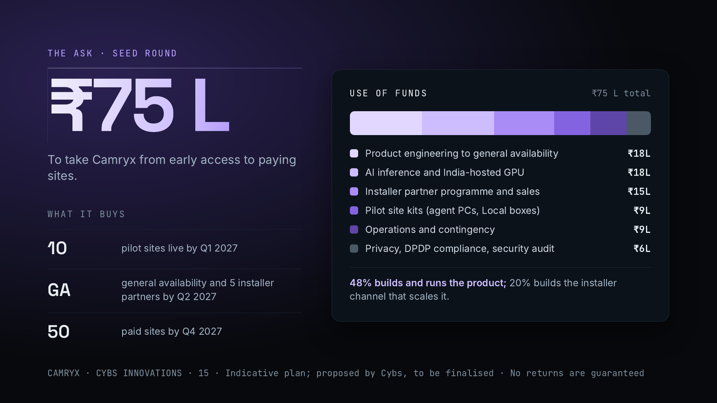
Notes:
We are raising an indicative ₹75 lakh for Camryx. Nearly half goes into the product itself: engineering to general availability and the AI inference and India-hosted GPU capacity to run it. A fifth builds the installer partner programme and sales, which is how Camryx scales. The rest covers pilot site kits, operations with a contingency, and privacy and security work for India’s data protection law. The round should deliver ten pilot sites, general availability with five installer partners, and fifty paying sites by the end of 2027. This allocation is a proposal to be finalised, and investor returns are not guaranteed.

Slide 16
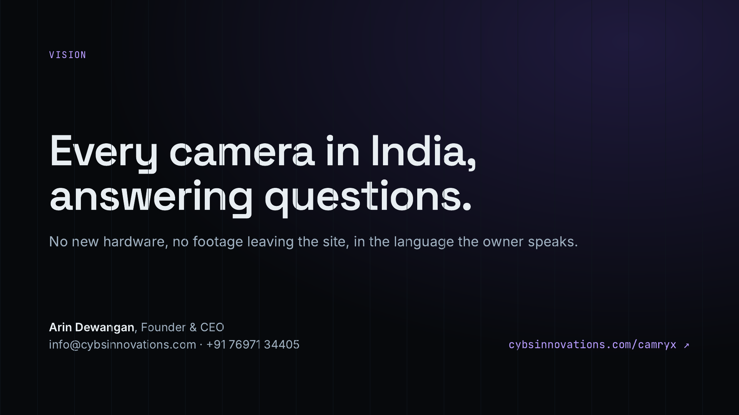
Notes:
Close on the vision: every camera already installed in India becomes something you can ask questions of, with no new hardware, footage kept on site, and answers in the owner’s own language. Repeat the ask, ₹75 lakh, and offer a live setup on a site of the investor’s choice.

