Slide 1
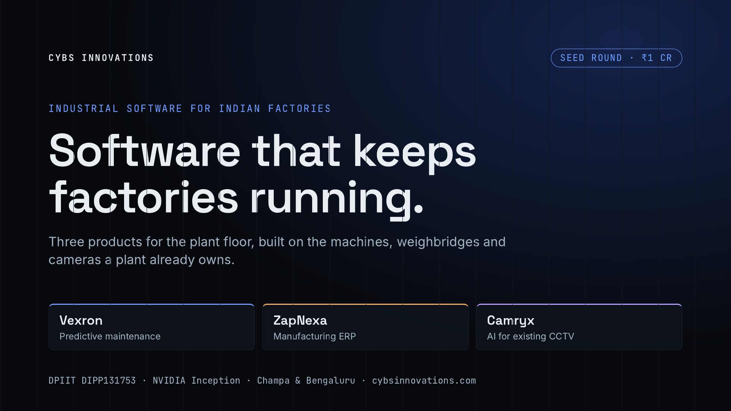
Notes:
Cybs Innovations builds industrial software for Indian factories: steel, cement, power, mining and heavy manufacturing. Three products, one buyer. Vexron predicts machine failures, ZapNexa runs the plant from weighbridge to invoice, and Camryx puts AI on the CCTV the plant already has. We are raising ₹1 crore, our first outside round.

Slide 2
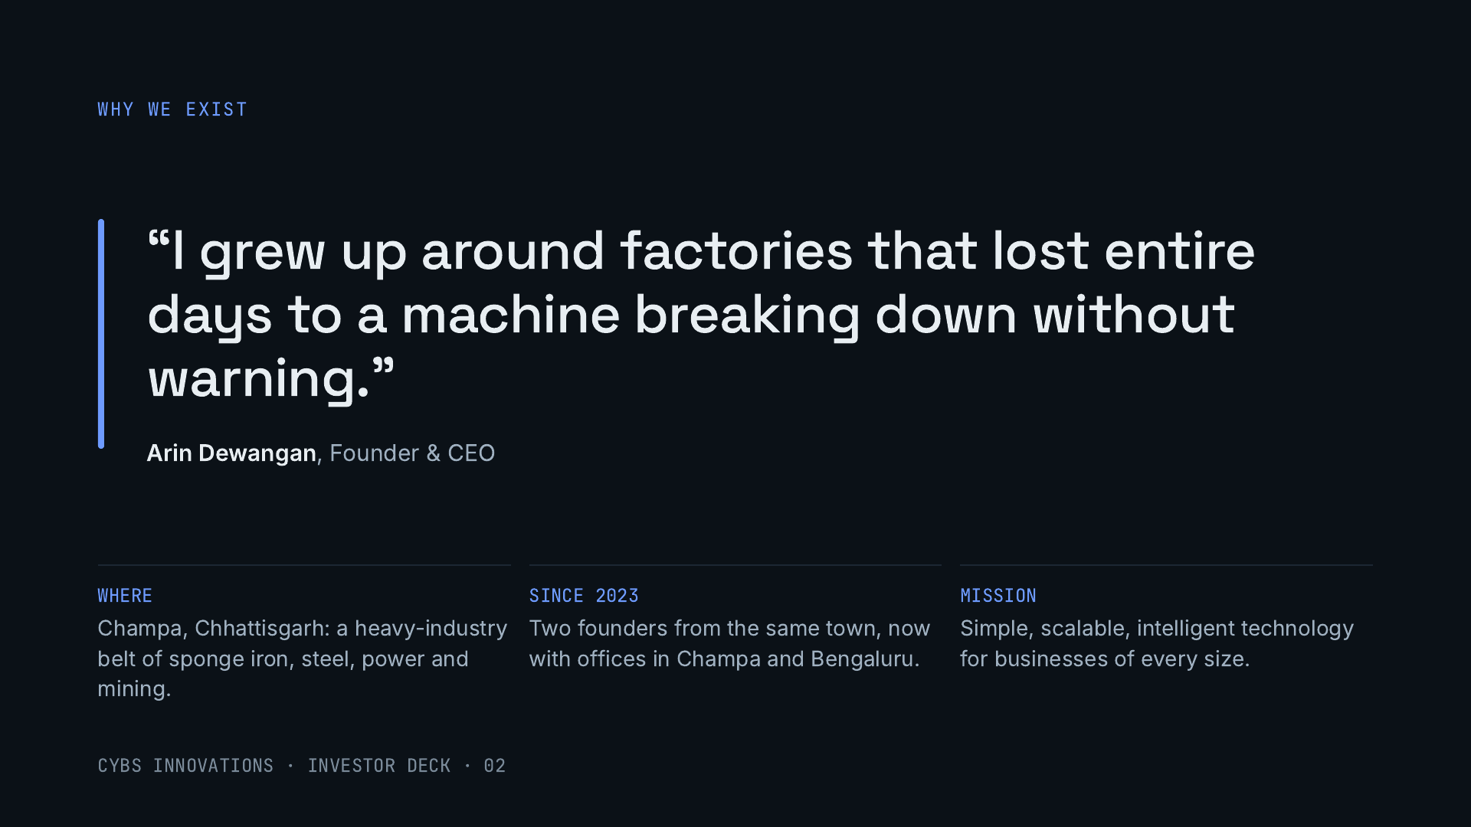
Notes:
Both founders grew up in Champa, inside Chhattisgarh’s industrial belt, watching plants lose whole days to breakdowns and paperwork. Cybs started in 2023 and now has offices in Champa and Bengaluru. Our mission: simple, scalable and intelligent technology for businesses of every size, starting with the factories we know best.

Slide 3
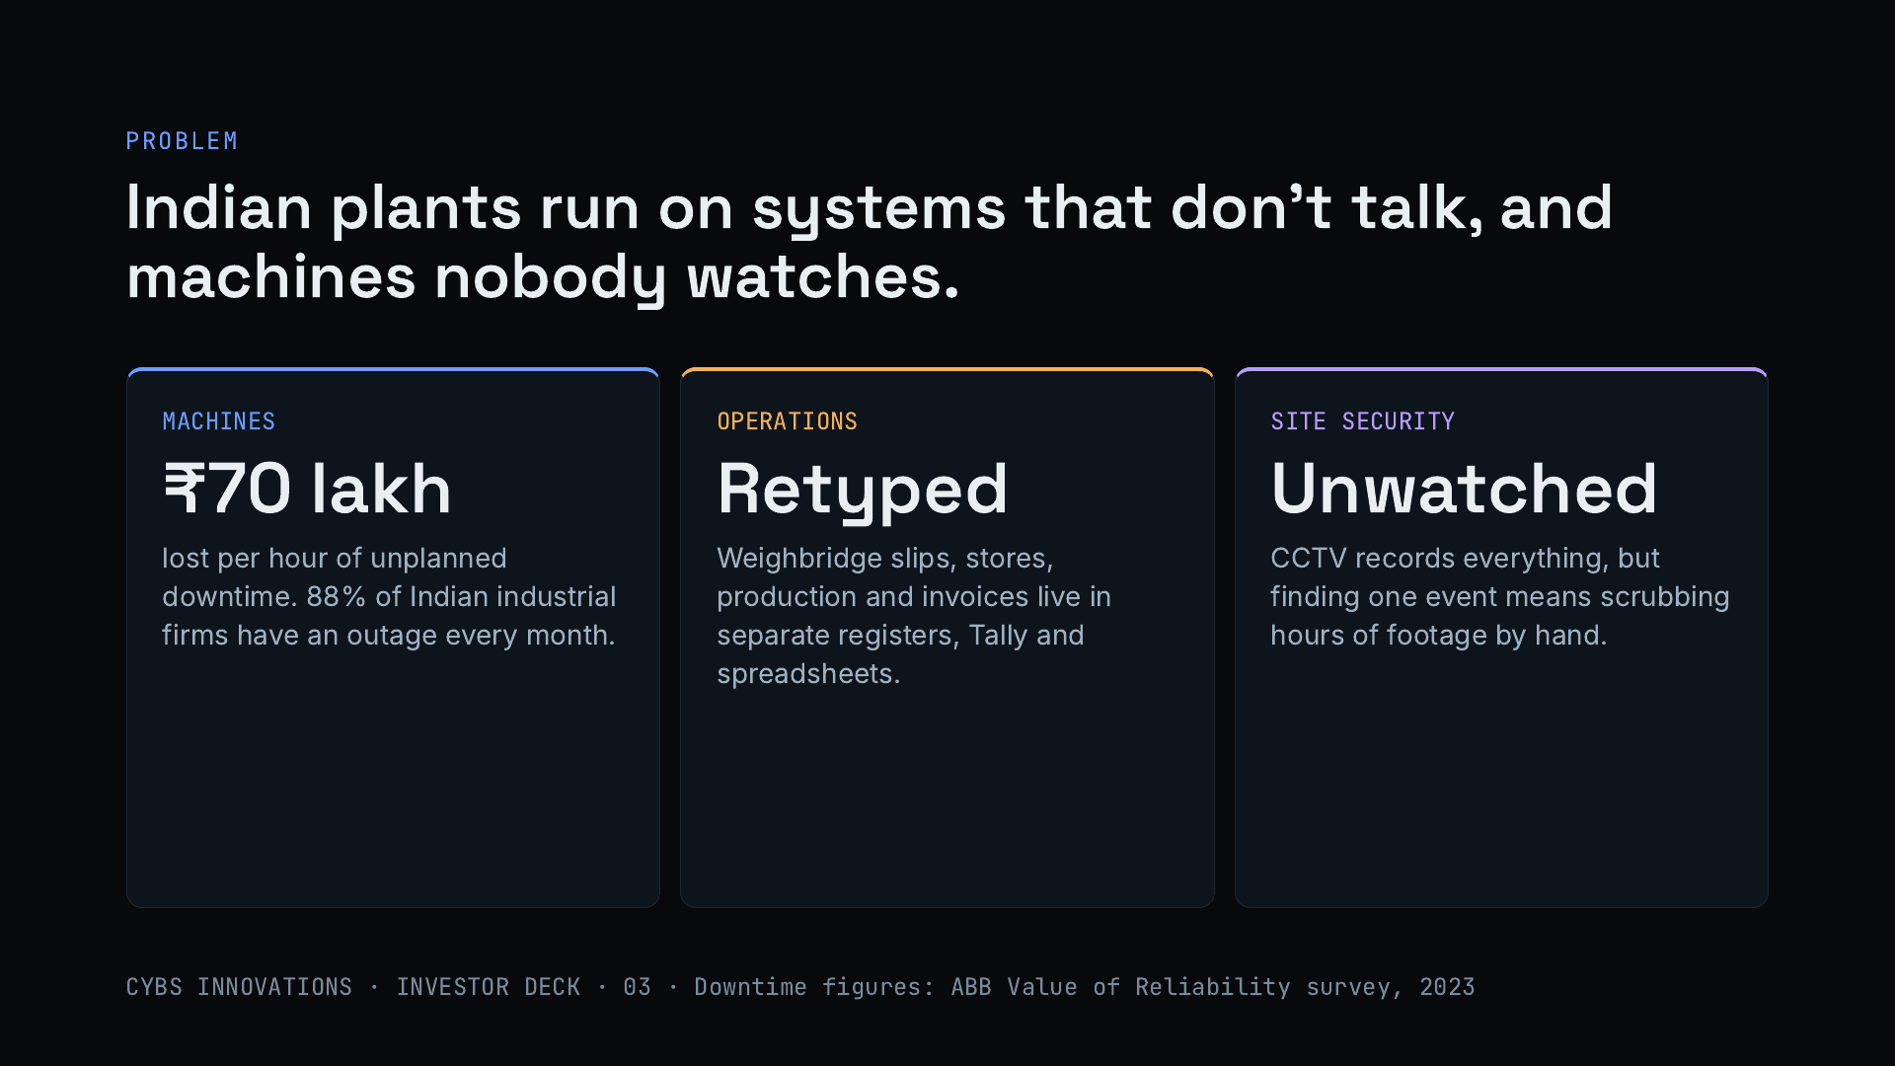
Notes:
Three problems inside the same plant. Machines fail without warning: ABB’s 2023 survey puts unplanned downtime at about ₹70 lakh an hour for a typical Indian industrial business, with 88% seeing an outage every month. Operations data is retyped from weighbridge slips into registers, Tally and spreadsheets. And the CCTV the plant already paid for records everything but answers nothing unless someone scrubs through hours of video.

Slide 4
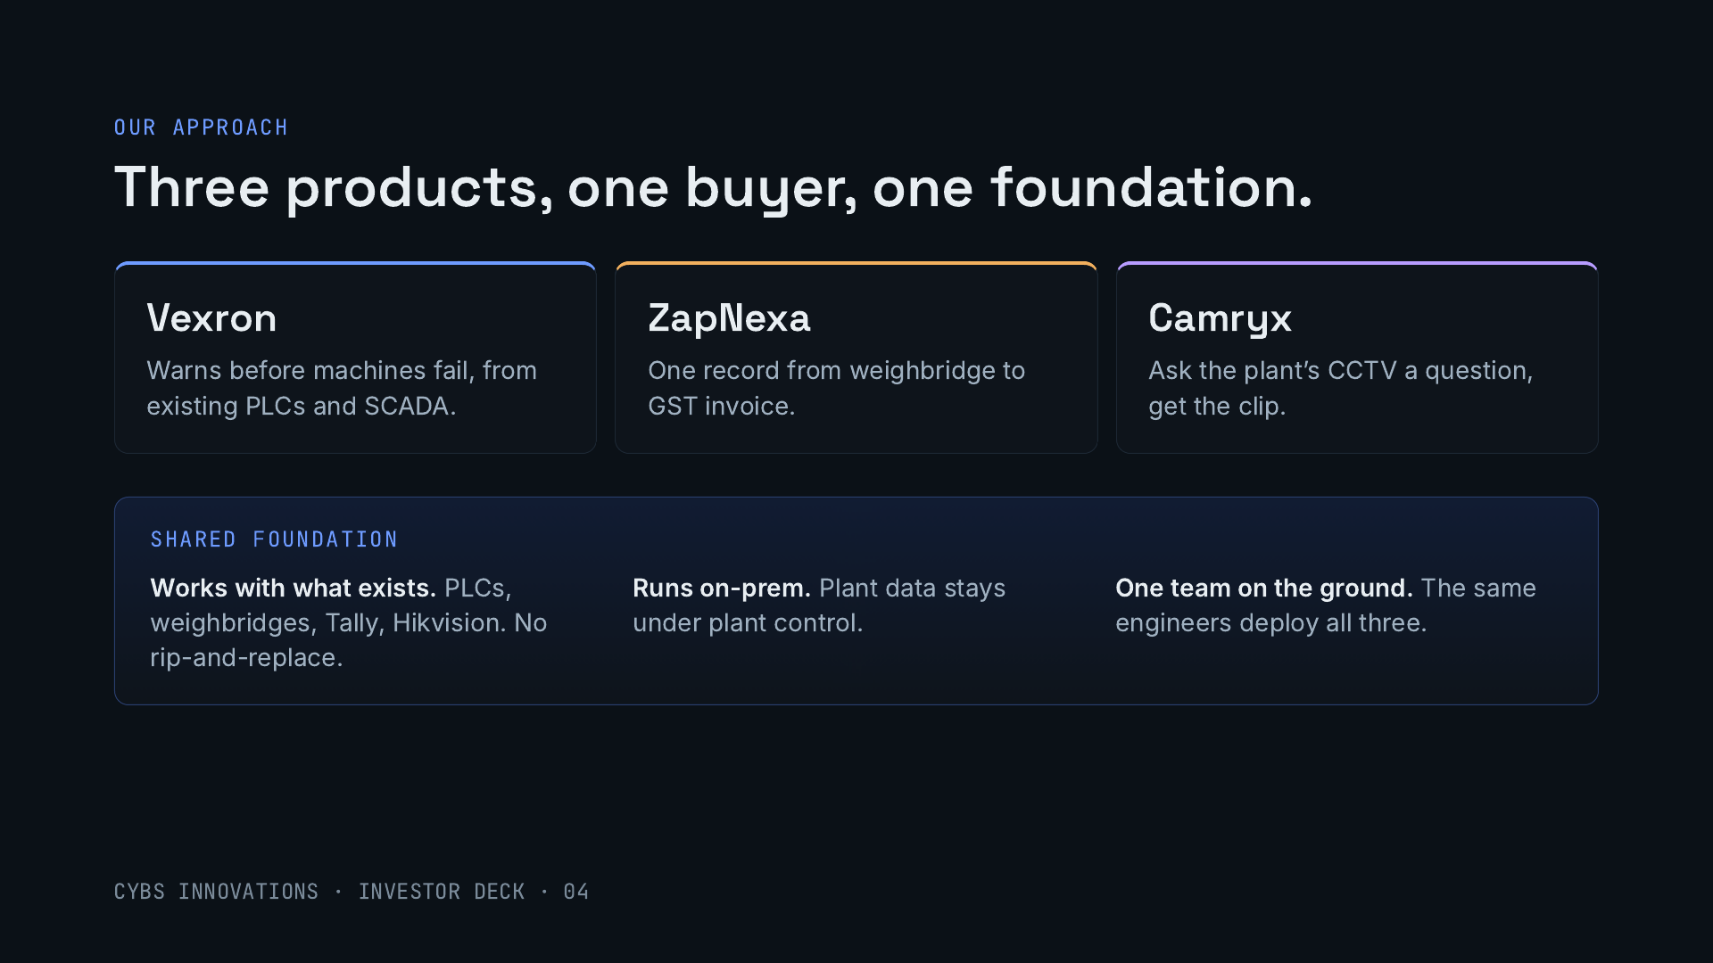
Notes:
Each product solves one of those three problems, and all three are sold to the same person: the plant owner or the head of operations. They share a foundation. Each works with equipment the plant already owns, each can run on-premise so data stays under plant control, and one Cybs engineering team deploys all of them. That is what makes cross-selling cheap.

Slide 5
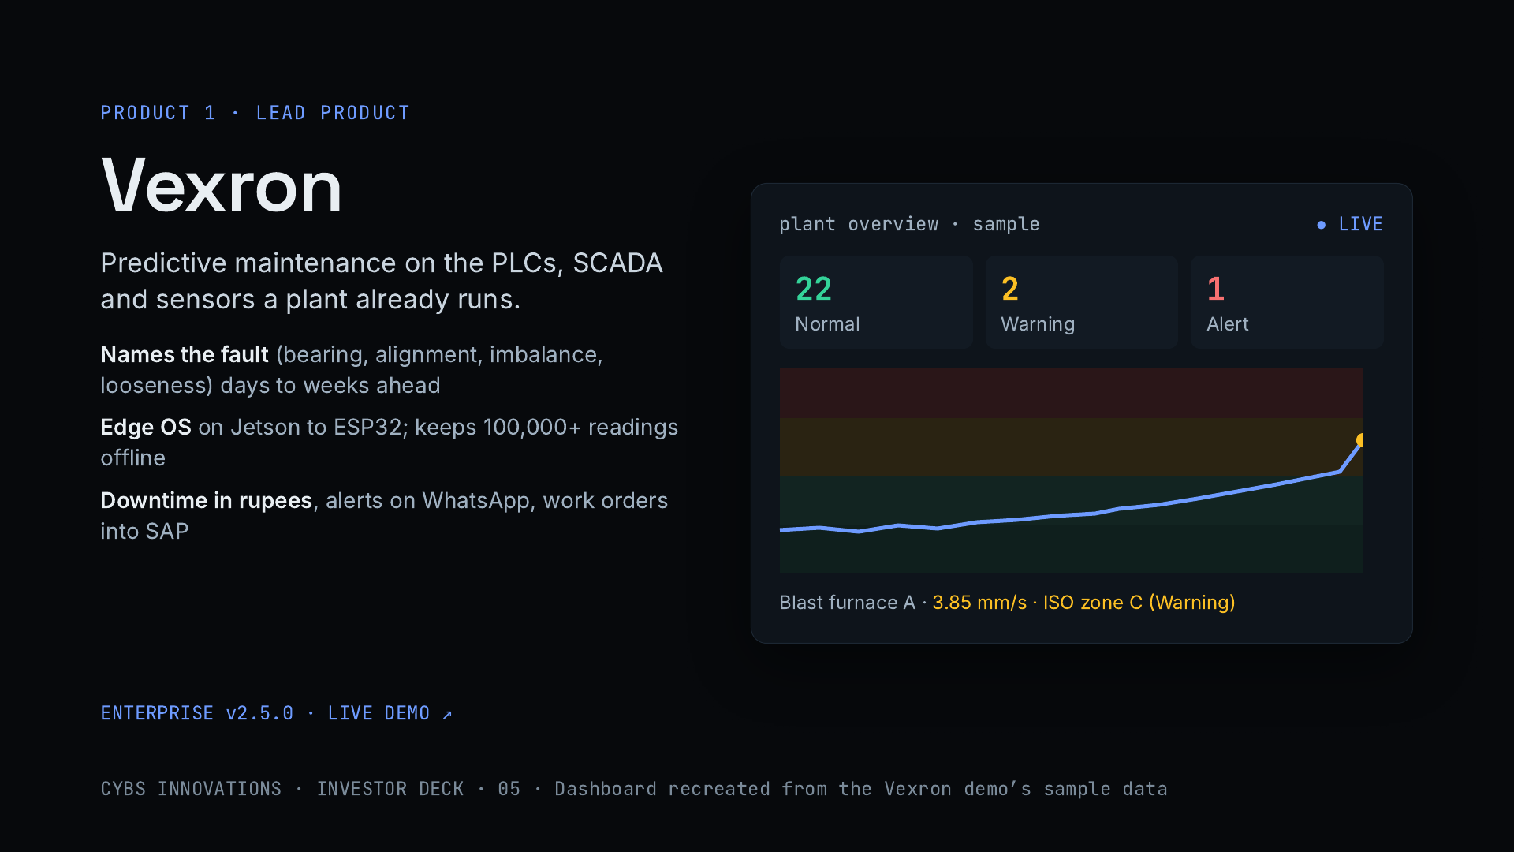
Notes:
Vexron is the lead product and where most accounts will start. It reads vibration, heat and power from the plant’s existing control systems, names the fault developing in a machine, and warns days to weeks before failure depending on the fault. The edge software runs on cheap hardware and keeps data through network drops. Every stop is priced in rupees, and alerts go out on WhatsApp with work orders into SAP or MES. The panel on the right recreates the live demo with its sample data.

Slide 6
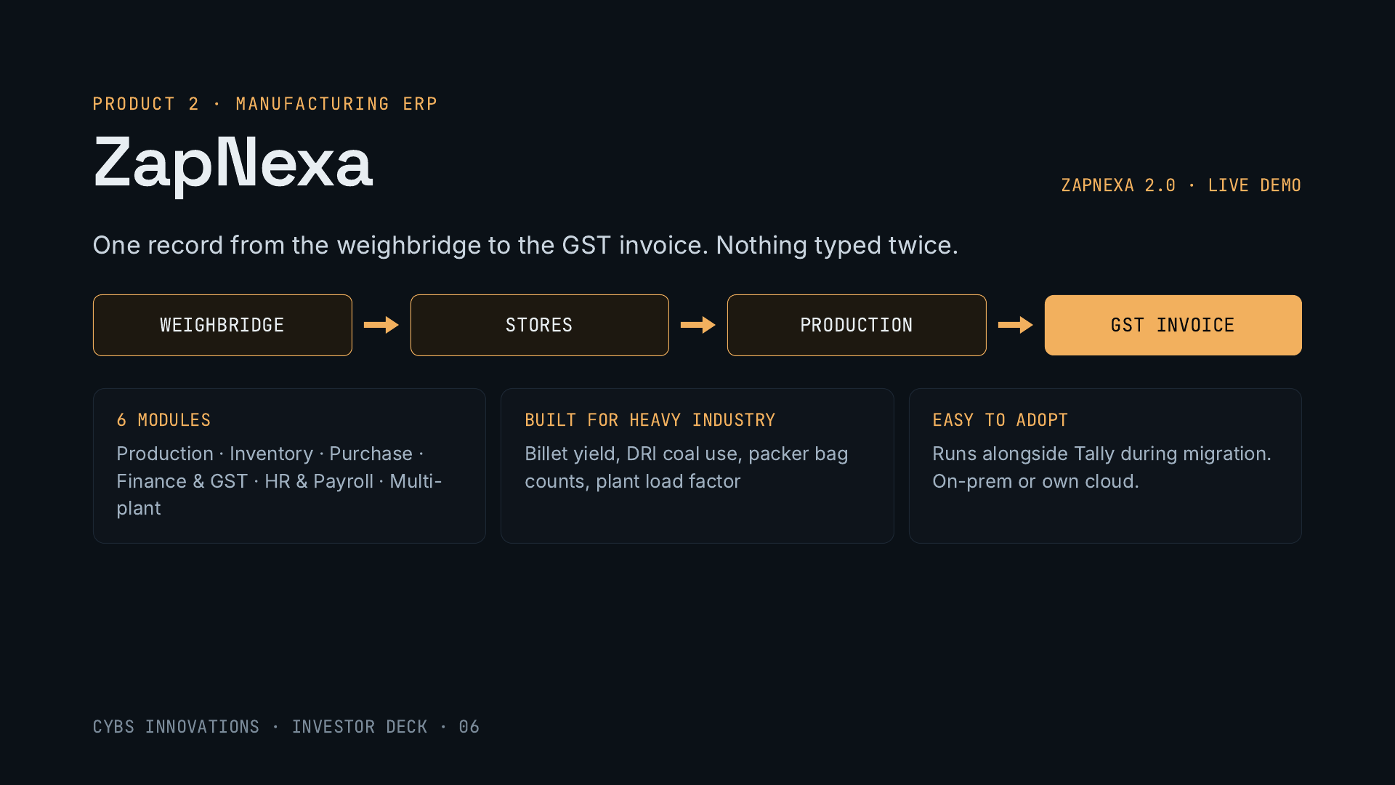
Notes:
ZapNexa is a manufacturing ERP built for heavy industry. The pitch to a plant is one record from the weighbridge weight through stores and production to the GST invoice, so nothing is retyped. Six modules, plus CRM, transport and approval workflows. It knows the plant’s own numbers: billet yield in steel, DRI coal use in sponge iron, bag counts in cement, plant load factor in power. It runs alongside Tally during migration, on the customer’s own servers or cloud, with a Windows desktop app. Version 2.0 added AI demand forecasting.

Slide 7
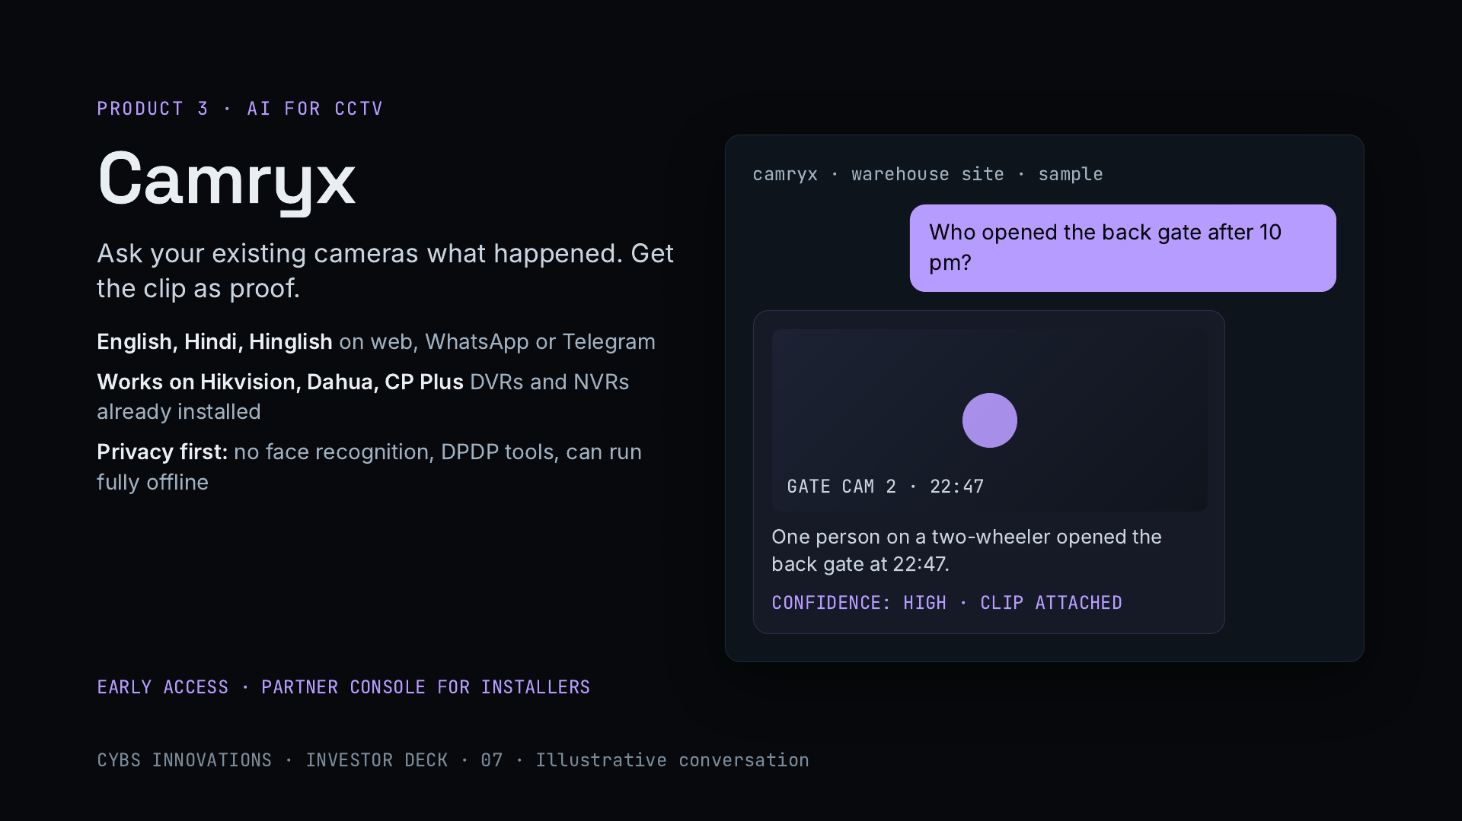
Notes:
Camryx puts AI on the CCTV a site already has. Ask a question in English, Hindi or Hinglish and get an answer naming the camera and time, with the clip as proof. Plain-language alert rules are checked by vision AI before they fire, and it produces daily reports and evidence packs. It connects to common Indian camera brands through a small site agent, uses no face recognition, includes tools for India’s data protection law, and can run fully offline. It is in early access, with a partner console so CCTV installers can resell it. The conversation shown is illustrative.

Slide 8
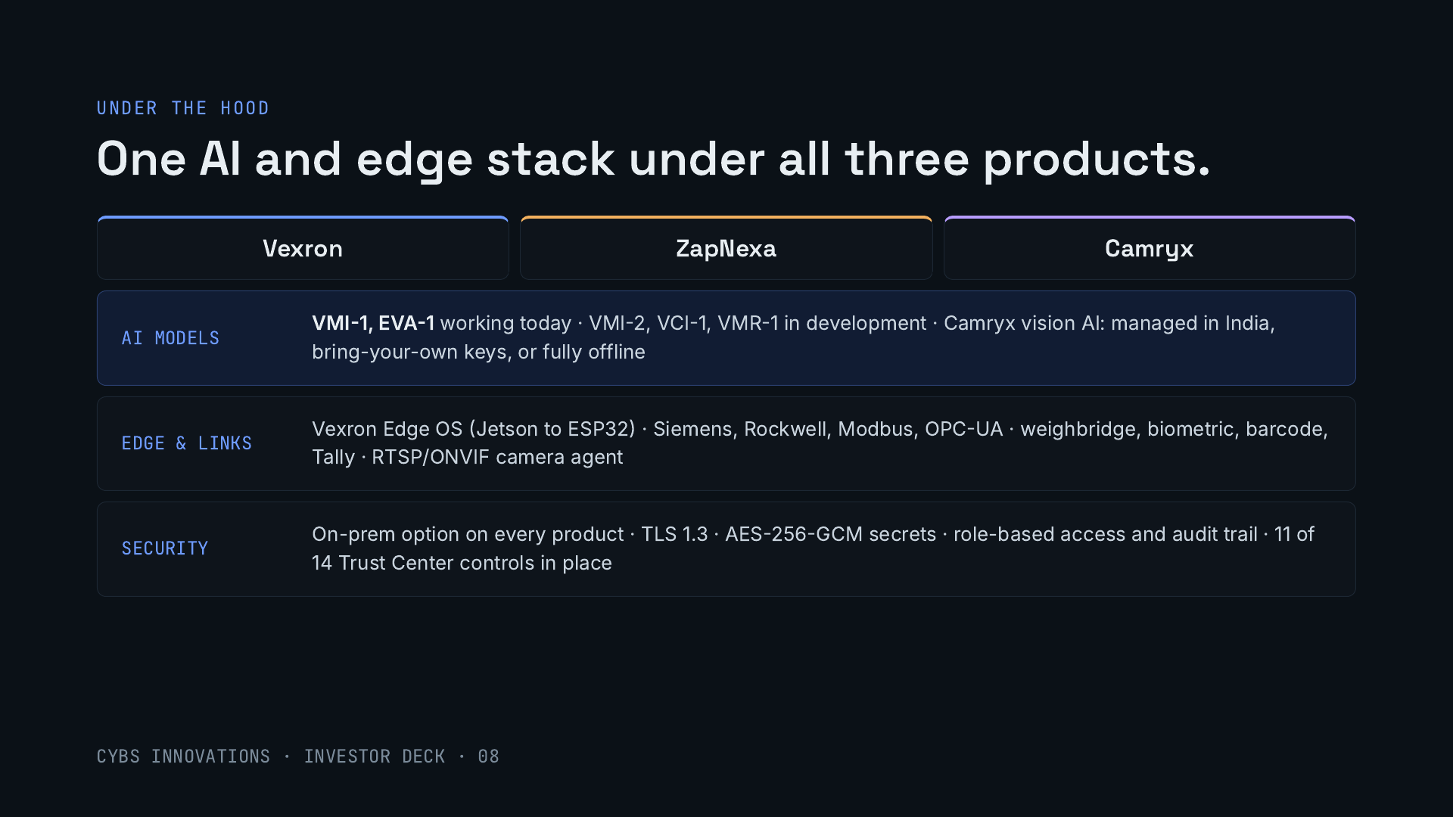
Notes:
The three products sit on shared technology, which is why a small team can build all three. Our own model family covers machine faults and an engineering assistant, with two models working today and three in development. Camryx lets customers choose managed AI hosted in India, their own AI keys, or a fully offline version. The edge layer speaks every major industrial protocol and connects weighbridges, biometric devices, barcode scanners, Tally and CCTV. Every product can run on-premise, and our Trust Center shows 11 of 14 security controls in place, with the remaining three in progress.

Slide 9
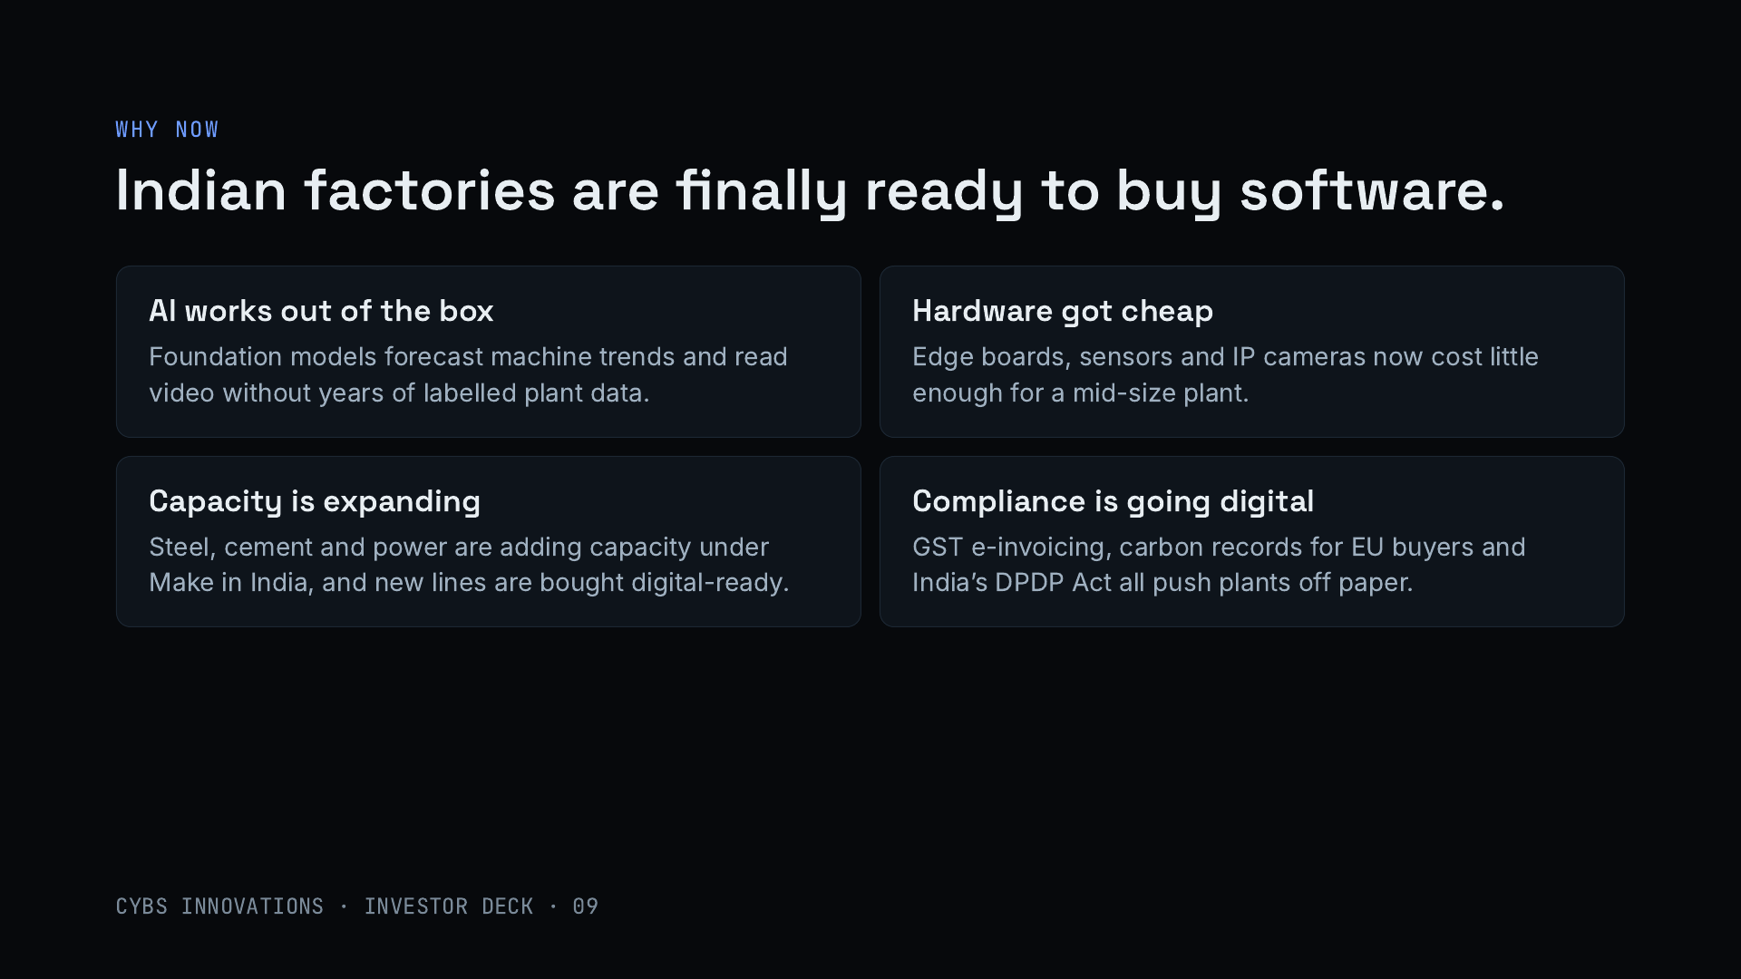
Notes:
Four shifts. AI now works without years of labelled plant data: time-series models forecast machine wear and vision models read CCTV footage. Edge hardware and cameras are cheap enough for a mid-size plant. Heavy industry is adding capacity under Make in India. And compliance is pushing plants onto software: GST e-invoicing, emissions records for European buyers, and India’s data protection law, which favours privacy-safe video systems like Camryx.

Slide 10
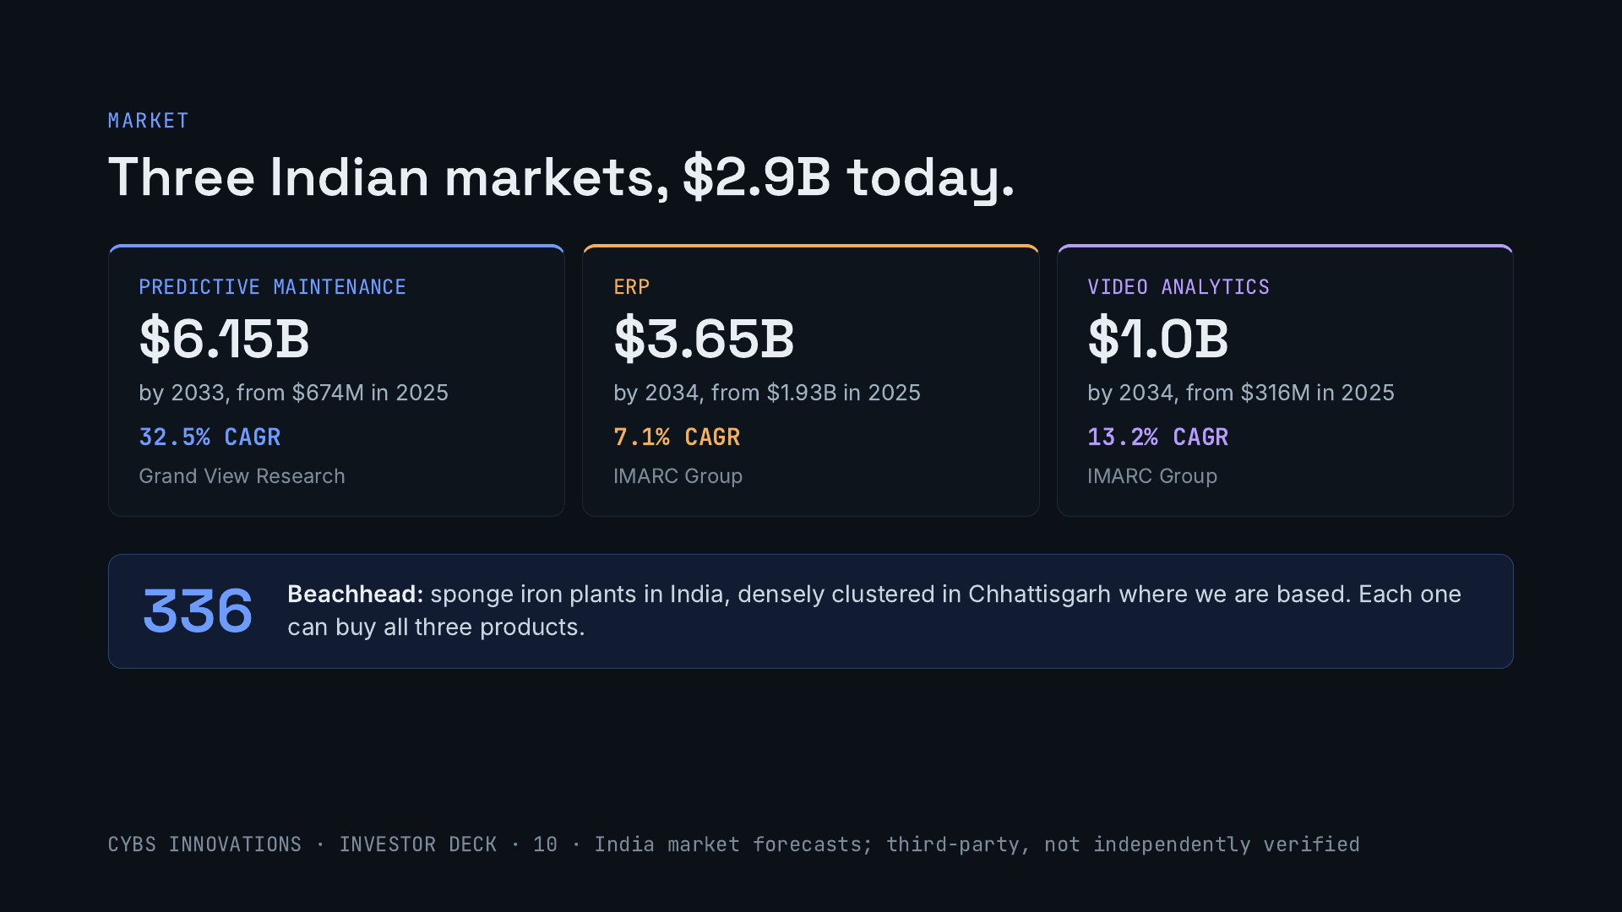
Notes:
Three Indian markets that together are worth about $2.9 billion in 2025. Predictive maintenance is the fastest growing: Grand View Research sizes it at $674 million in 2025 and $6.15 billion by 2033, a 32.5% annual growth rate. IMARC sizes India’s ERP market at $1.93 billion in 2025, reaching $3.65 billion by 2034, and video analytics at $316 million, reaching about $1 billion by 2034. Our beachhead is the roughly 336 sponge iron plants in India, many near us in Chhattisgarh, and each of them is a buyer for all three products. These are third-party forecasts.

Slide 11
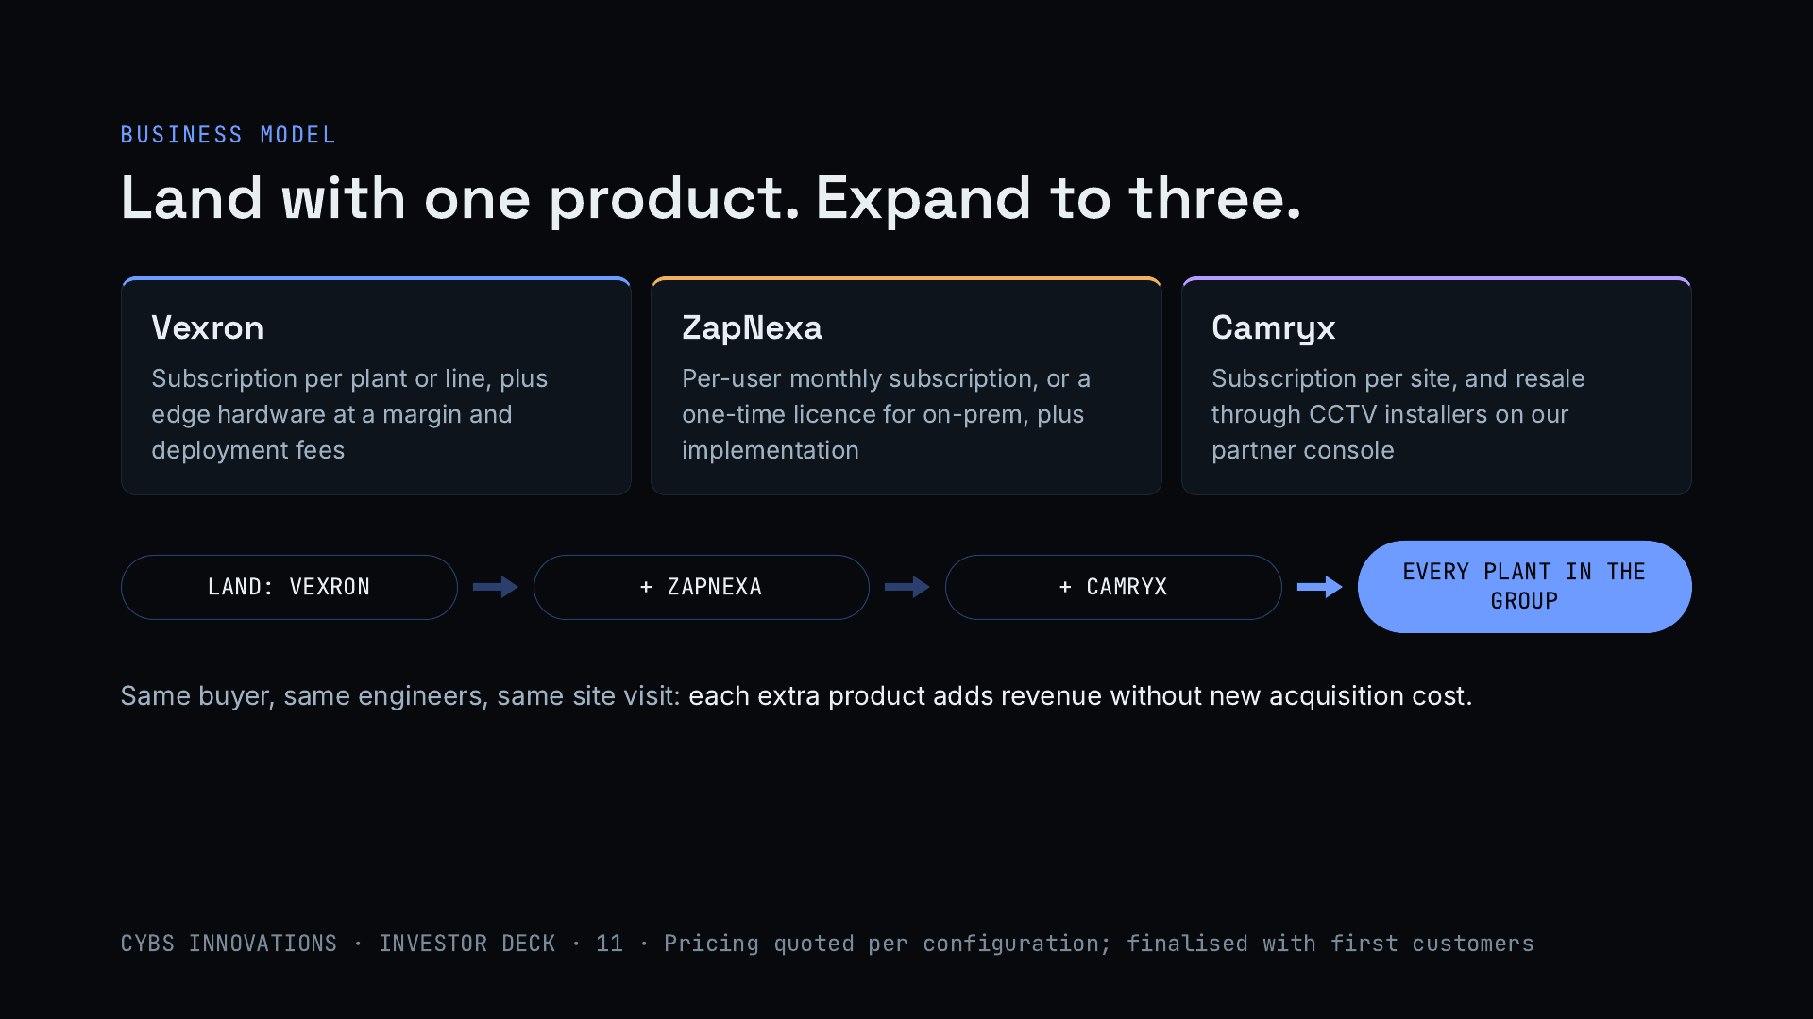
Notes:
Each product earns recurring revenue. Vexron is a subscription per plant or line, plus edge hardware and deployment. ZapNexa is a per-user monthly subscription or a one-time licence for on-premise installs. Camryx is a subscription per site, and CCTV installers can resell it through our partner console. The motion is land and expand: most plants start with Vexron on a few critical machines, then add ZapNexa and Camryx, then roll out across the group’s other plants. Pricing is quoted per configuration and will be finalised with the first customers.

Slide 12
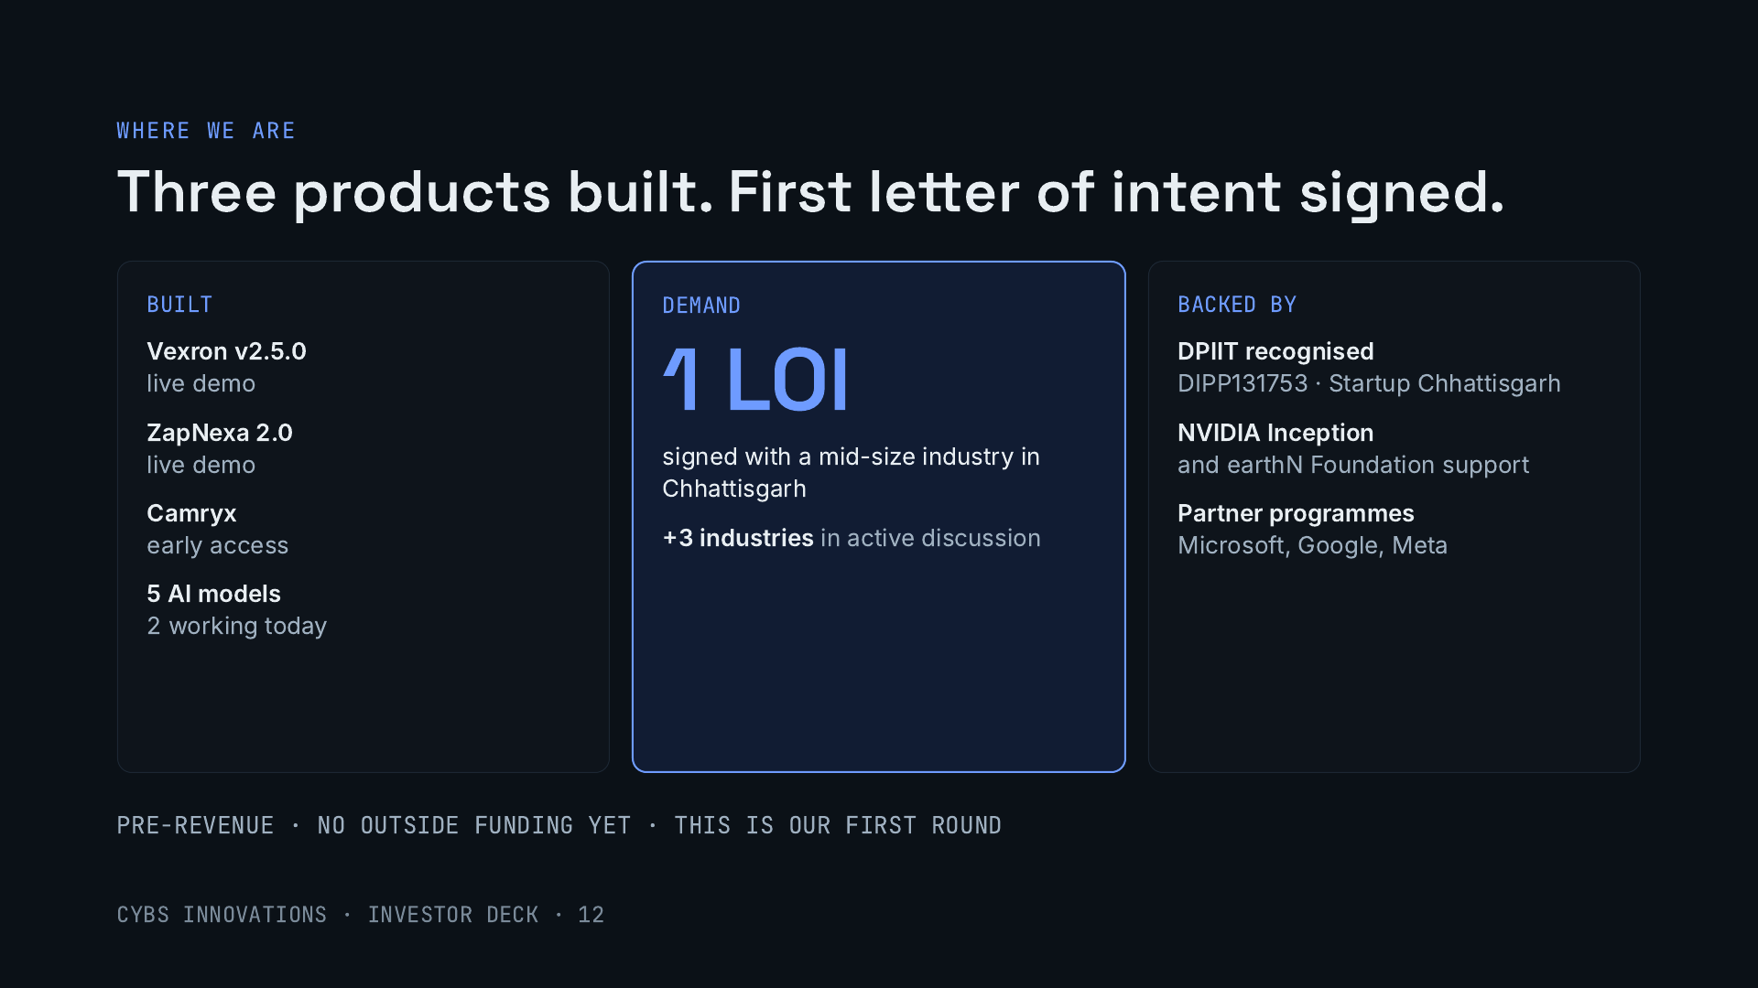
Notes:
Be direct about the stage. All three products are built: Vexron and ZapNexa have public live demos and Camryx is in early access, with five AI models, two of them working today. On demand, we have one signed letter of intent from a mid-size industry in Chhattisgarh and three more industries in active discussion. We are recognised by DPIIT and Startup Chhattisgarh, part of NVIDIA Inception, and members of Microsoft, Google and Meta partner programmes. We are pre-revenue and have not raised outside money; this is our first round.

Slide 13
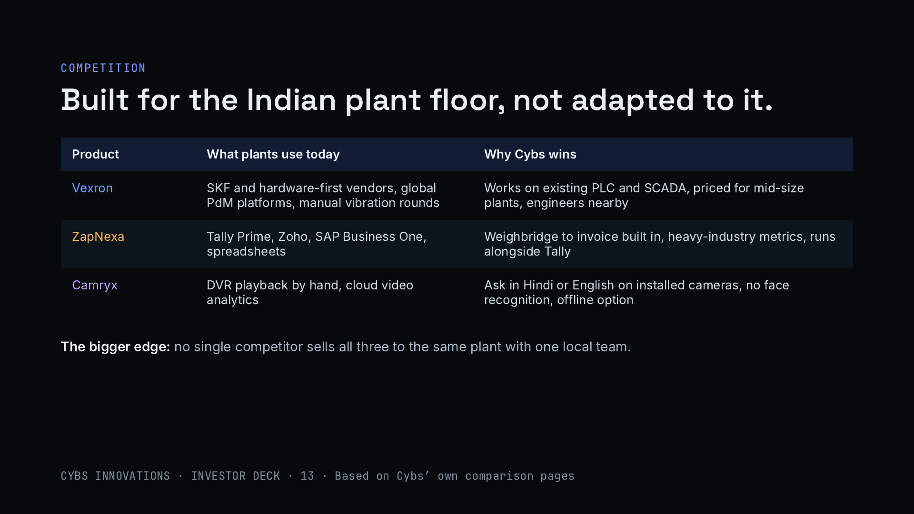
Notes:
For each product the plant already has an alternative. For Vexron: SKF and other hardware-first vendors, which are strong but premium, global platforms priced for large enterprises, and manual vibration rounds. For ZapNexa: Tally, Zoho or SAP Business One, none of which handles the weighbridge-to-invoice flow of a heavy plant out of the box. For Camryx: scrubbing DVR footage by hand, or cloud video analytics. Our wider advantage is that one local team sells and deploys all three to the same buyer.

Slide 14
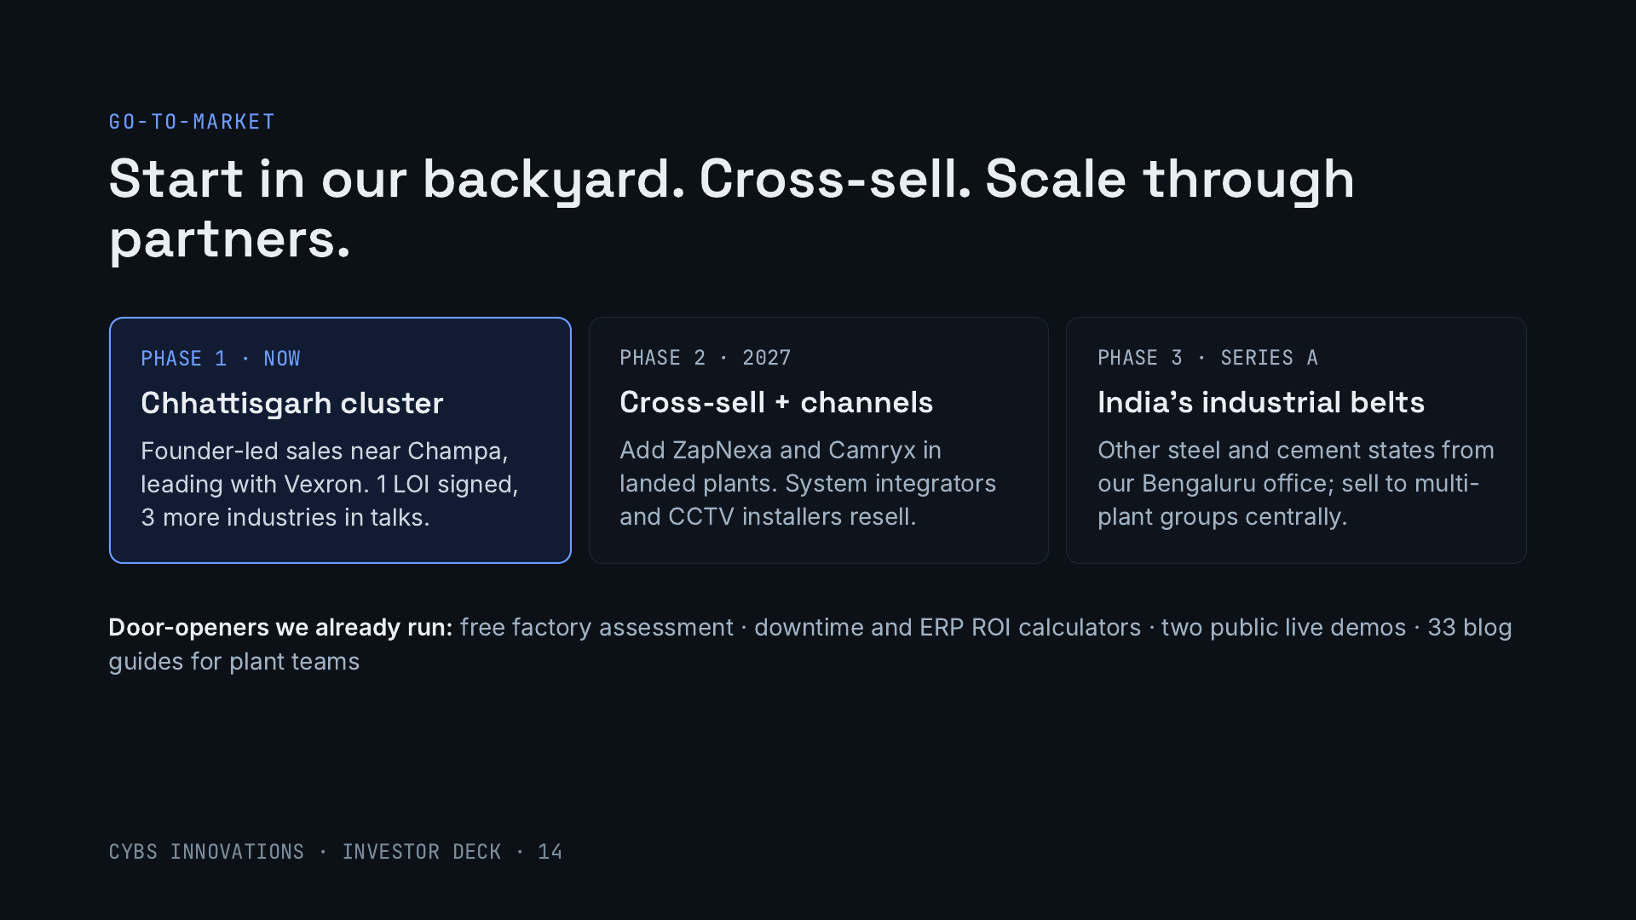
Notes:
We start where we have an unfair advantage: Champa sits in one of India’s densest clusters of sponge iron, steel and power plants. Sales are founder-led and lead with Vexron, where we already have one signed letter of intent and three industries in talks. Once a plant is live, we add ZapNexa and Camryx, and bring in system integrators and CCTV installers as resellers; Camryx already has a partner console for installers. With Series A we expand to other industrial states from Bengaluru. Our free tools and demos generate the first conversations.

Slide 15
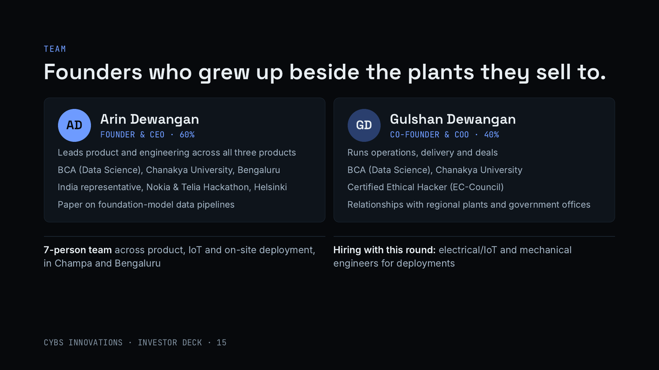
Notes:
Both founders grew up in Champa, in Chhattisgarh’s industrial belt. Arin leads product and engineering across Vexron, ZapNexa and Camryx: data science degree from Chanakya University, represented India at the Nokia and Telia hackathon in Helsinki, and has presented research on data pipelines for foundation models. Gulshan runs operations, delivery and deals, is a Certified Ethical Hacker, which matters when plants worry about connecting their systems, and holds the regional relationships with plants and government offices. A 7-person team covers product, IoT and deployment.

Slide 16
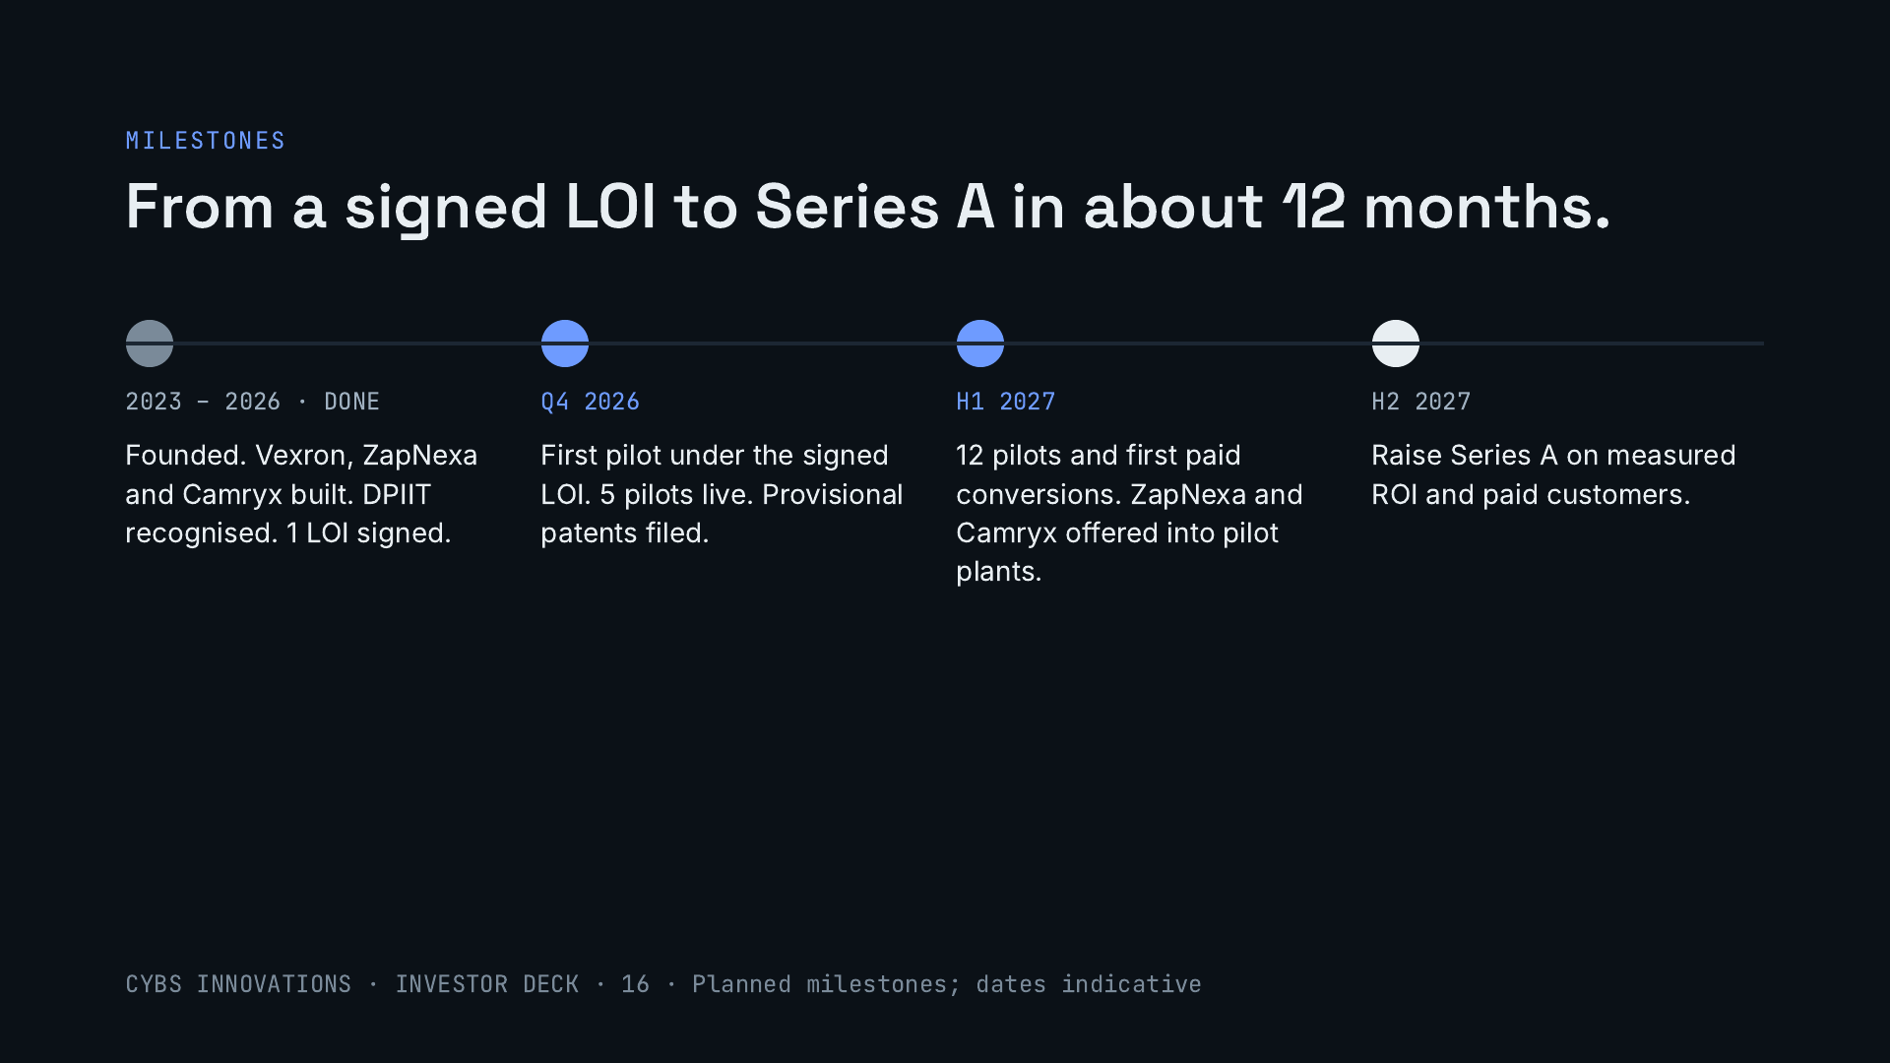
Notes:
What the seed money buys, in order. The first pilot comes from the letter of intent we have already signed. Five pilots and provisional patents this quarter. Twelve pilots and the first paid conversions in the first half of 2027, with ZapNexa and Camryx offered into the same plants. Then a Series A on measured ROI and paying customers.

Slide 17
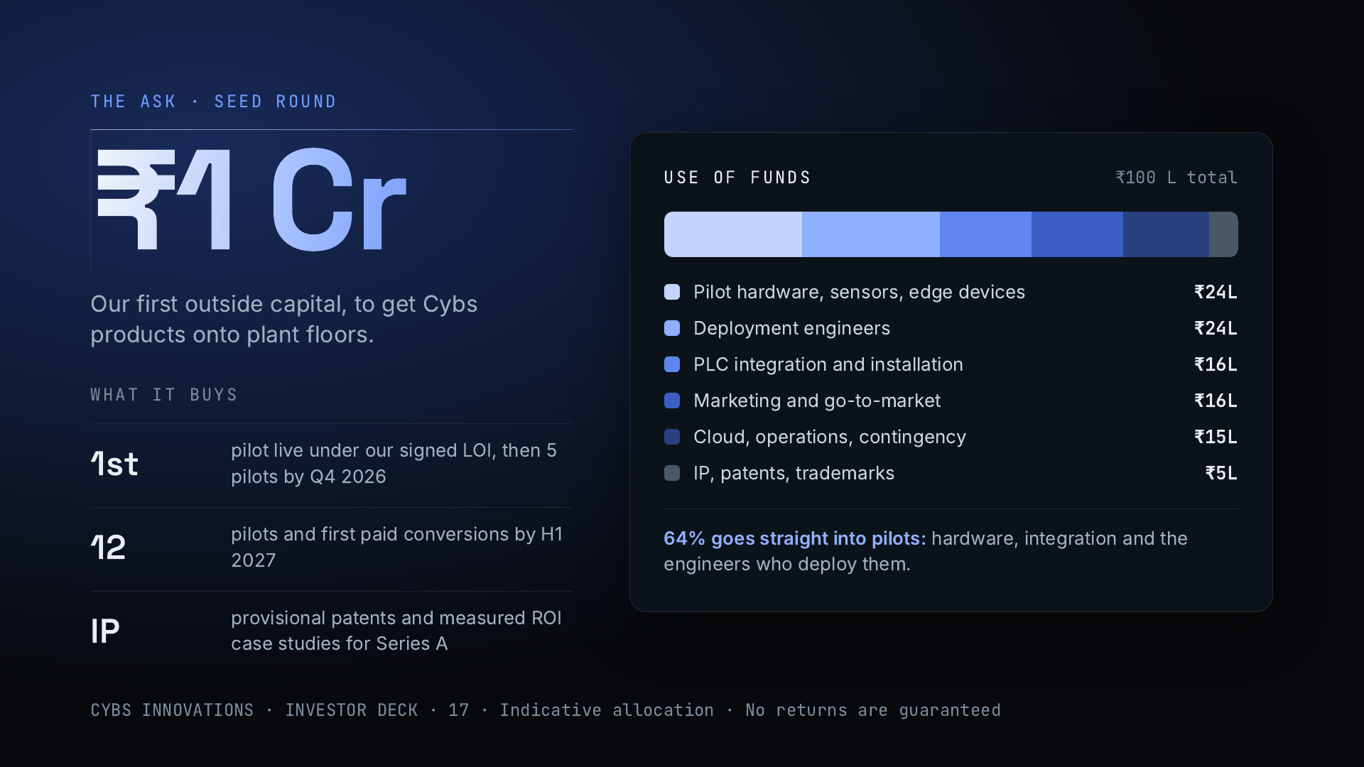
Notes:
We are raising ₹1 crore, our first outside money. About 64% goes straight into pilots: hardware, sensors and edge devices, PLC integration, and the engineers who deploy them. The rest covers go-to-market, cloud and operations with a contingency, and provisional patents. The pilots lead with Vexron and open each plant for ZapNexa and Camryx. The round produces measured ROI case studies and first paid conversions that set up a Series A. Possible investor returns come from later-round equity appreciation, secondary sales in later rounds, or a strategic acquisition, with no guarantees.

Slide 18
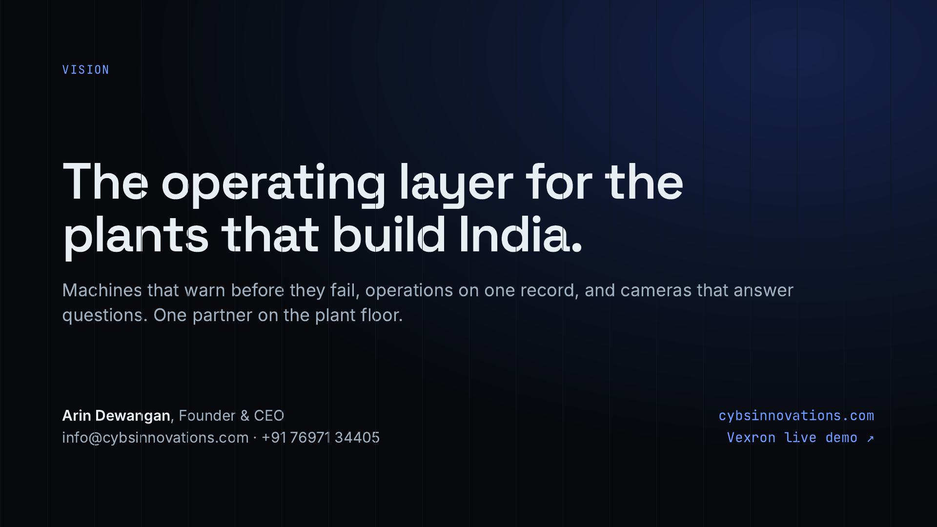
Notes:
Close on the vision: Cybs as the one software partner a heavy-industry plant needs, with machines that warn before failing, operations on one record, and cameras that answer questions. Repeat the ask, ₹1 crore, and offer next steps: a live demo of Vexron or ZapNexa, or a visit to a plant in Chhattisgarh.

