Slide 1
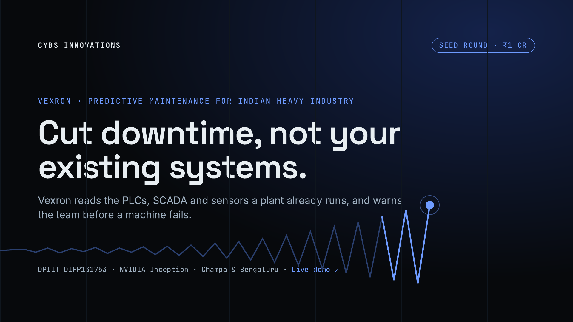
Notes:
One line: Vexron is predictive maintenance built for Indian heavy industry. It plugs into the control systems a plant already owns, so there is nothing to rip out. We are raising ₹1 crore, our first outside round, to put Vexron on plant floors through pilots.

Slide 2
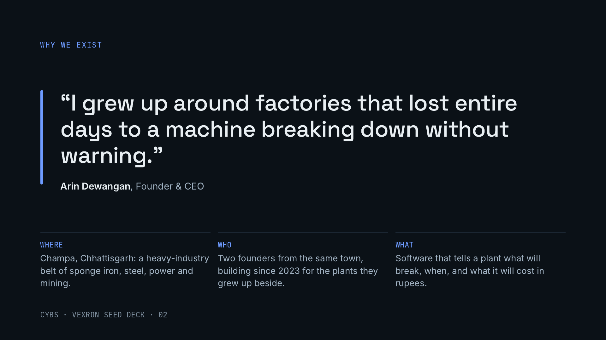
Notes:
Start with why. Arin grew up in Champa watching plants lose whole days to breakdowns nobody saw coming. Cybs was started in 2023 by two founders from that town, and Vexron is built for exactly those plants. This is founder-market fit: we know the buyers, the machines and the shop floor.

Slide 3
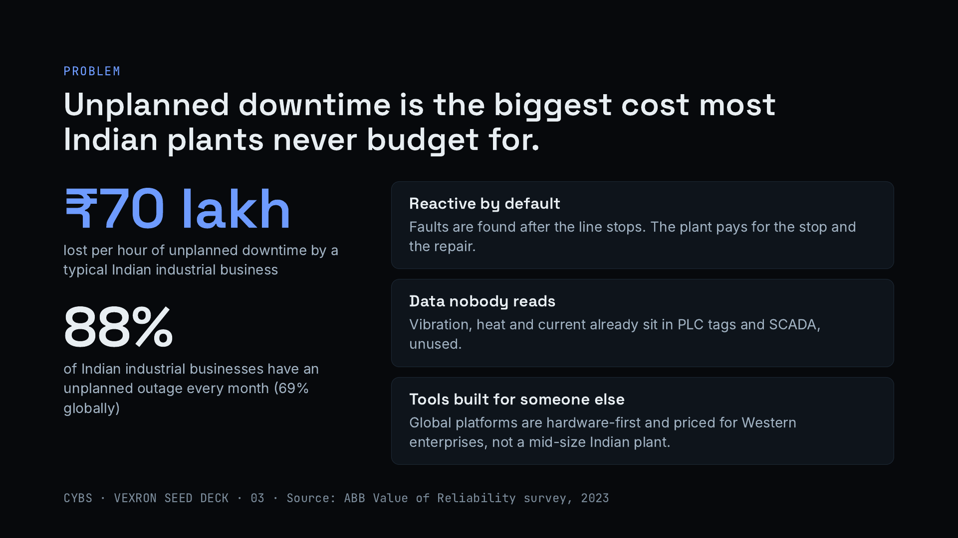
Notes:
ABB’s 2023 survey of 3,215 maintenance leaders puts an hour of unplanned downtime at about ₹70 lakh for a typical Indian industrial business, and 88% of Indian respondents see an outage every month, against 69% globally. These are self-reported survey figures. Three reasons it persists: maintenance is reactive, the data to predict failure is already in the control system but nobody reads it, and the global tools are built and priced for someone else.

Slide 4
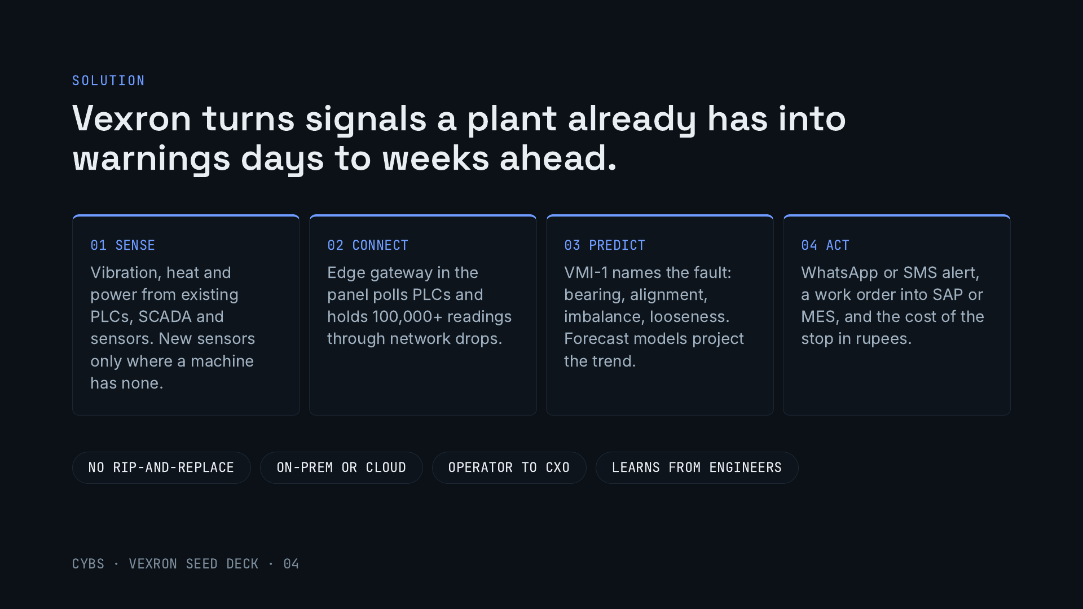
Notes:
Four steps, nothing to replace. Vexron reads what the plant’s control system already produces, adds a sensor only where a critical machine has none, and turns a raw signal into a named fault, an alert on WhatsApp, a work order and a rupee figure finance understands. Engineers confirm or reject each alert, and the models learn from that. Lead time depends on the fault: slow wear gives weeks, fast faults less.

Slide 5
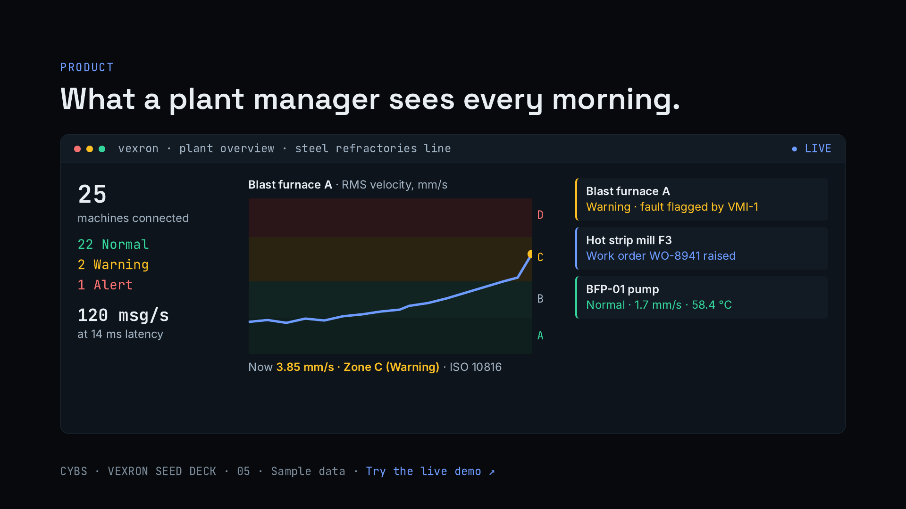
Notes:
This is a recreation of the Vexron demo, using its sample data. A steel refractories plant with 25 connected machines: 22 normal, 2 in warning, 1 in alert. The chart shows one machine drifting from ISO zone A into zone C, which is when Vexron raises a warning, names the likely fault and opens a work order. Offer to run the live demo in the meeting: it includes a 3D model of the plant and a button that simulates an anomaly end to end.

Slide 6
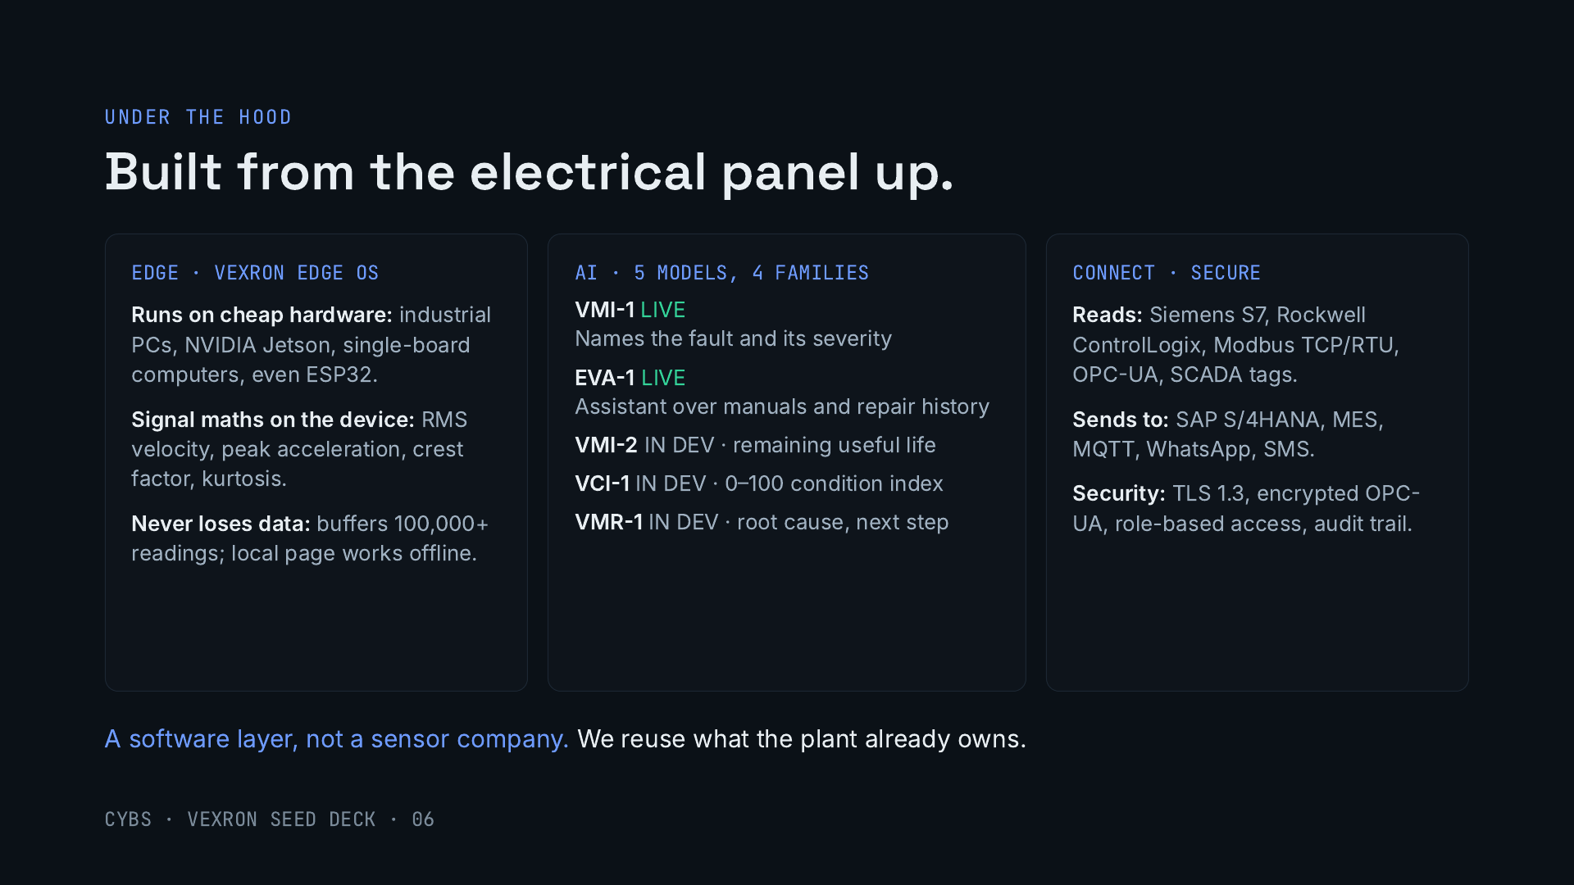
Notes:
Why this is hard to copy. The edge layer runs on very cheap hardware and does the signal processing on the device, so a plant does not need a server room to start, and no data is lost when the network drops. The AI layer is our own model family: two models working today, three in development. Time-series foundation models (Chronos-Bolt and TimesFM) handle forecasting. And we speak the plant’s protocols natively: Siemens, Rockwell, Modbus, OPC-UA, with alerts going out on WhatsApp, which is how Indian maintenance teams actually communicate.

Slide 7
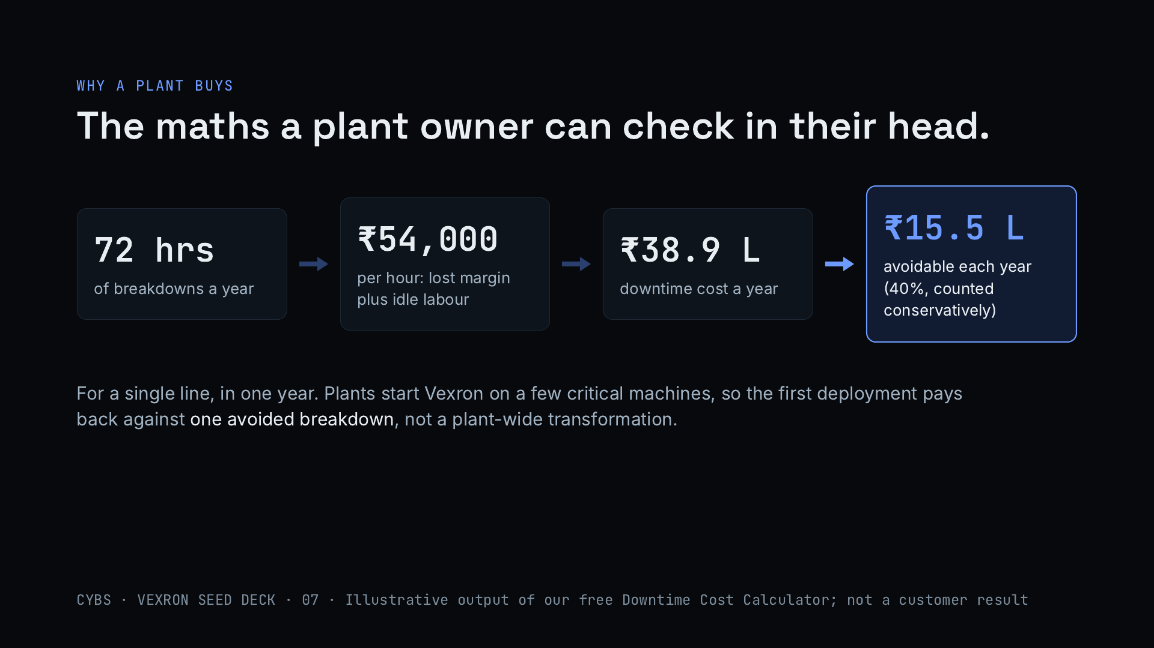
Notes:
This is the worked example from the free Downtime Cost Calculator on our website, with illustrative inputs: 72 hours of breakdowns a year at ₹54,000 an hour (₹36 lakh of lost margin and ₹2.88 lakh of idle labour) comes to about ₹38.9 lakh a year. The calculator counts only mechanical faults and treats 40% as avoidable, about ₹15.5 lakh a year. It is not a customer result; in sales we run it with each plant’s own numbers, and the pilots will give us measured figures.

Slide 8
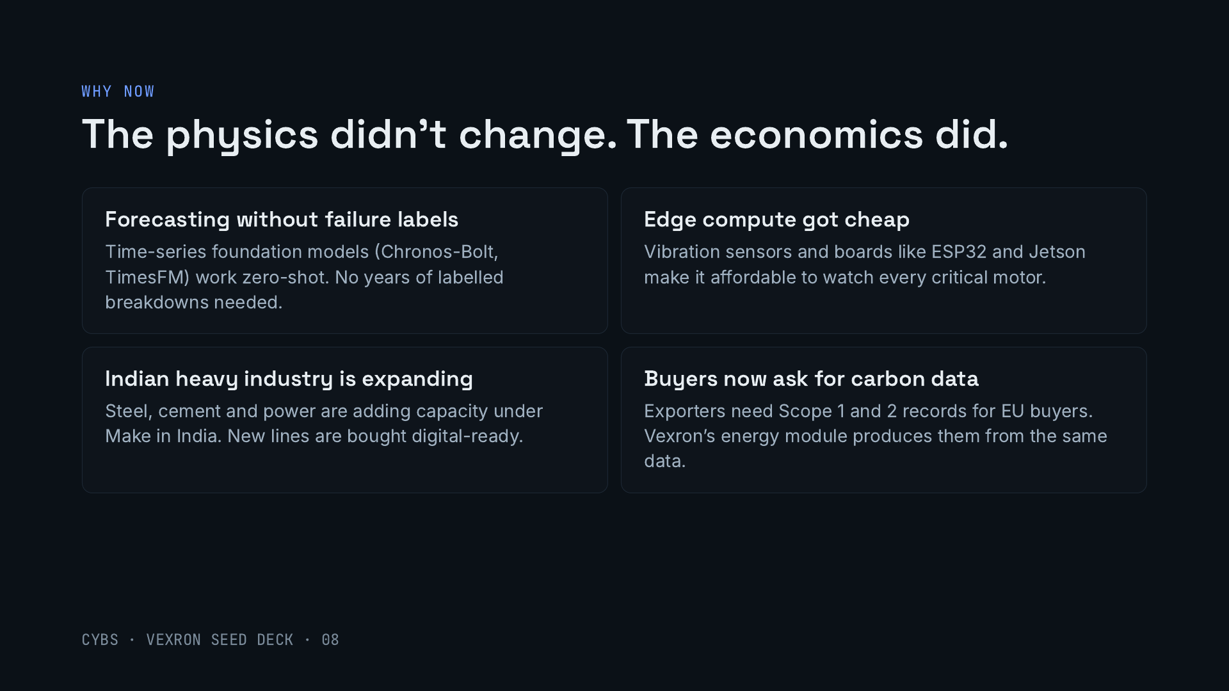
Notes:
Four shifts. Forecasting models now work without labelled failure data, which used to block predictive maintenance in plants that never logged their breakdowns. Edge hardware is cheap enough to watch every critical motor. Indian heavy industry is adding capacity. And exporters increasingly need emissions records for European buyers, which Vexron’s energy and carbon module builds from the same machine data.

Slide 9
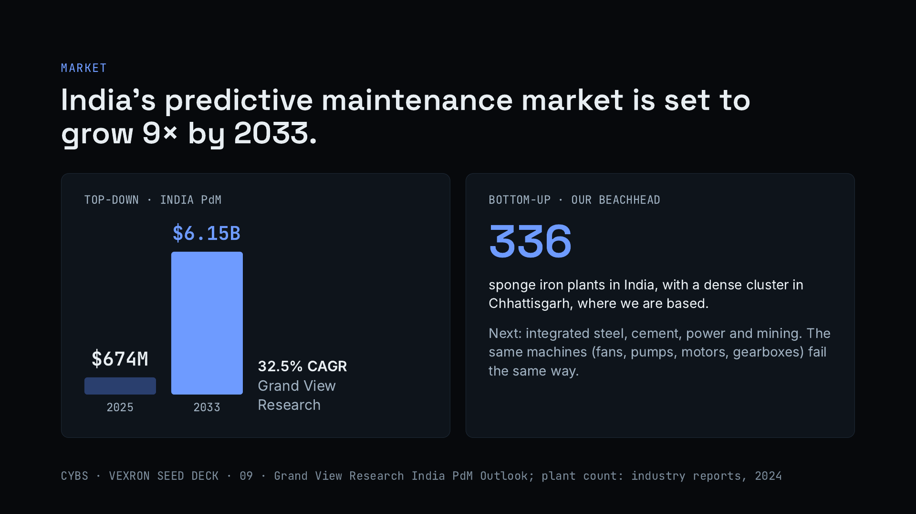
Notes:
Top-down, Grand View Research sizes India’s predictive maintenance market at about $674 million in 2025, growing to about $6.15 billion by 2033, a 32.5% annual growth rate. Bottom-up, our first market is sponge iron: about 336 plants nationally, many close to us in Chhattisgarh. From there the same product sells into integrated steel, cement, power and mining, because the rotating equipment is the same. Third-party forecasts are not independently verified.

Slide 10
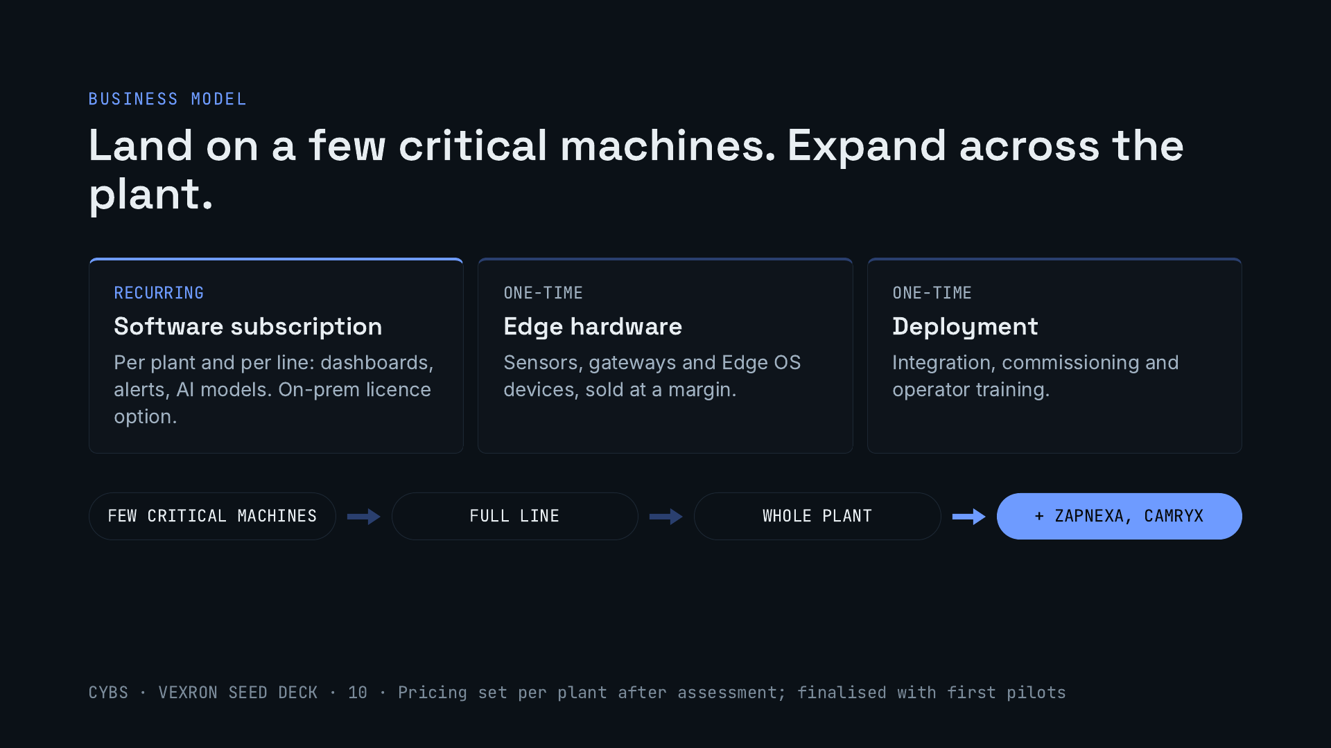
Notes:
Three revenue lines: a recurring software subscription, edge hardware at a margin, and one-time deployment. The motion is land and expand: prove alerts on a handful of critical machines against a baseline, extend to the line and the plant, then sell our other two products into the same account. Pricing is quoted per plant after an assessment and will be finalised with the first pilots.

Slide 11
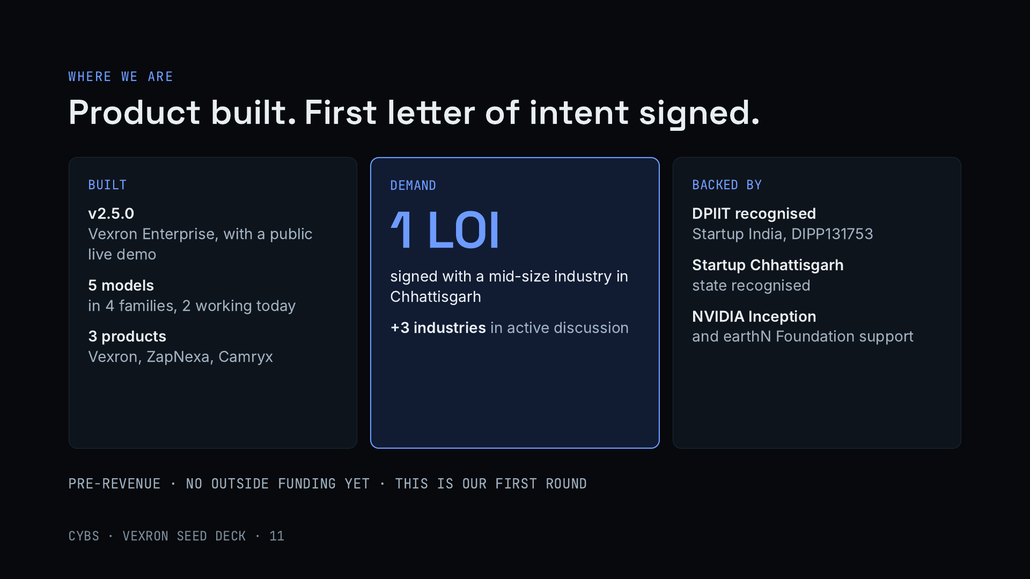
Notes:
Be direct about the stage. The product is built: Vexron Enterprise v2.5.0 with a public demo, five models with two working today, and two more products. On demand, we have one signed letter of intent from a mid-size industry in Chhattisgarh and three more industries in active discussion. We are recognised by DPIIT and Startup Chhattisgarh and part of NVIDIA Inception. We are pre-revenue and have not raised outside money; this round turns the letter of intent into the first pilot.

Slide 12
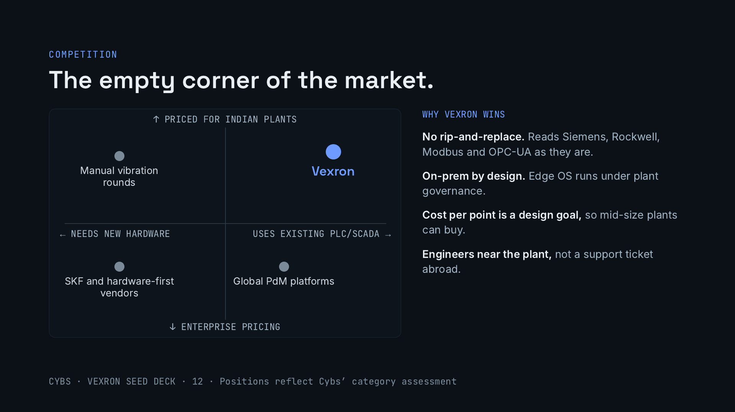
Notes:
Plants have three options today. Manual vibration rounds are cheap but miss fast faults. SKF and other hardware-first vendors are strong, with real sensor pedigree and a global network, and fit plants standardised on one vendor, but they are premium. Global predictive maintenance platforms are capable but priced and supported for large enterprises. Vexron sits in the open corner: it works on what the plant already has, at a price a mid-size Indian plant can approve. Most plants will still use a mix with manual rounds on low-criticality machines.

Slide 13
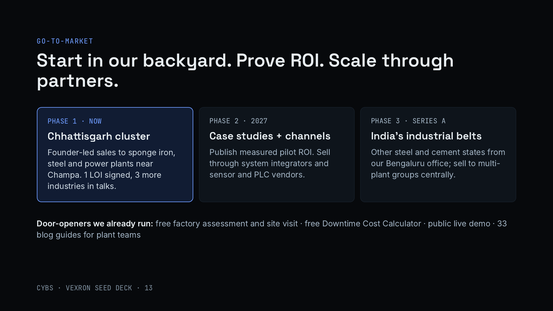
Notes:
We start where we have an unfair advantage: Champa sits inside one of India’s densest clusters of sponge iron, steel and power plants. Sales are founder-led, and the first conversation is a free factory assessment or the downtime calculator on our site. We already have one signed letter of intent and three industries in discussion. Once pilots give measured ROI, we publish case studies and add channel partners. With Series A we expand to other industrial states from Bengaluru and sell to multi-plant groups.

Slide 14
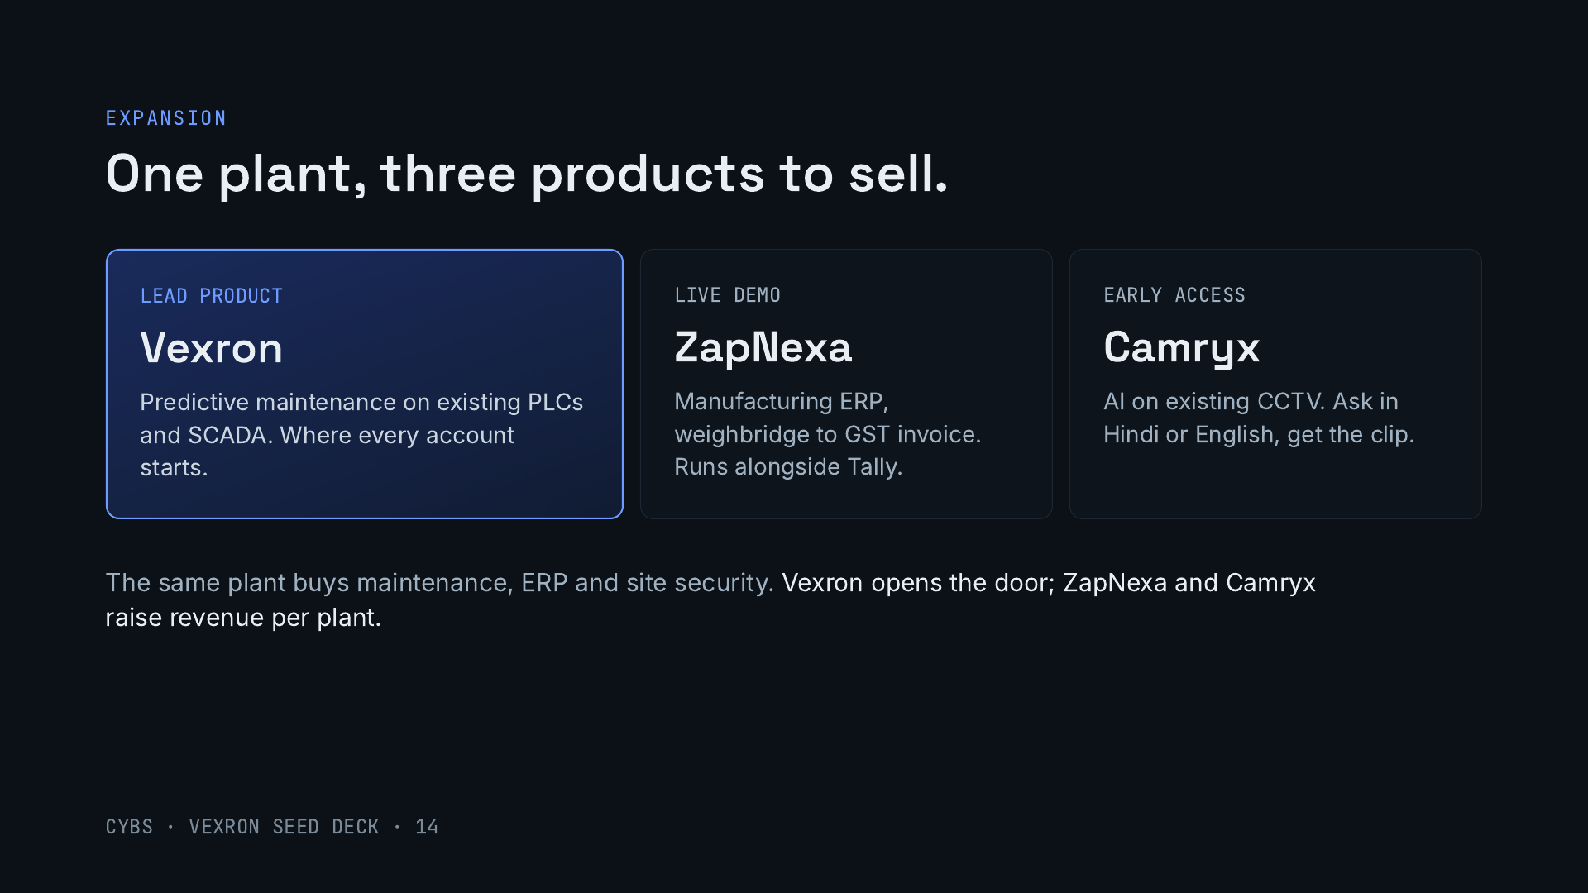
Notes:
The seed round is focused on Vexron, but every plant we land can also buy ZapNexa, our manufacturing ERP, and Camryx, which adds AI search and alerts to the CCTV the plant already has. Both are built and shown on our website. That raises revenue per account without new acquisition cost.

Slide 15
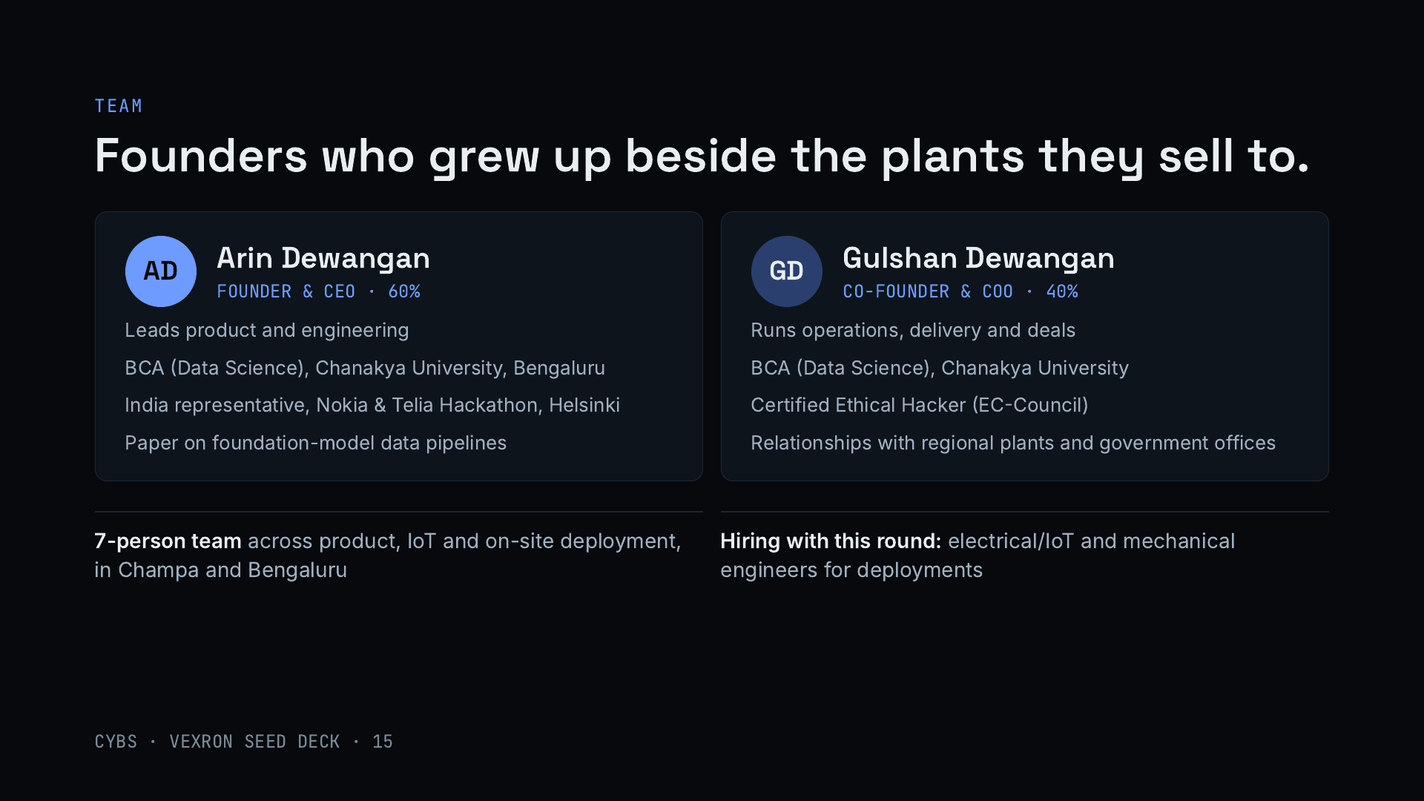
Notes:
Both founders grew up in Champa, in Chhattisgarh’s industrial belt. Arin leads product and engineering: data science degree from Chanakya University, represented India at the Nokia and Telia hackathon in Helsinki, and has presented research on data pipelines for foundation models. Gulshan runs operations, delivery and deals, is a Certified Ethical Hacker, which matters when plants worry about connecting control systems, and holds the regional relationships with plants and government offices. The 7-person team covers product, IoT and deployment.

Slide 16
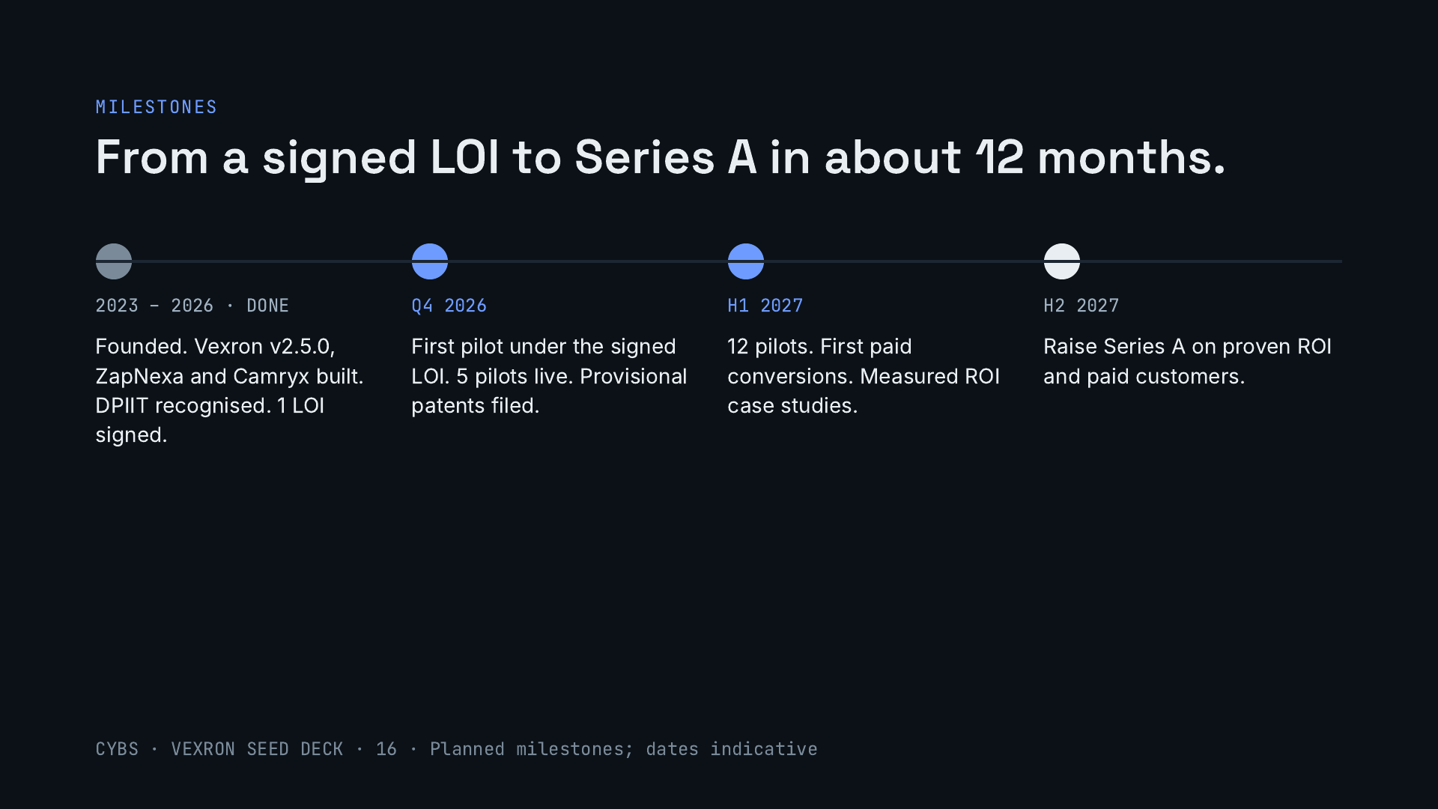
Notes:
What the seed money buys, in order. The first pilot comes from the letter of intent we have already signed. Five pilots and provisional patents this quarter, twelve pilots with the first paid conversions in the first half of 2027, and measured ROI case studies that become the basis for a Series A.

Slide 17
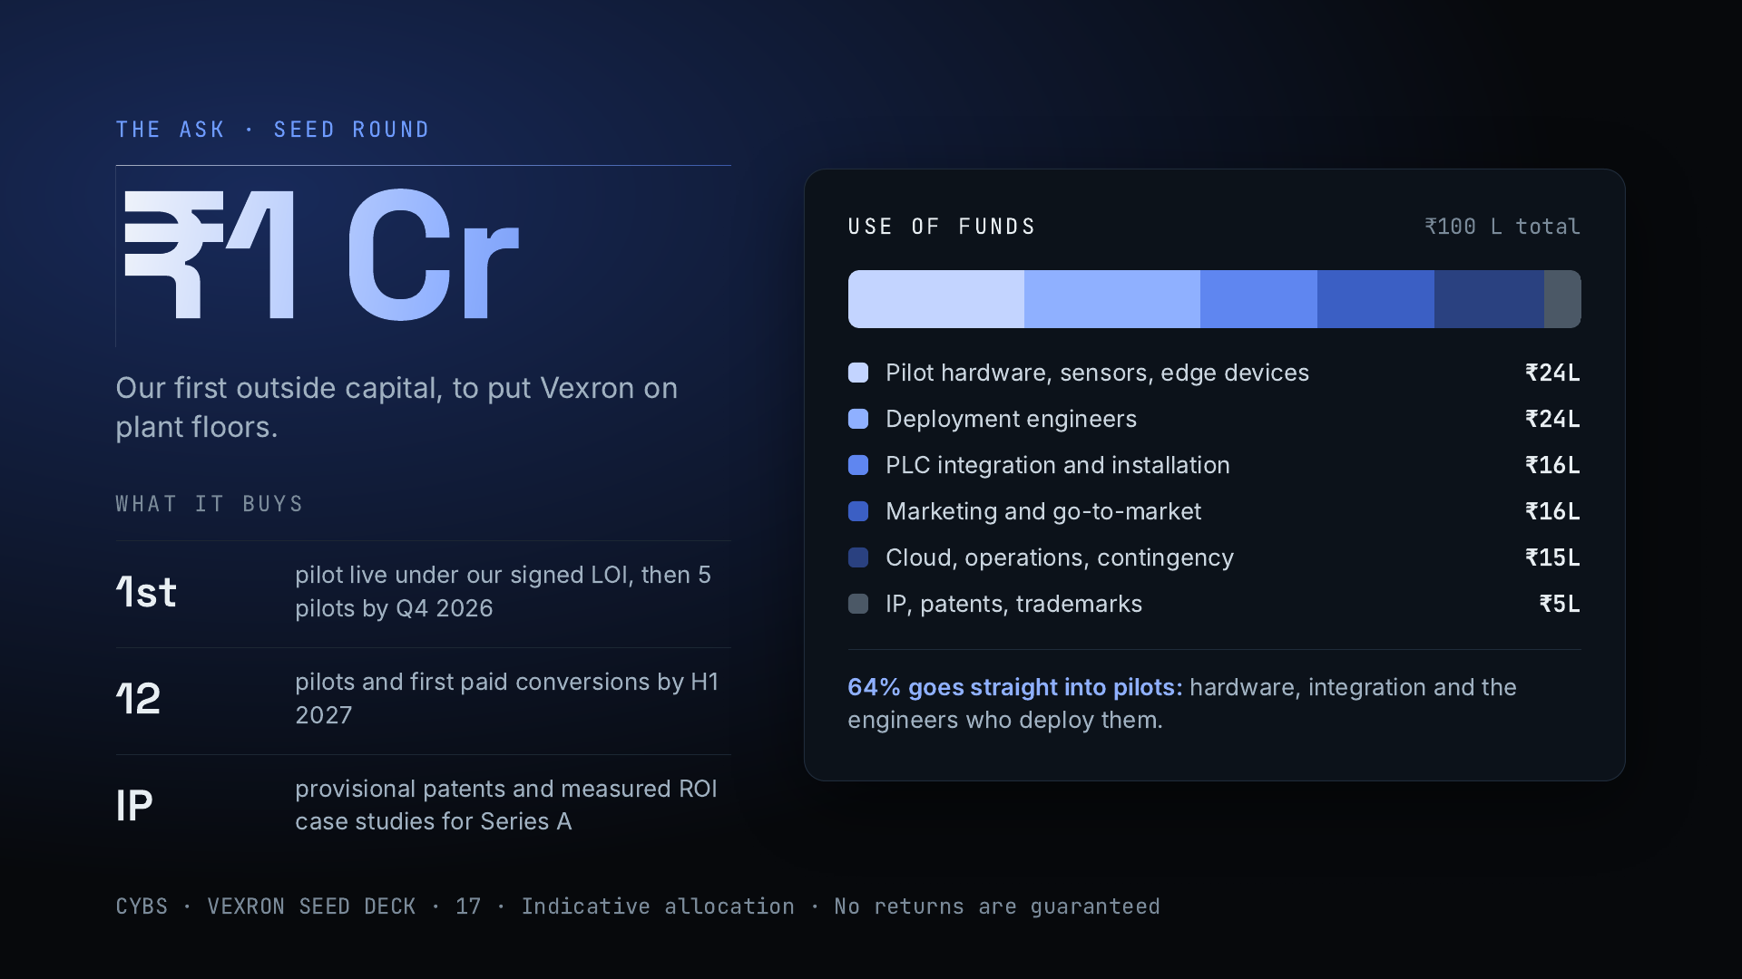
Notes:
We are raising ₹1 crore, our first outside money. About 64% goes straight into pilots: hardware, sensors and edge devices, PLC integration, and the engineers who deploy them. The rest covers go-to-market, cloud and operations with a contingency, and provisional patents. The round turns our signed letter of intent into a live pilot and produces the measured ROI case studies and first paid conversions that set up a Series A. Possible investor returns come from later-round equity appreciation, secondary sales in later rounds, or a strategic acquisition, with no guarantees.

Slide 18
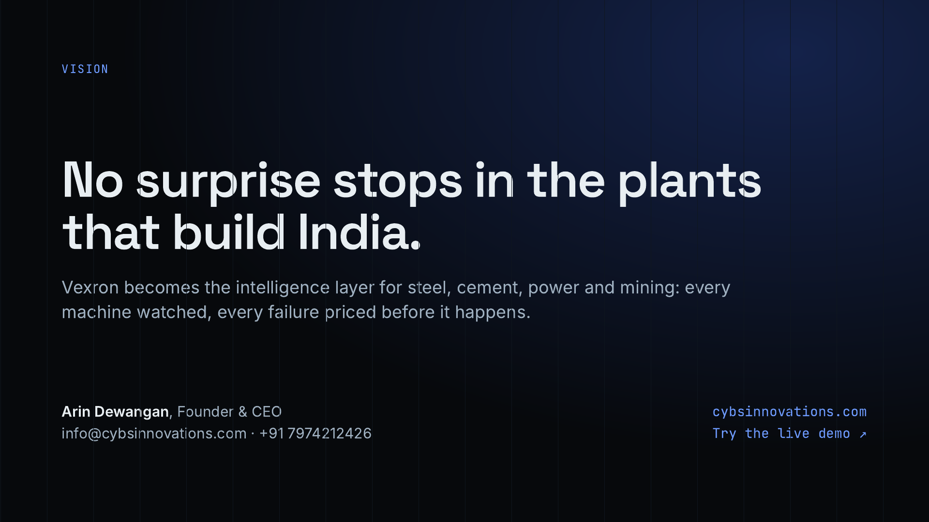
Notes:
Close on the vision: Vexron as the layer that tells every heavy-industry plant in India what is about to fail and what it will cost. Repeat the ask, ₹1 crore, and offer two next steps: a live demo walkthrough, or a visit to a plant in Chhattisgarh.

