Slide 1
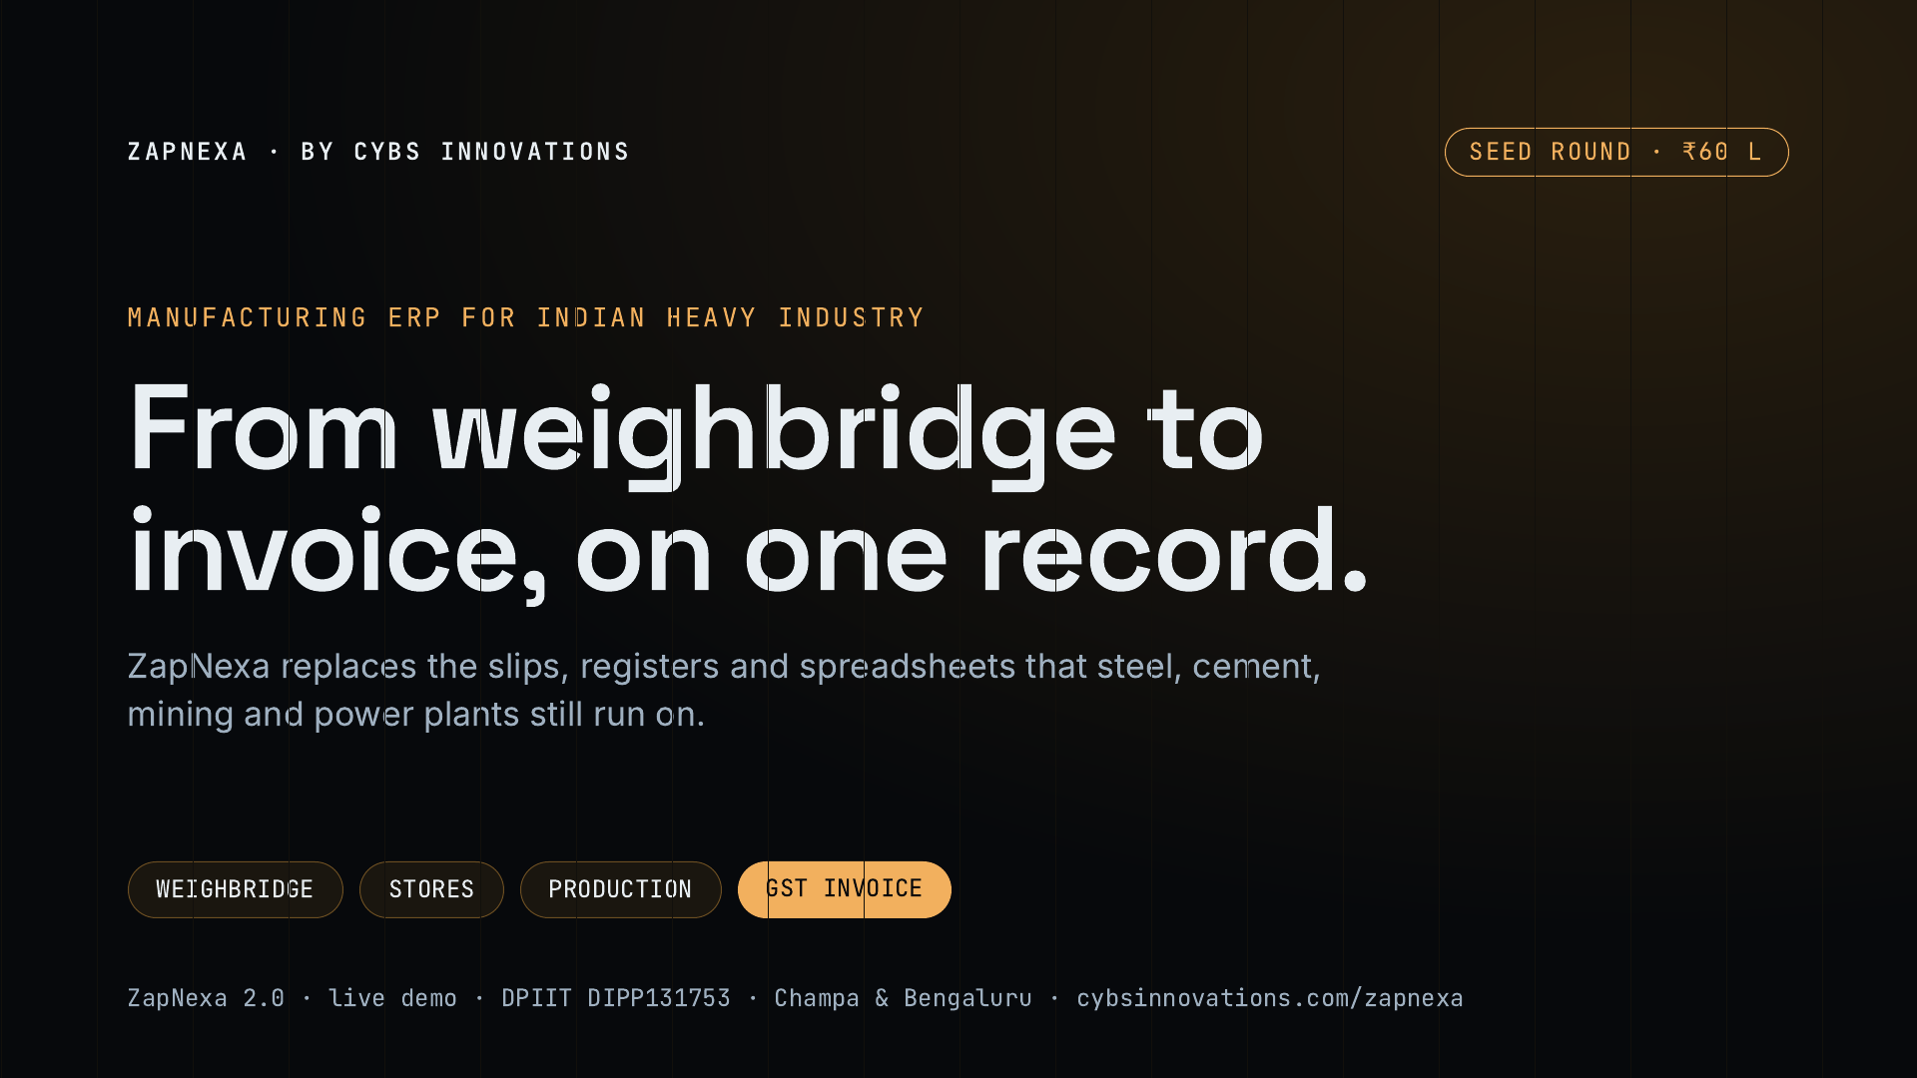
Notes:
ZapNexa is a manufacturing ERP built for Indian heavy industry by Cybs Innovations. The one-line pitch: one record from the weighbridge weight through stores and production to the GST invoice, so nothing is typed twice. We are raising ₹60 lakh to put ZapNexa into its first paying plants.

Slide 2
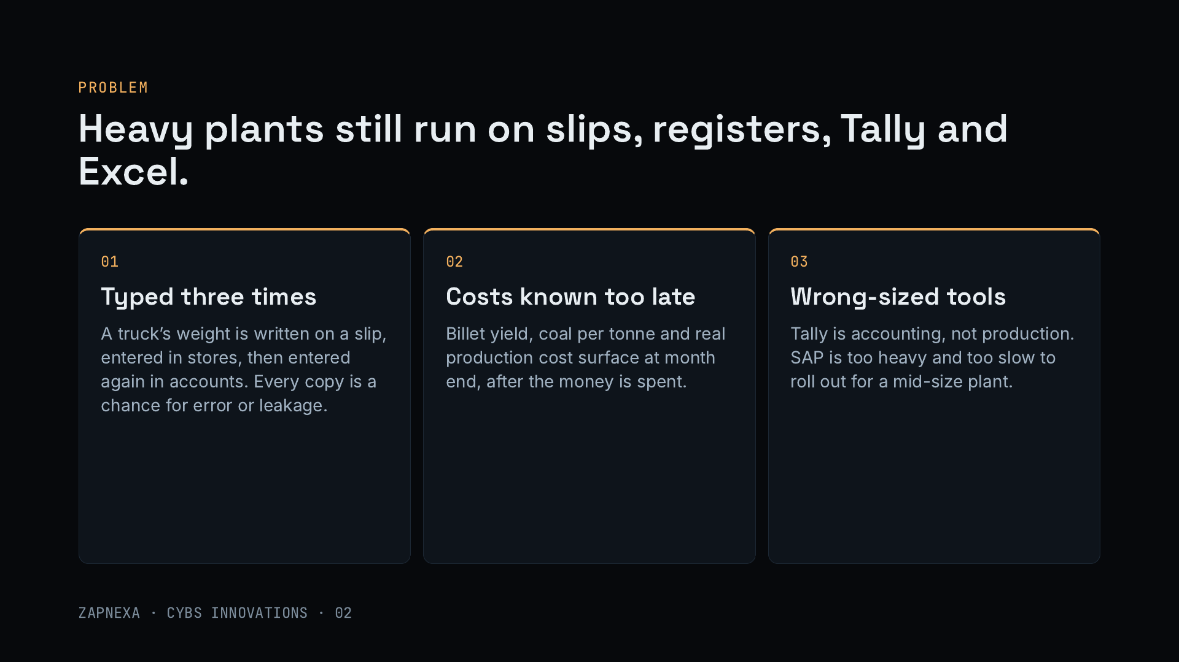
Notes:
Walk through a truck arriving at a sponge iron plant. The weight is written on a slip, entered into the stores register, and entered again into accounts. Every retyping is a chance for error or leakage. The numbers the owner cares about, like billet yield or coal used per tonne, are only known at month end. And the tools on offer are the wrong size: Tally is excellent accounting but is not a production tool, while SAP-class ERPs are heavy, expensive and slow to roll out for a mid-size plant.

Slide 3
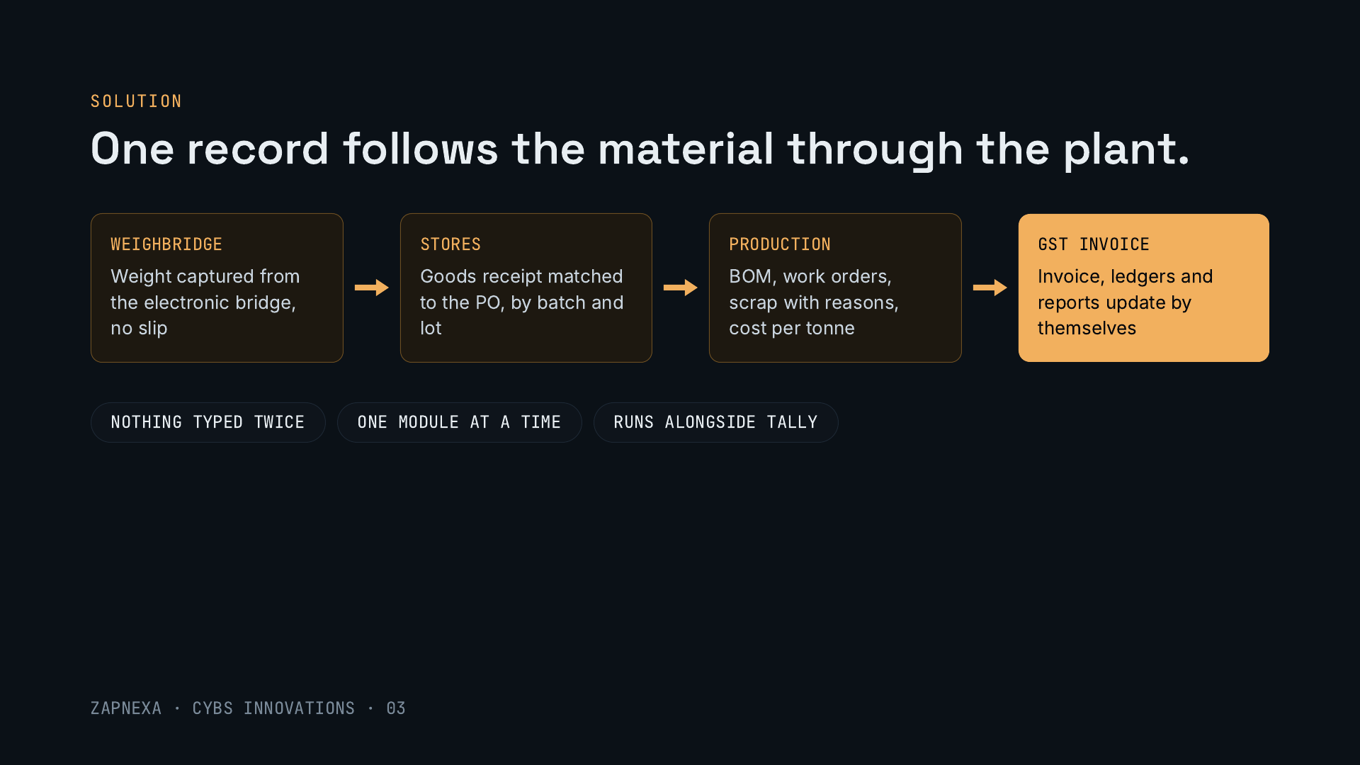
Notes:
ZapNexa captures the weight straight from the electronic weighbridge, matches the goods receipt to the purchase order by batch and lot, tracks production against the bill of materials with scrap and its reasons, and raises the GST invoice from the same record. Plants start with one module, prove it on real data at one factory, and extend. Finance can keep using Tally during the migration.

Slide 4
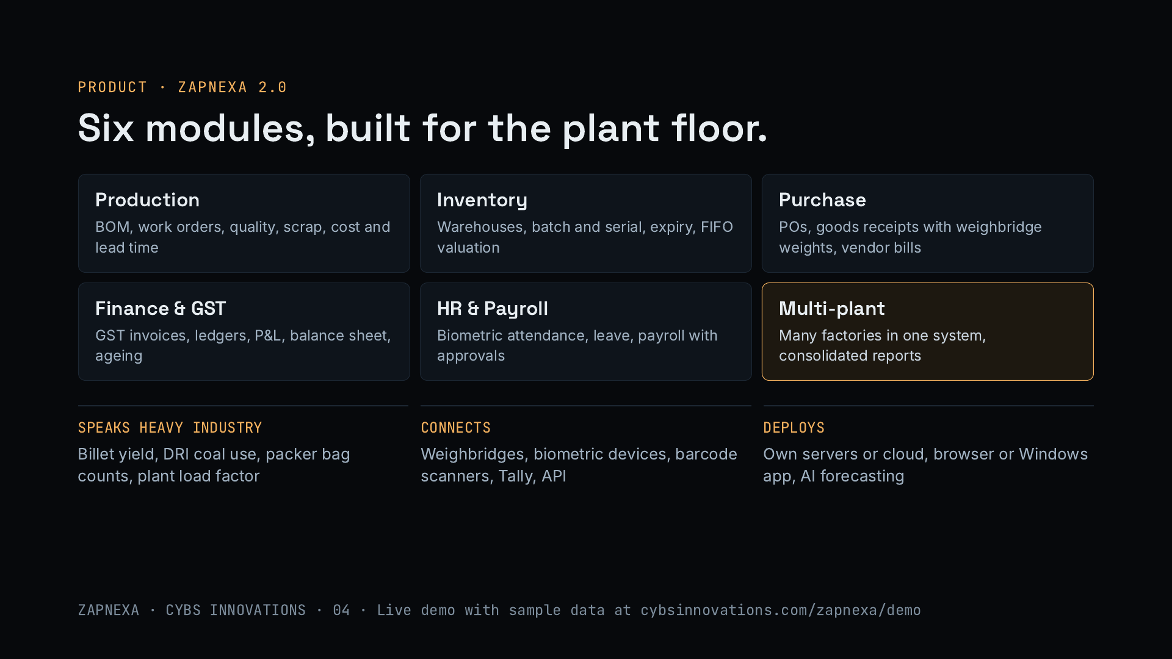
Notes:
Six core modules: production, inventory, purchase, finance and GST, HR and payroll, and multi-plant, plus CRM, transport and approval workflows. What sets it apart is that it speaks heavy industry: billet yield in steel, coal use in sponge iron, bag counts in cement, plant load factor in power. It connects to weighbridges, biometric devices, barcode scanners and Tally, runs on the customer’s own servers or cloud, and version 2.0 added AI demand forecasting. Security includes signed sessions, per-action permissions, encrypted secrets and audit logs.

Slide 5
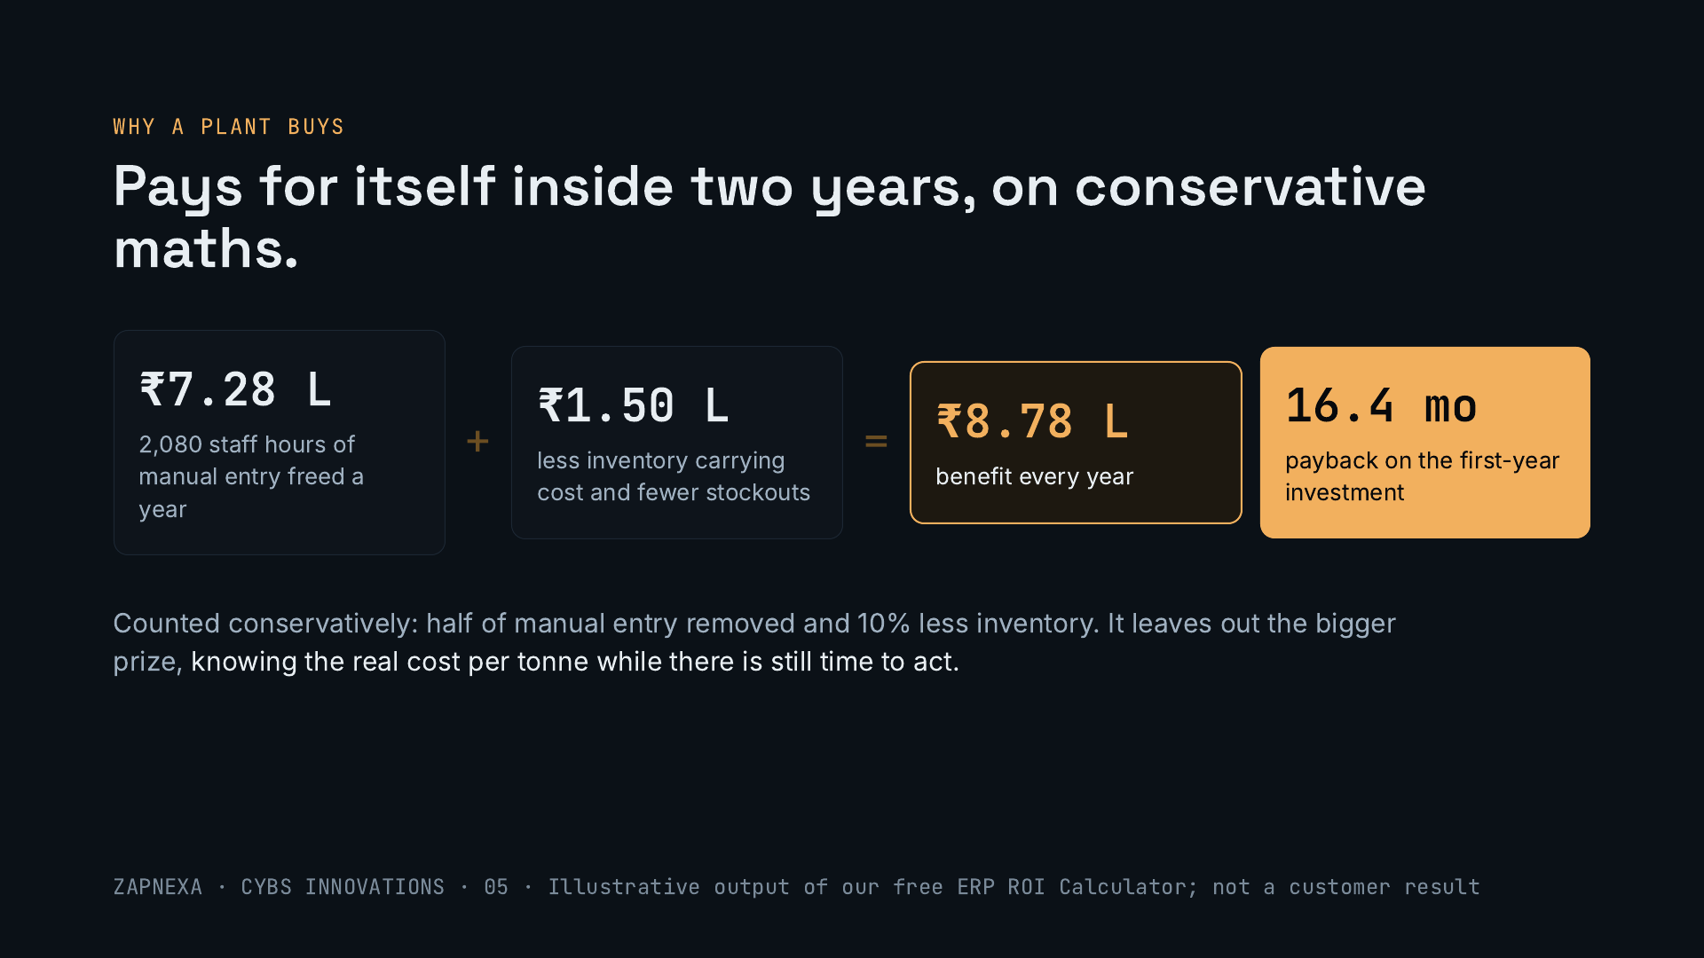
Notes:
This is the worked example from the free ERP ROI Calculator on our website, with illustrative inputs. Freeing half of the manual data entry recovers about 2,080 staff hours a year, worth ₹7.28 lakh. Ten percent less inventory saves about ₹1 lakh in carrying cost, and fewer stockouts recover about ₹50,000. That is ₹8.78 lakh a year, which pays back the first-year investment in about 16 months. It is deliberately conservative and is not a customer result; in sales we run it with each plant’s own numbers.

Slide 6
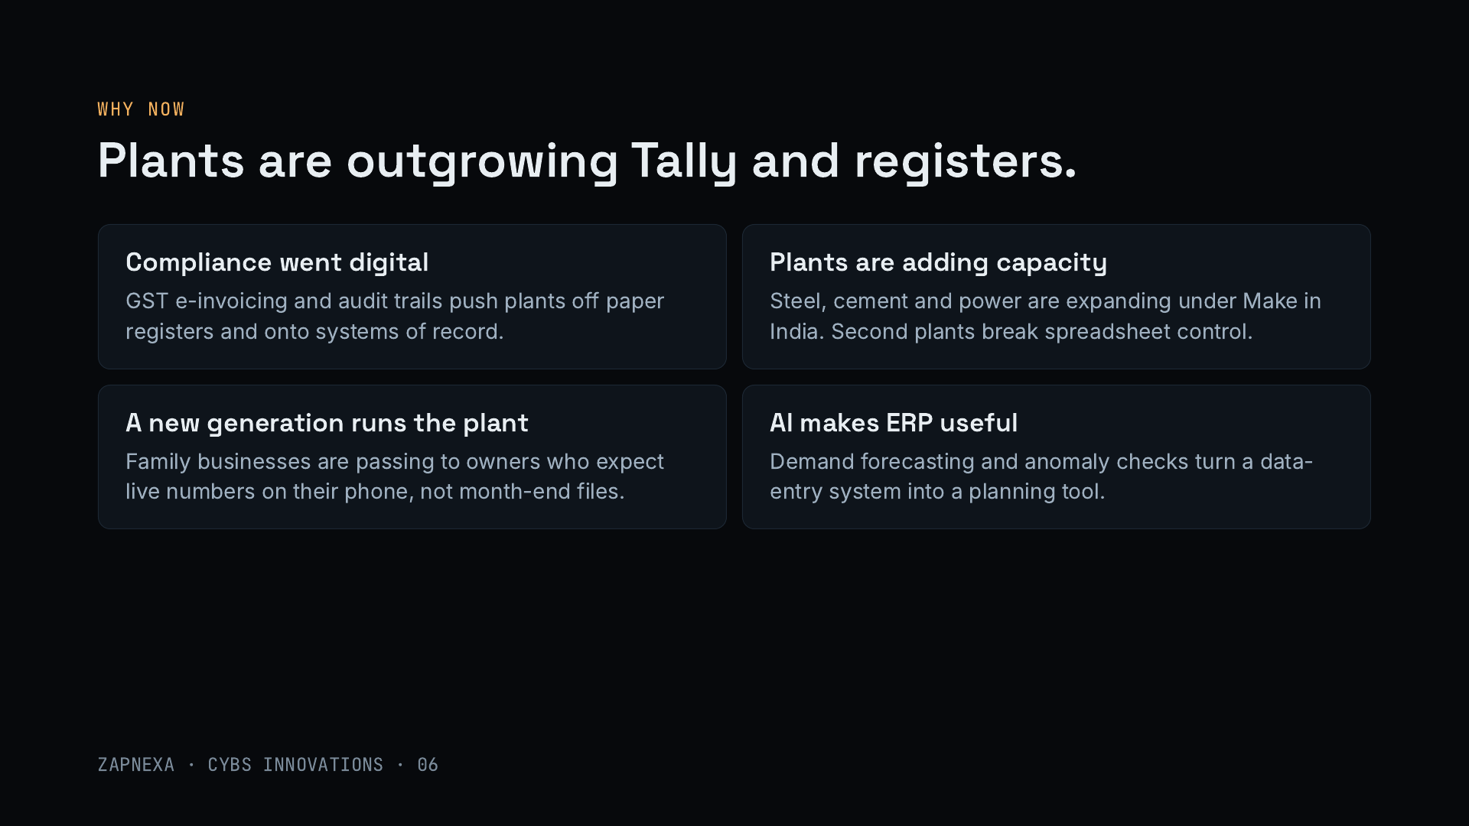
Notes:
Four shifts. Compliance has gone digital with GST e-invoicing and audit expectations. Heavy industry is adding capacity, and the moment a group runs a second plant, spreadsheets and registers stop working. Many family-run plants are passing to a younger generation that expects live numbers on their phone. And AI, like the demand forecasting in ZapNexa 2.0, turns an ERP from a data-entry chore into a planning tool.

Slide 7
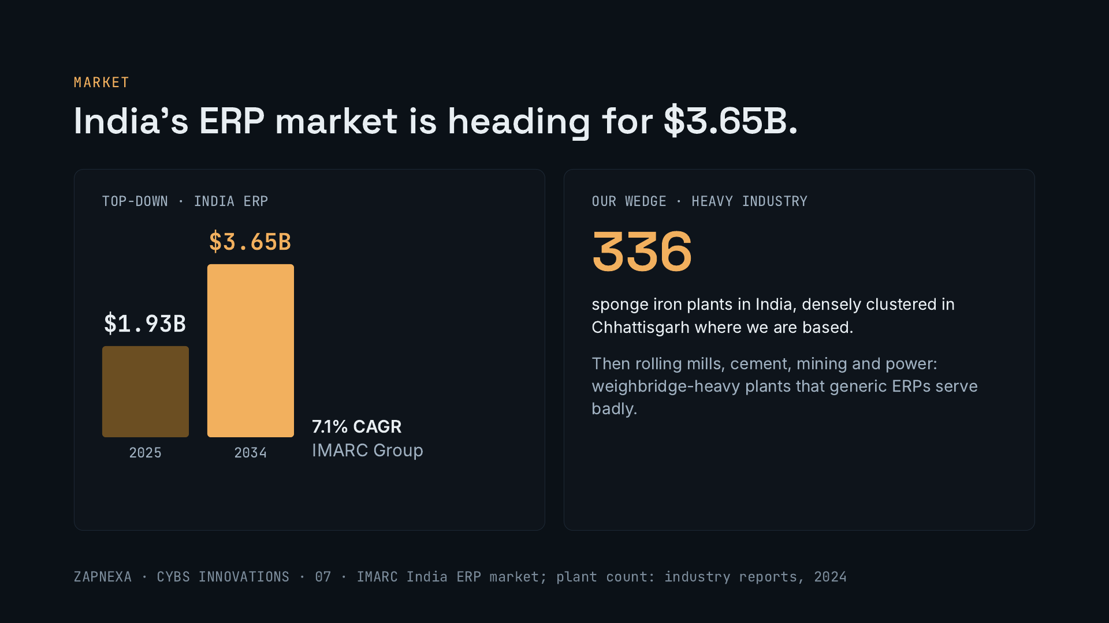
Notes:
Top-down, IMARC sizes India’s ERP market at about $1.93 billion in 2025, reaching about $3.65 billion by 2034, a 7.1% annual growth rate. It is a large, steady market; our angle is the part generic ERPs serve badly: weighbridge-heavy, process-heavy plants. Our first market is sponge iron, about 336 plants nationally, many near us in Chhattisgarh, then rolling mills, cement, mining and power. Third-party forecasts are not independently verified.

Slide 8
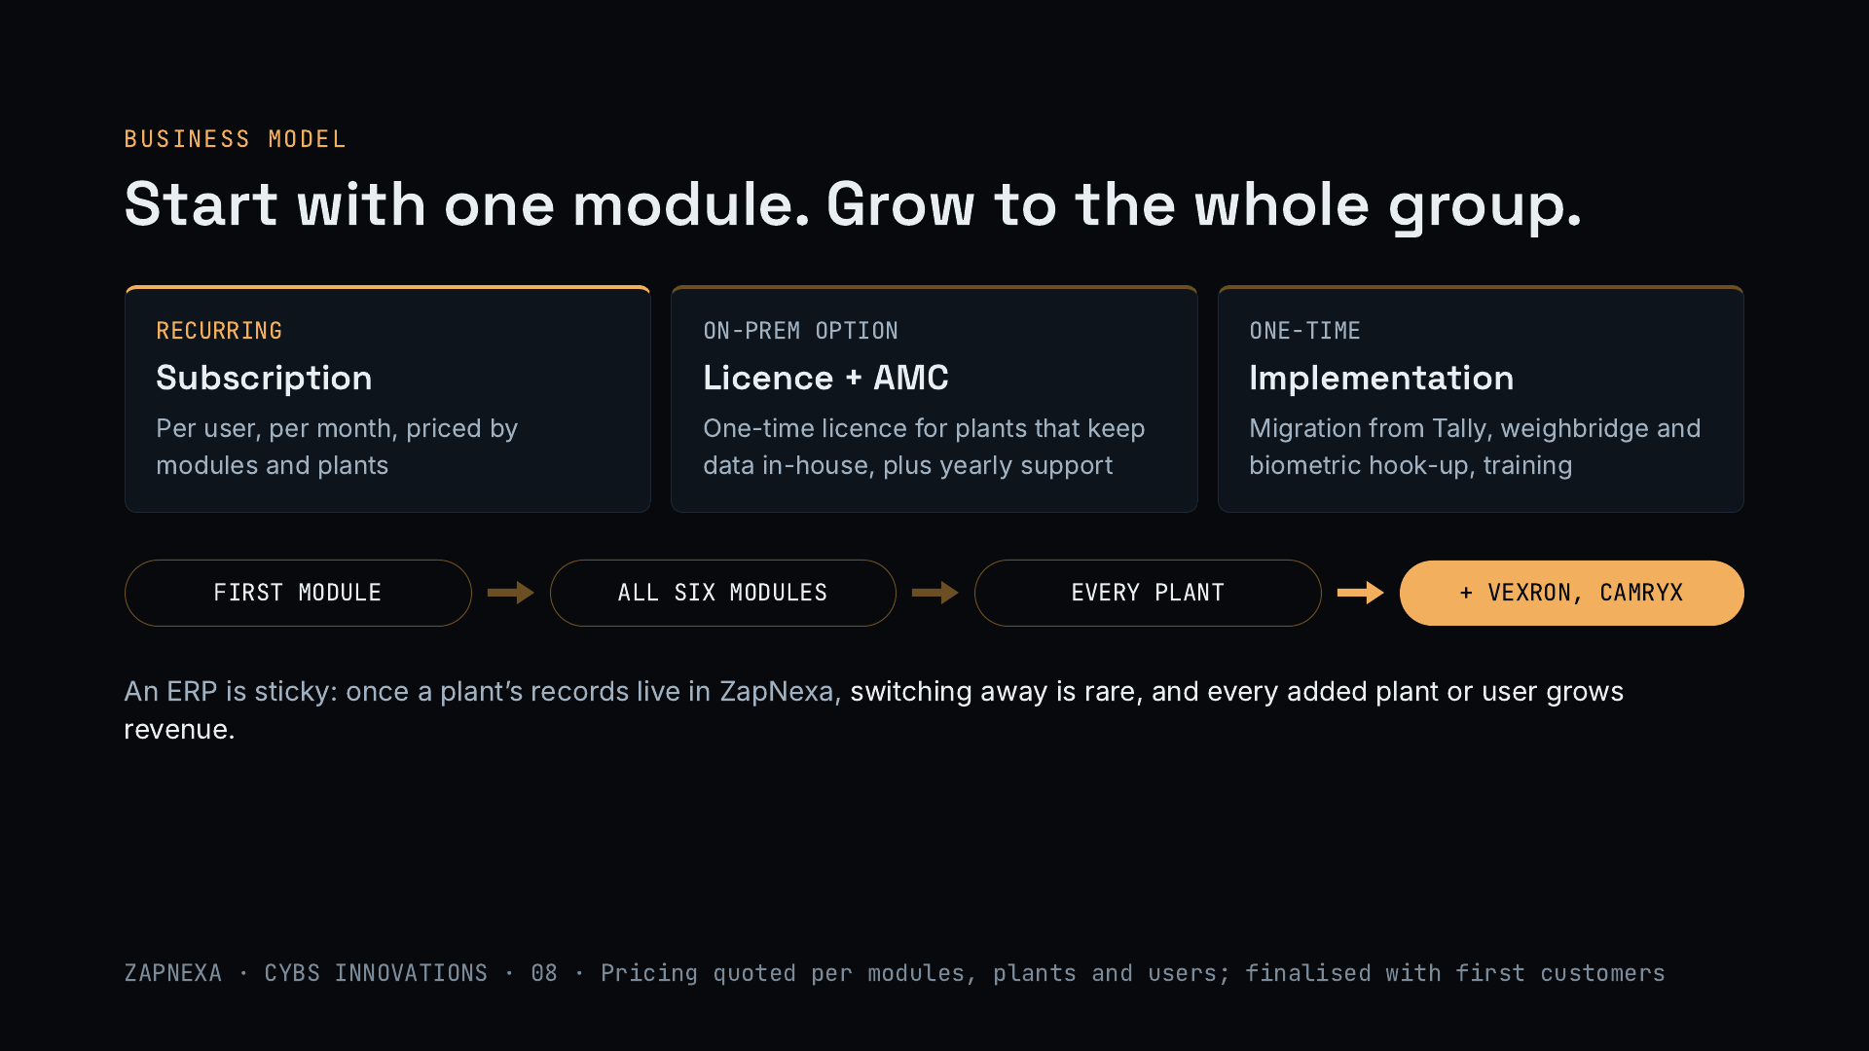
Notes:
Three revenue lines. A per-user monthly subscription priced by modules and plants; a one-time licence with yearly support for plants that keep data on their own servers; and one-time implementation covering Tally migration, weighbridge and biometric hook-up, and training. Plants start with one module, add the rest, roll out to every plant in the group, and then buy Vexron and Camryx from the same team. ERPs are sticky, so revenue compounds as plants and users are added.

Slide 9
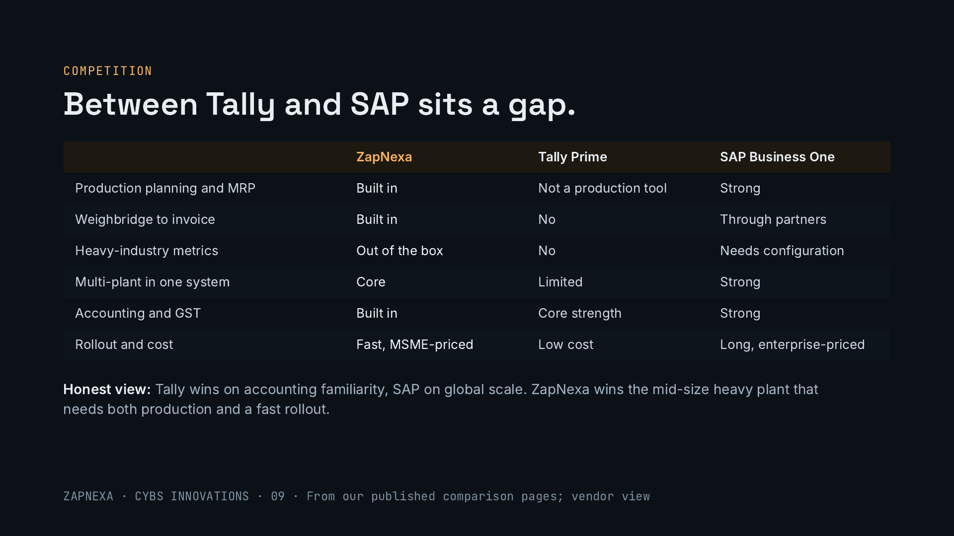
Notes:
Mid-size heavy plants are stuck between Tally, which is excellent accounting software but not a production tool, and SAP Business One, which is strong but needs partners and configuration, takes longer to roll out and costs more. ZapNexa sits in that gap: production, weighbridge and multi-plant built in, at a price and rollout speed a mid-size plant can manage. Be honest about where the others win, as our own comparison pages are: Tally on accounting familiarity, SAP on global scale and ecosystem. Zoho is also a common alternative; our comparison page covers it.

Slide 10
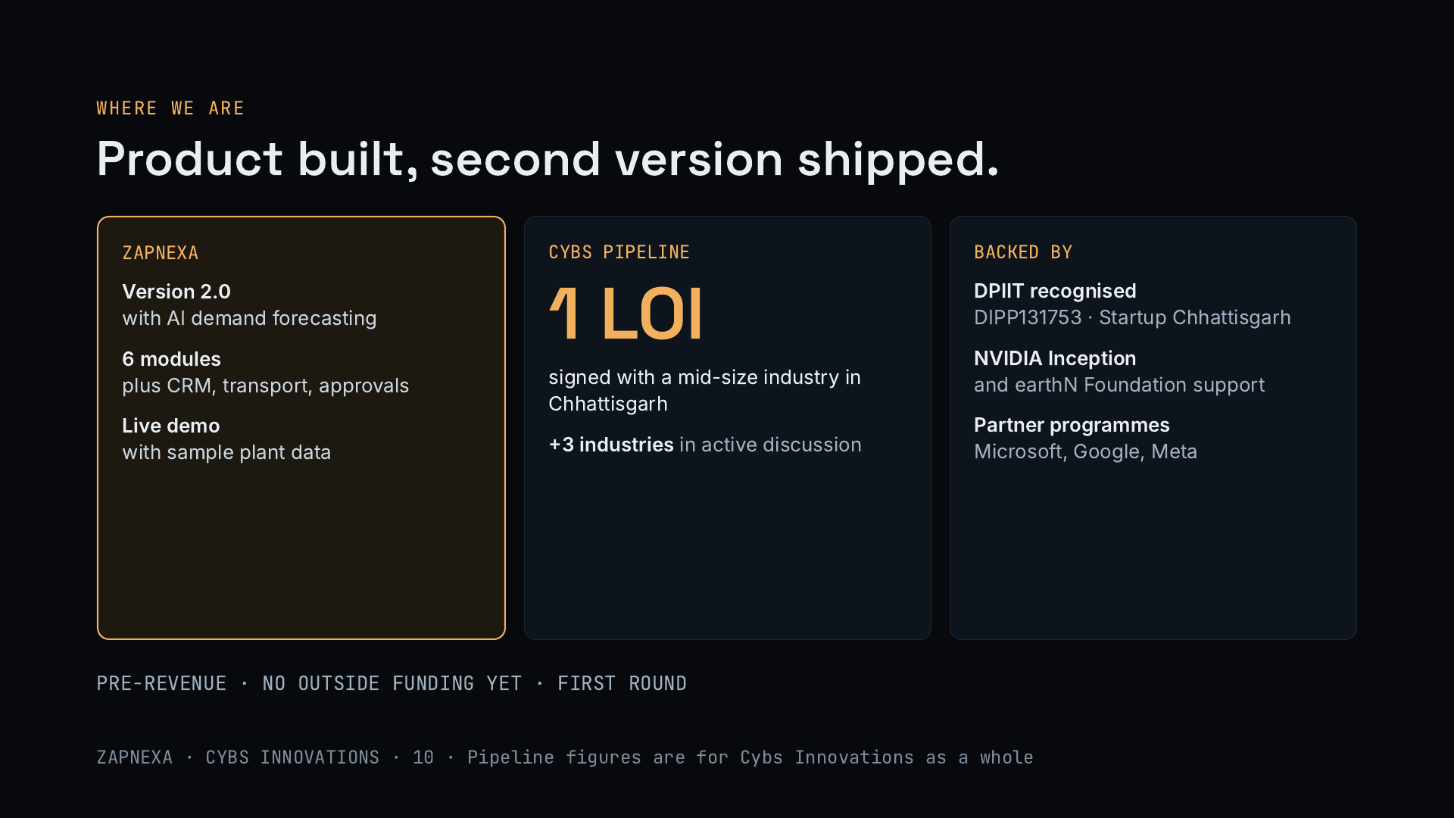
Notes:
Be direct about the stage. ZapNexa is built and on its second version, which added AI demand forecasting. It has six core modules plus CRM, transport and approvals, and a public live demo. Across Cybs Innovations we have one signed letter of intent from a mid-size industry in Chhattisgarh and three more industries in discussion; these are company-wide, not specific to ZapNexa. We are pre-revenue and this is our first outside round.

Slide 11
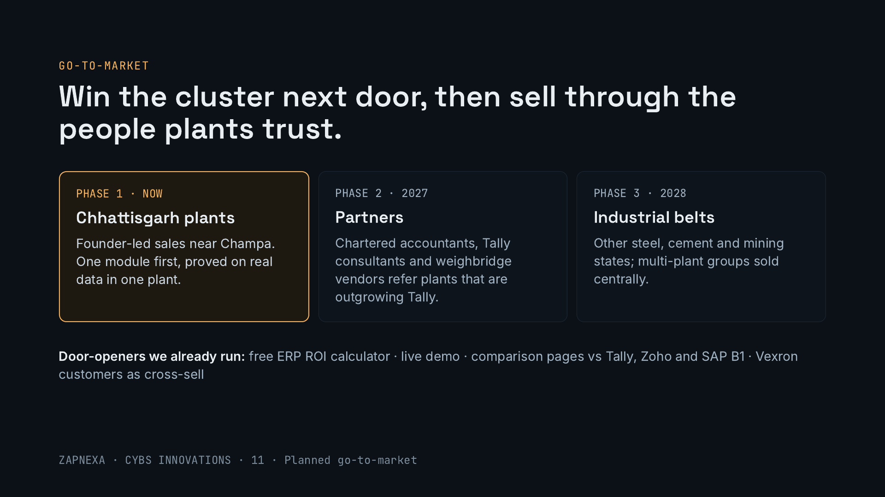
Notes:
Phase one is founder-led sales in the Chhattisgarh cluster: start each plant on one module and prove it on real data. Phase two adds partners who already advise plants: chartered accountants, Tally consultants handling migrations, and weighbridge vendors. Phase three expands to other industrial states and sells to multi-plant groups centrally. Our free ROI calculator, live demo and comparison pages already generate conversations, and every Vexron customer is a ZapNexa prospect.

Slide 12
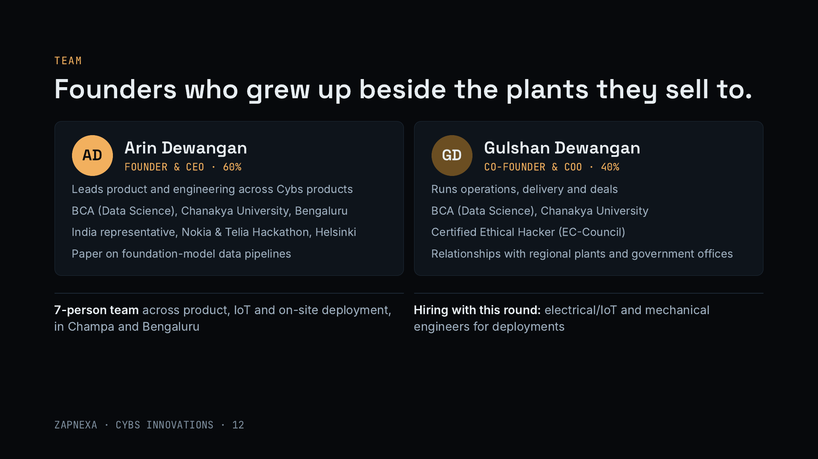
Notes:
Both founders grew up in Champa, in Chhattisgarh’s industrial belt. Arin leads product and engineering across Vexron, ZapNexa and Camryx: data science degree from Chanakya University, represented India at the Nokia and Telia hackathon in Helsinki, and has presented research on data pipelines for foundation models. Gulshan runs operations, delivery and deals, is a Certified Ethical Hacker, which matters when plants worry about connecting their systems, and holds the regional relationships with plants and government offices. A 7-person team covers product, IoT and deployment.

Slide 13
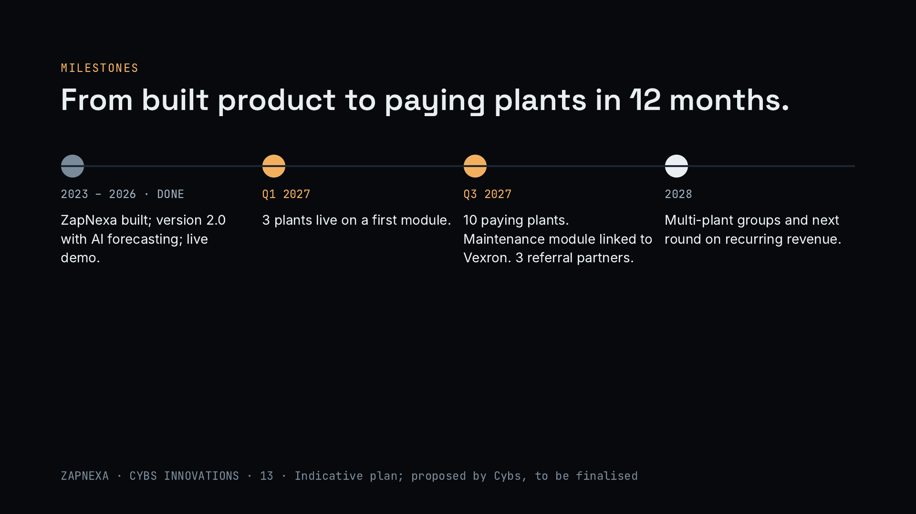
Notes:
What the money buys. Three plants live on a first module by the first quarter of 2027. Ten paying plants by the third quarter, along with a maintenance work-order module that links to Vexron, which ZapNexa does not have today, and three referral partners. Then multi-plant groups and the next round on recurring revenue in 2028. These are indicative targets.

Slide 14
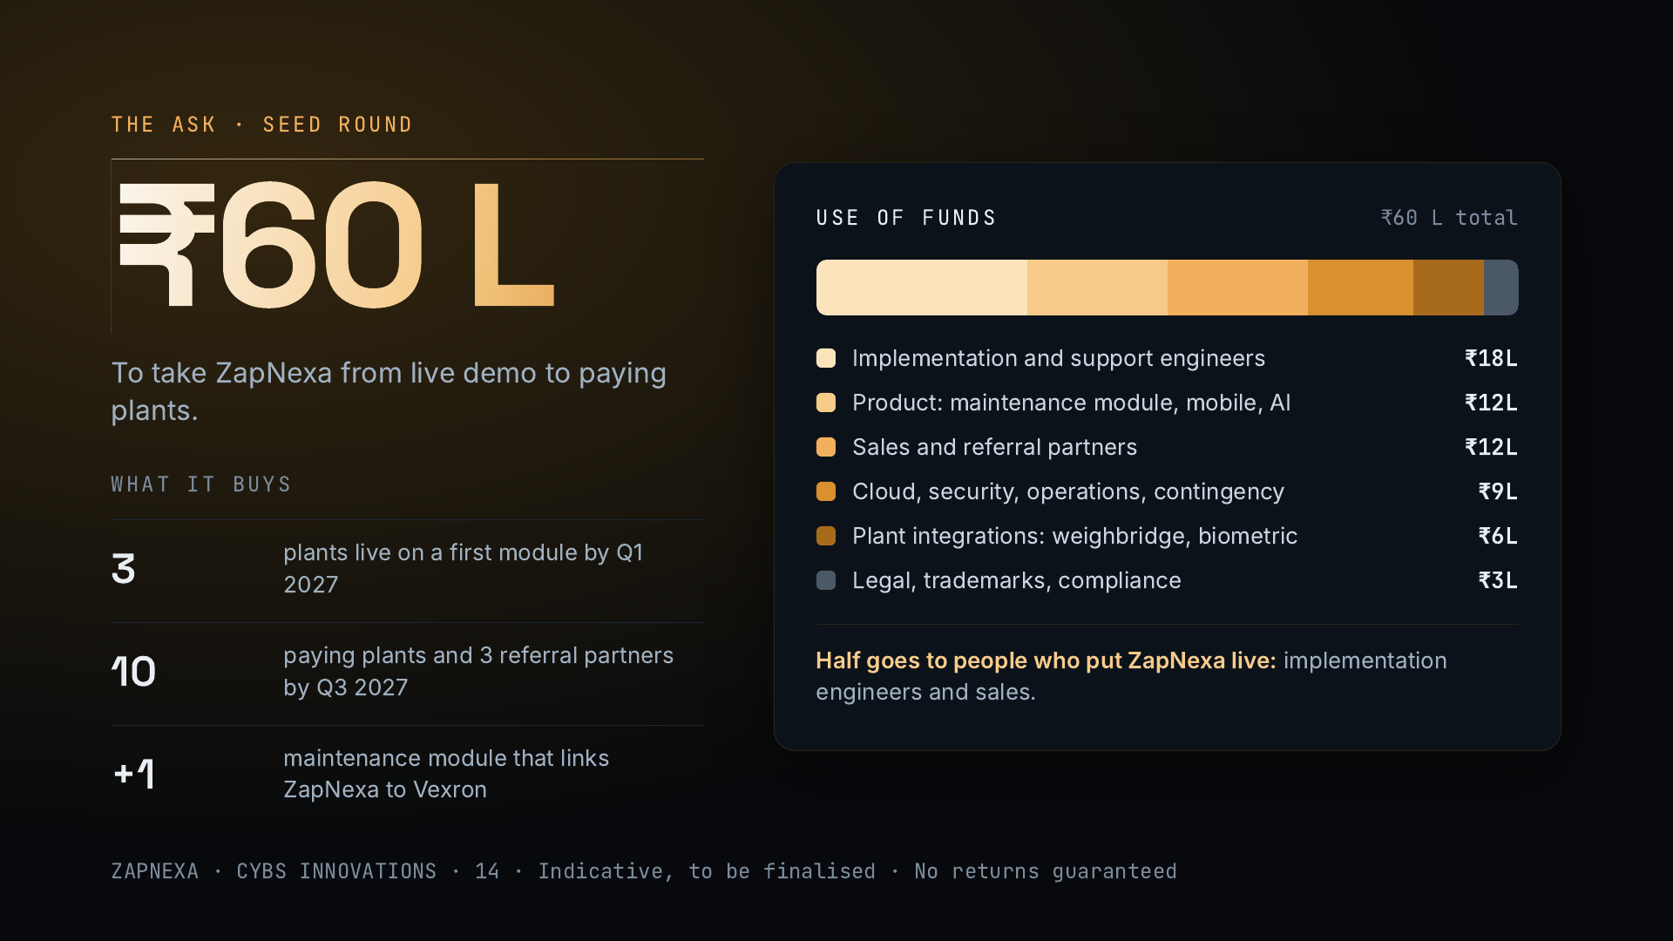
Notes:
We are raising ₹60 lakh for ZapNexa. An ERP is software-heavy, so the money goes mostly to people: implementation and support engineers who put plants live, and sales with referral partners. The rest builds the maintenance module that links to Vexron, plus mobile and AI features, covers cloud, security and operations, plant integrations such as weighbridges and biometric devices, and legal costs. It buys three plants live by early 2027 and ten paying plants by the third quarter. Possible investor returns come from later-round equity appreciation, secondary sales or acquisition, with no guarantees.

Slide 15
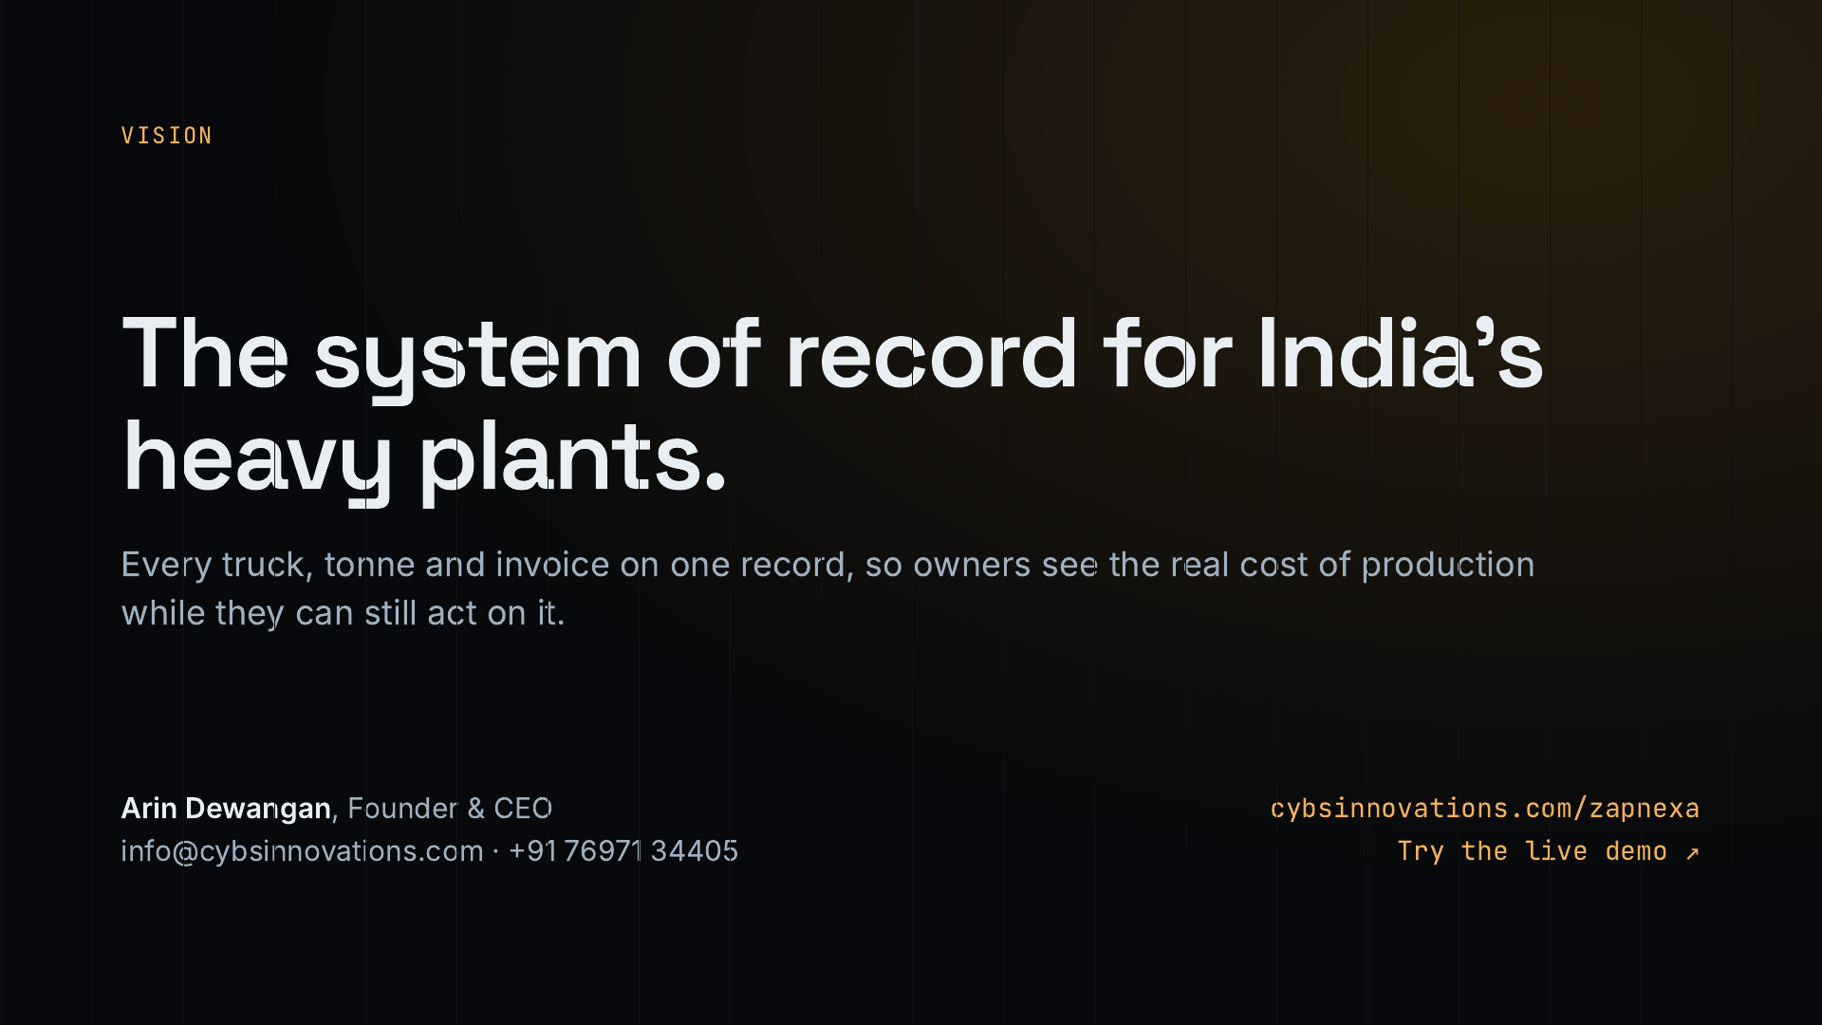
Notes:
Close on the vision: ZapNexa as the system of record for India’s heavy plants, where every truck, tonne and invoice lives on one record and owners know their real cost of production in time to act. Repeat the ask, ₹60 lakh, and offer a live demo or a visit to a plant in Chhattisgarh.

